Slide 1



Quantum Key Distribution in 6G Networks – Part I
First Summer School on Security and Privacy in 6G Networks
Madrid, Jun. 27th 2024
Javier Faba
javier.faba@upm.es
Laura Ortiz
laura.ortiz@upm.es

Slide 2
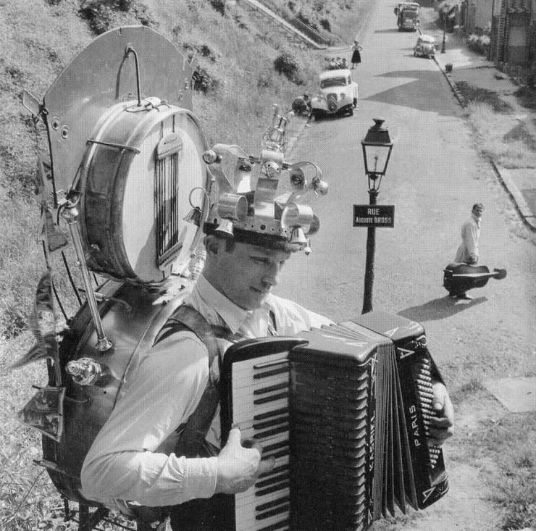
Objective:
To give an account of quantum communications –currently this means essentially Quantum Key Distribution (QKD)- from the basic technologies to the applications.
A little bit ambitious and broad…
.. but you still know a few things.
So we will skip some..

Slide 3
Quantum
Information
Communication
Cryptography
in theory

Slide 4
Quantum Communications
What is Quantum communications?
  Quantum Communications:
    The ability to transport information encoded in the states of quantum systems.
    The ability to profit from non-classical correlations among distant quantum systems.
      E.g. a qubit (the analogous of a bit in quantum information) enconded in the polarization states of light (any two-states quantum system could do), an entangled pair...
  It allows to do things that cannot be done using only classical resources:
    Quantum Cryptography
    Quantum state teleportation
    Quantum Sensing/metrology
    Communications between quantum computers
    …

Slide 5
The Qubit.
Define two quantum states as 0 y 1: |0> y |1>
  |0> means “the quantum state representing the value 0 of the qubit”... Whatever the physical implementation: photon polarization , spin states…
  Often regarded as the “computational basis”
  Technically: an element in a Hilbert space of dimensión 2.
A quantum state is a solution of the Schrödinger equation
The Schrödinger equation is linear, then a generic state of a single qubit is:
|φ> = α|0> + β|1>
No-cloning: an unknown quantum state cannot be copied.
α,β complex numbers
(Wooters, Zurek 1982. Why took more tan 50 years to realize this?)
Notes:
Escribir el teorema de no clonación en la pizarra

Slide 6

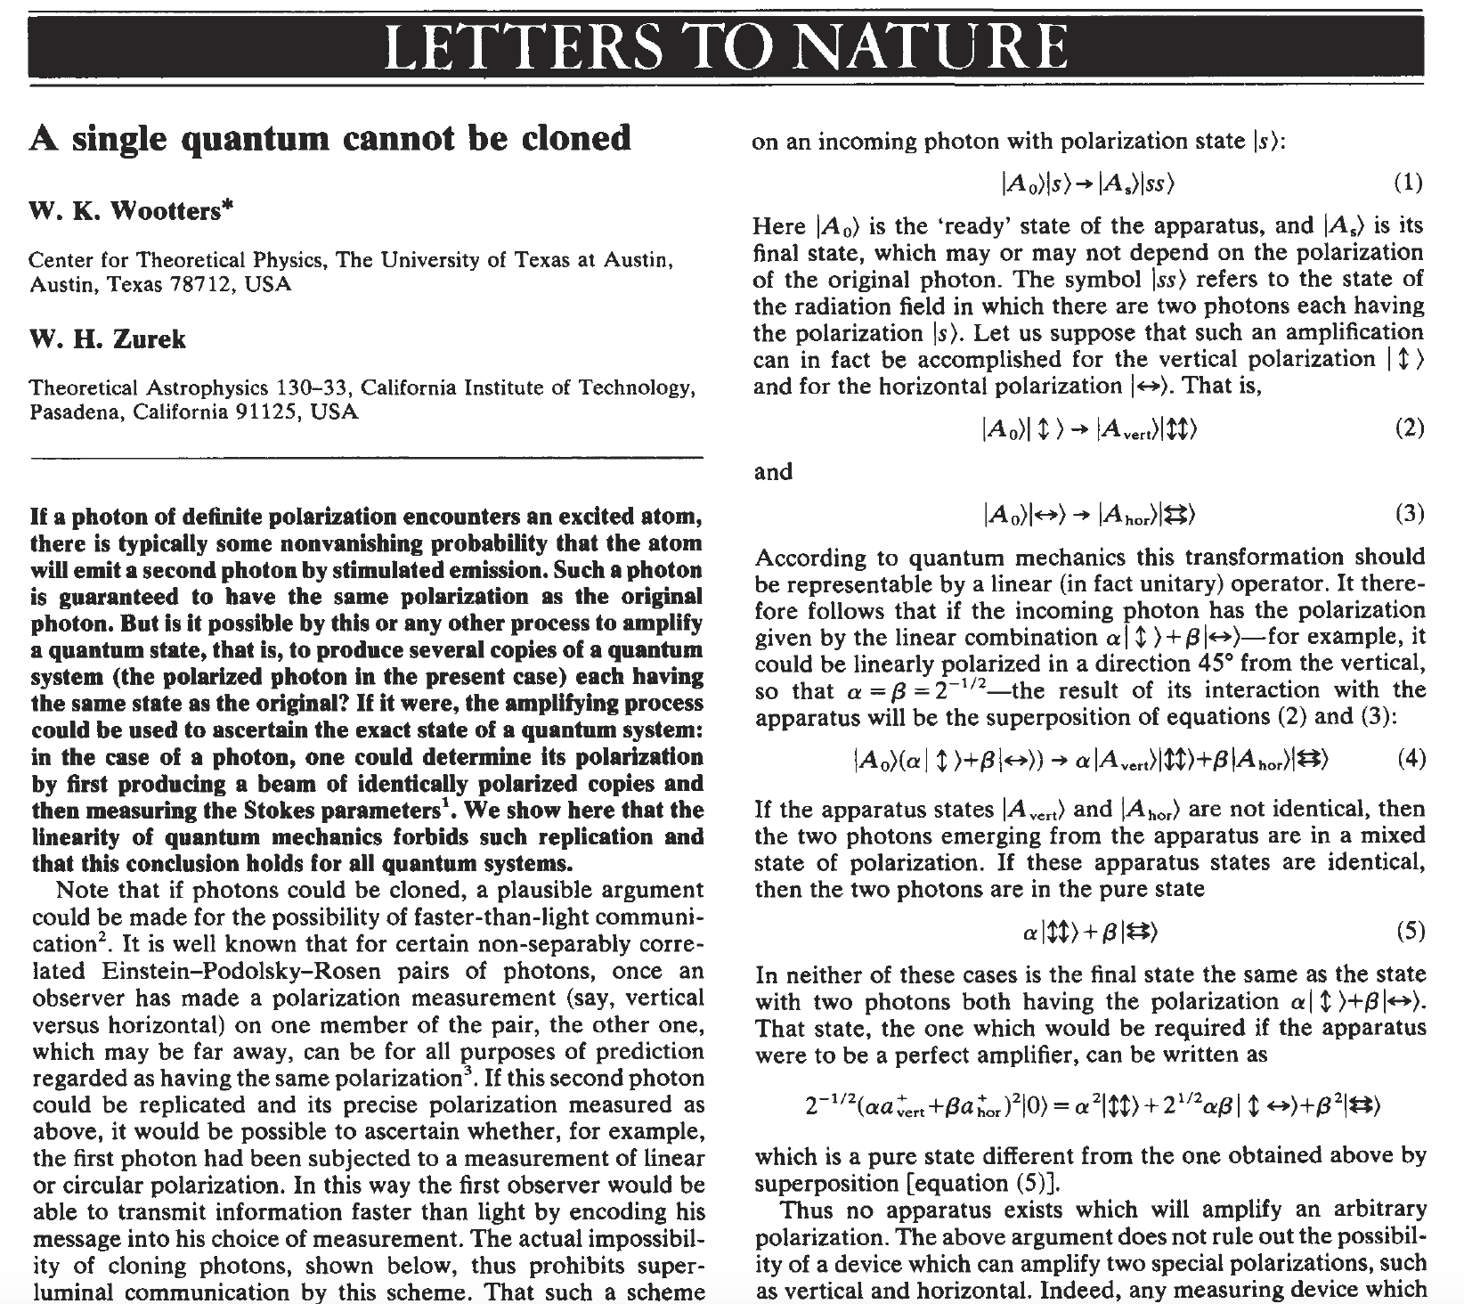
Notes:
This is the original paper of the no-cloning theorem.

Slide 7
Resources: The Qubit.
Reading the state of a qubit (measurement):
  (|α|²+|β|² = 1, measurement done in the {|0>,|1>} basis.
  Note: measurement modifies the state of the qubit.
  We do not have access to α or β
Measurement
|0>
Prob. |α|²
α|0> + β|1>
|1>
Prob. |β|²

Slide 8
Quantum information.
The state of two qubits?
A linear combination of all the basis states:
|00>, |01>,|10>,|11> ; 2² states
Notation. Important.
The position does matter
First qubit
Second qubit
The state can be written as |φ> = α₀₀|00> + α₀₁|01>+ α₁₀|10>+ α₁₁|11>
Note: 300 qubits: 2³⁰⁰ ~ 10⁹⁰ basis states. If we want to describe this state “classically” we have to store 2x10⁹⁰ complex numbers… the total number of atoms in the universe is estimated to be 10⁸⁰…there is no way to store this.

Slide 9
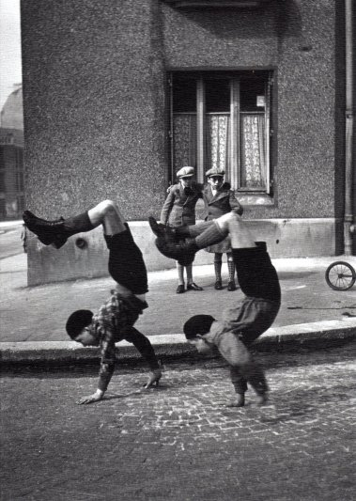
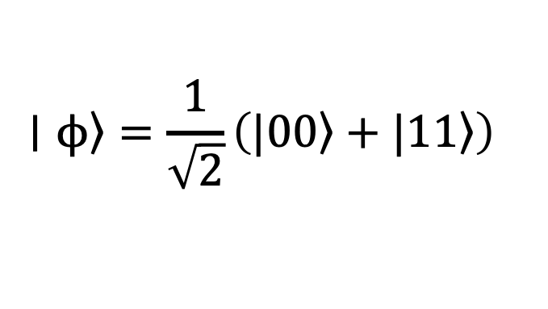
Quantum information.
Moreover, with two qubits, strange
things happen…
For example, the state:
  Is an entangled state: It is not separable as it cannot be described as the direct product of the states of two single qubit states.
  Non-local!. Non-classical correlations!! E.g.: If the first qubit is measured and 0 is obtained, then the second qubit is , with certainty, also a 0… even if it is in the other side of the Galaxy… -> Bell inequalities
$$∣ϕ〉=\frac{1}{\sqrt{2}}\left(|00〉+|11〉\right)$$
R. Doisneau

Slide 10
Quantum Information … good for?
… from the nice (and fundamental!) discussions between Einstein and Bohr… to alter significant parts of our technology:
Quantum computing.
  More powerful tan classical (Only rigorously demonstrated in 2018 “Forrelation” problem)
  Optimization, search, quantum chemistry, pharmacology…
  Cryptanalysis (Shor: RSA and ECC broken)
Quantum Communications.
  Quantum teleportation: unlimited distance Quantum communications (quantum repeaters).
  Quantum Cryptography: Information-theoretic security (this is, non-computational, or “absolute” security) – Quantum Key Distribution. Also other primitives.
Precision measurements
  The International System is based now on quantum.
...

Slide 11
Quantum Communications
Ingredients
Quantum channel.
Single Quantum detectors.
Single Quantum Emitters (incl. entangled pairs)
Quantum State preparation and analysis.
Quantum conversion (flying qubits to stationary qubits: matter-photon interface)
Moderate quantum processing capabilities.
Quantum memories.
1)-4) = QKD as we know it.
+5)-7) = Full quantum communications
                Including unlimited distance QKD
Will analyze them later
Note: There are some relatively recent schemes without quantum memories, all photonic, hence no need for flying->stationary conversion

Slide 12
Quantum Communications
Basic protocols
Teleportation
Quantum Key Distribution (BB84)
In the second part, we (you) will implement teleportation and BB84 using NetSquid

Slide 13
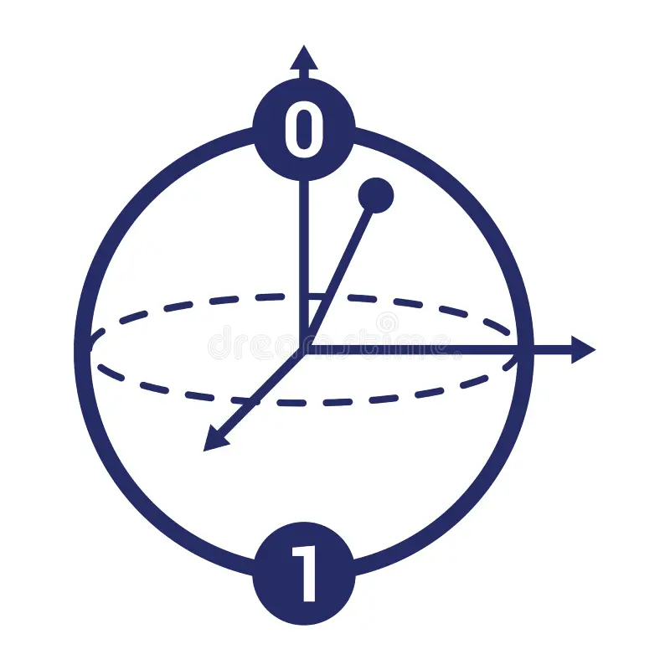
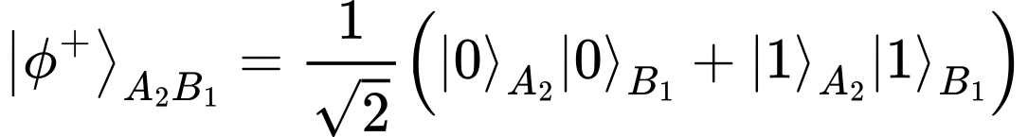

Quantum Teleportation: overview
Alice
Bob
Entangled pair
A₁
A₂
B₁
Qubit for teleporting

Slide 14

Quantum Teleportation: overview
Alice performs a projective measurement in the Bell basis
Alice
Bob
A₁
A₂
B₁

Slide 15
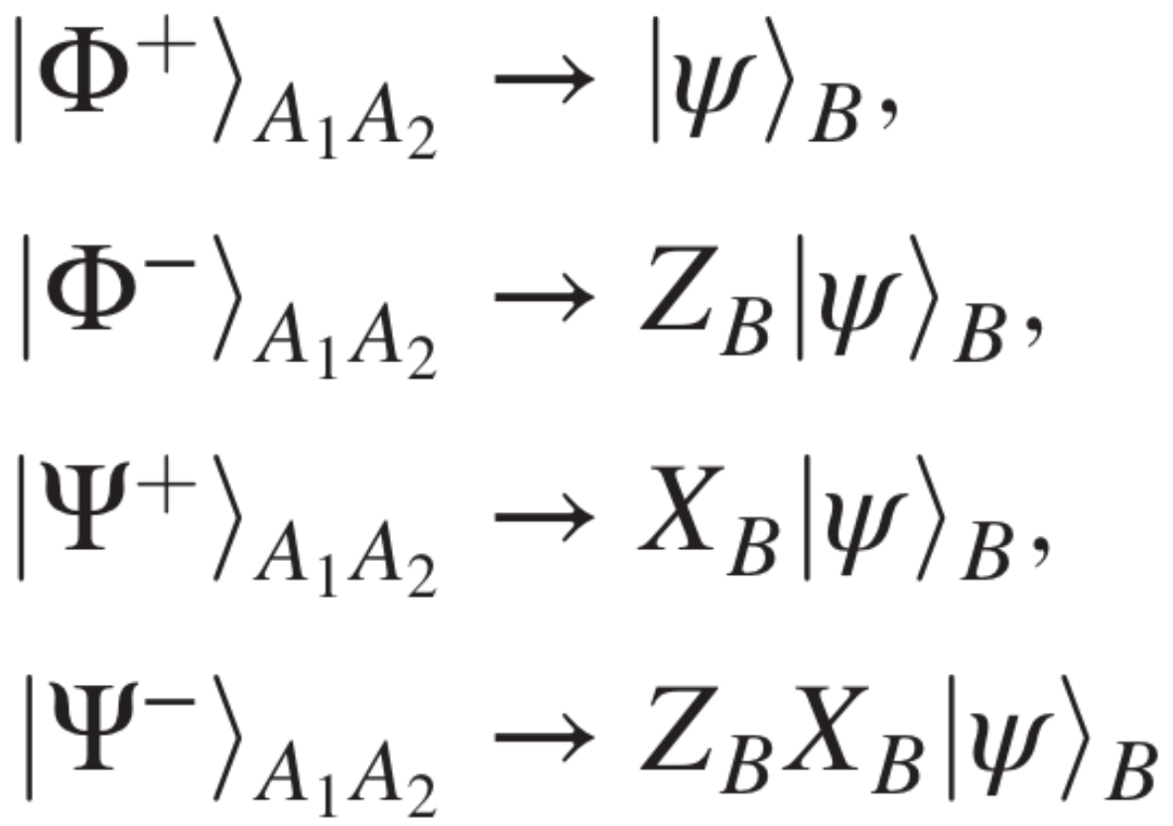
Quantum Teleportation: overview
The system {A₁, A₂} is in some Bell state (it is entangled)
Alice
Bob
Bob’s qubit is in one of those four states, depending on the result of the measurement of Alice
A₁
A₂
B₁

Slide 16
Quantum Teleportation: overview
The system {A₁, A₂} is in some Bell state (it is entangled)
Alice classically communicates the measurement result to Bob, so he can apply the corresponding gate to the state and to obtain the teleported state!
Alice
Bob
Bob’s qubit is in one of those four states, depending on the result of the measurement of Alice
A₁
A₂
B₁

Slide 17
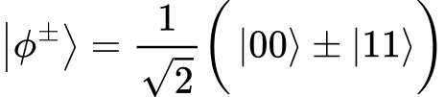
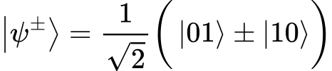
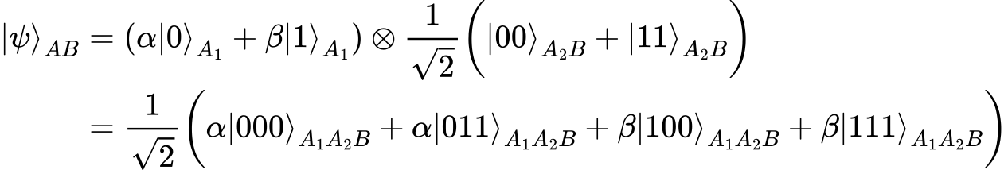


Quantum Teleportation: details
The Bell states are:
The total state before teleportation is:
We perform a Bell measurement on A₁ and A₂, this is, we project the total state using the Bell projectors:

Slide 18
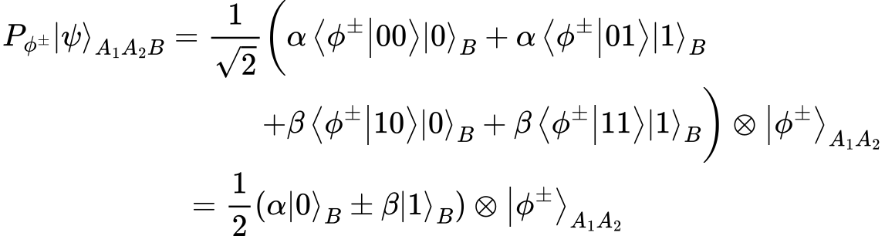
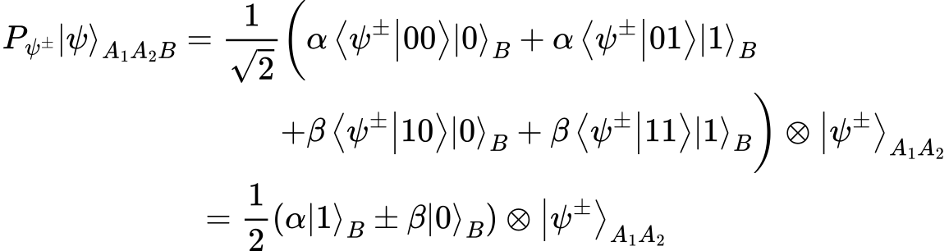
Quantum Teleportation: details
Depending on the output of the measurement, we obtain one of those four projected total states:

Slide 19
Quantum Teleportation: details
Depending on the output of the measurement, we obtain one of those four projected total states:
The information has been teleported from Alice to Bob! But not exactly the same state… it depends on the measurement result of Alice.
Alice has a Bell state, and Bob has the initial qubit!

Slide 20







Quantum Teleportation: details
If Alice measured
Bob has to do nothing
If Alice measured
Bob has to apply
If Alice measured
Bob has to apply
If Alice measured
Bob has to apply

Slide 21
Quantum Teleportation: details
  The emitter sends two bits (classical) to the receiver to tell which one.
  The receiver applies the quantum gates I (if 00), X (if 10), Y (if 01) or Z (if 11) to its qubit to recover the teleported state α|0>+β|1>
  Important:
    α and β have never been measured. There is no knowledge gain on the state. It is unknown.
    The original qubit have disappeared from the emitter (all qubits have been measured there) and the original state has been transferred into the element of the EPR pair that owned the receiver, which now holds the state α|0>+β|1>

Slide 22
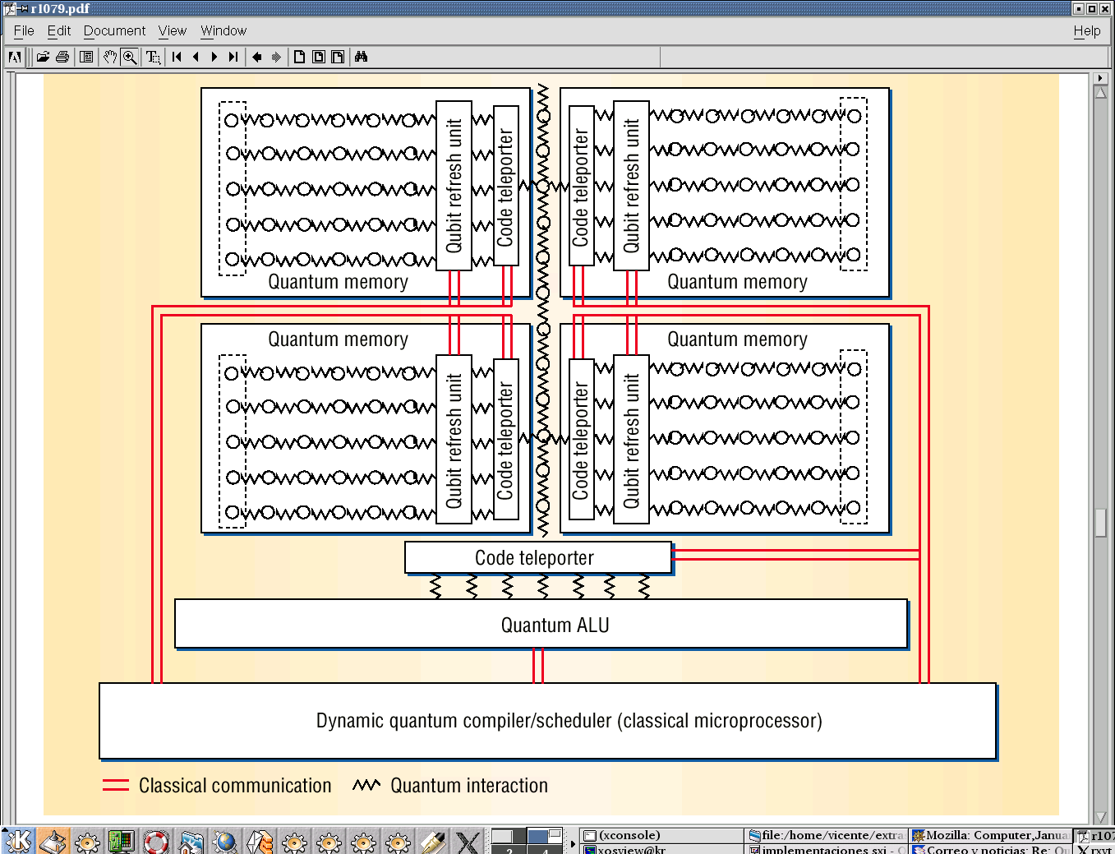
What is good for?
Teleportation as an element in the design of a General Purpose Quantum Computer Architecture: Transporting states from memory to the ALU.
Oskin, ' A Practical Architecture for Reliable
Quantum Computers’.
IEEE Computer 35, Vol. 1,79(2002)

Slide 23
The problem now is to have entangled pairs for two arbitrary nodes…
¡Entanglement swapping!
Note: if we can distribute entanglement among arbitrary nodes within the quantum network, we can teleport information (and more) without restrictions! This is the fundamental challenge for Quantum Internet network.

Slide 24
Entanglement swapping: overview
C
A
Entangled pair
Entangled pair
B

Slide 25
Entanglement swapping: overview
C
A
Entangled pair
Entangled pair
B
If C performs a projective measurement in the Bell basis…

Slide 26
Entanglement swapping: overview
C
Entangled pair
A
B
Entangled pair

Slide 27
Entanglement swapping: overview
C
Entangled pair
Entanglement swapping from AC,CB to CC, AB!
A
B
Entangled pair

Slide 28
Entanglement swapping: overview

Slide 29
Entanglement swapping: overview

Slide 30
Entanglement swapping: overview

Slide 31
Entanglement swapping: overview
Through entanglement swapping, we have created entanglement between two non-directly connected nodes!

Slide 32
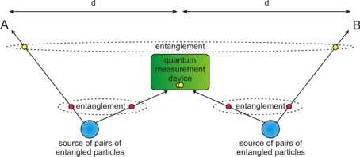
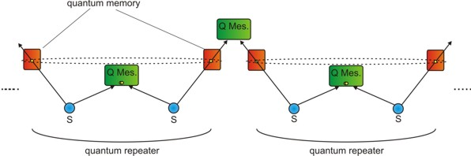
Long distance Quantum Communications: Quantum Repeaters
EP2
EP1
A sketch of an implementation of entanglement swapping (quantum repeater)
Teleportation
EP1

Slide 33
Teleportation: some experiments with photons and atoms.
  1993, Protocol proposal: Bennet, C.H. Et al. “Teleporting an unknown quantum state via dual classic and Einstein-Podolsky-Rosen channels” Phys. Rev. Lett. 70, 1895 (1993)
  1997, First realization. Photons, probabilistic. Bouwmeester, D. et al. “Experimental Quantum Teleportation” Nature 390, 575 (1997)
      Boschi et al. Phys. Rev. Lett. 80, 1121 (1998). Base de Bell completa: Kim et al, Phys. Rev. Lett. 86, 1370 (2001)
  2003, Photons, 2km standard optical fibre, probabilistic: Marcikic, I. et al. “Long-distance teleportation of qubits at telecommunication wavelengths” Nature 421, 509 (2003)
  2004, atoms, deterministic, techniques for a scalable QC.
      Riebe,M. “Deterministic Quantum teleportation with atoms” Nature 429, 734 (2004)
      Barrett, M.D. “Deterministic Quantum teleportation with atomic qubits” Nature 429, 737 (2004)
  2007-2009 Zeilinger et al. 144 Km Tenerife- La Palma. Towards satellite QKD.
Nobel Prize!

Slide 34
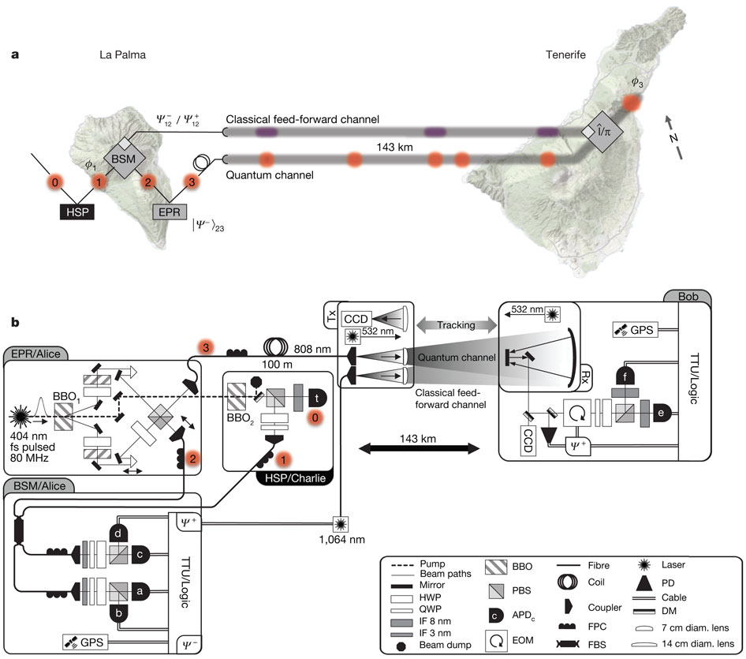
Teleportation over 144 Km
Full Teleportation:
Requires simultaneous
Manipulation of 3
Particles (the qubit to
be Teleported and the
Entangled pair)
Together with the
Classical signalling
Required in the last
Step of the teleportation.
The experiment
Demonstrates the same
Kind of manipulation
Required for a real
Quantum network.
Quantum teleportation over 143 kilometres using active feed-forward, X. Ma et al.
Nature 489, 269–273 (13 September 2012)

Slide 35
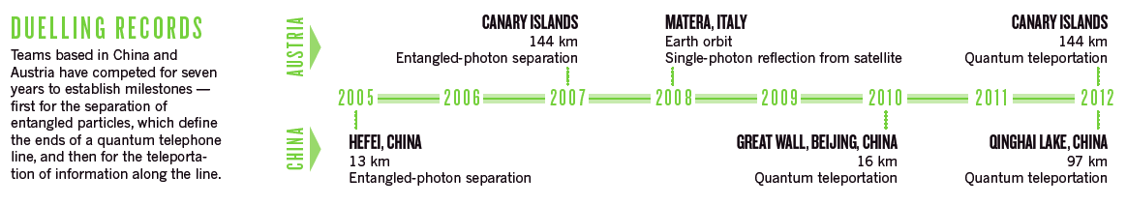
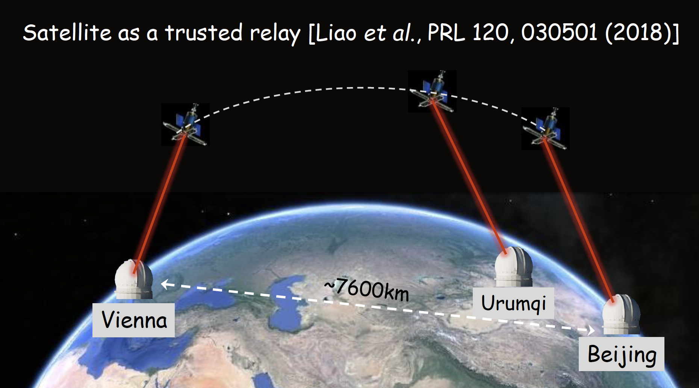
The Micius Satellite

Slide 36
Quantum Cryptography
Quantum Cryptography.
  In principle: any means to do cryptography based on the processing and transmission of quantum signals.
  Usually equated to Quantum Key Distribution (QKD).
  But there are other algorithms: oblivious transfer, secret sharing…
    Important: they do not necessarily share the same security properties.
Next: The typical QKD protocol: the BB84.
  Actually a QKD protocol does not distribute keys: they are created during the protocol, which needs a first authentication key for the first round: It is more accurate to think of it as Quantum Key Growing.
IDQ, Toshiba, ThinkQuantum… implement BB84 in their devices!

Slide 37
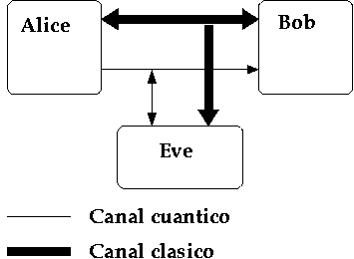
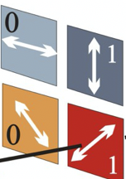


Quantum Cryptography.
Ingredients:
A qubit emitter (think photons): Alice.
  Can prepare qubits in different states and basis.
A qubit receiver: Bob
  Can measure qubits in different basis
A quantum channel (able to transport the qubits from Alice to Bob)
A classical channel (public but authentic)
… and the spy (Eve)

Slide 38
Resources: The Qubit.
Remember!
Reading the state of a qubit (measurement):
  (|α|²+|β|² = 1, measurement done in the {|0>,|1>} basis.
  Note: measurement modifies the state of the qubit.
  We do not have access to α or β
Measurement
|0>
Prob. |α|²
But it could be other basis! (different from 0 and 1)
α|0> + β|1>
|1>
Prob. |β|²

Slide 39
Vertical polarizer
Vertically polarized photons
All photons pass through the ‘slit’

Slide 40
Horizontal polarizer
Vertically polarized photons
Zero photons pass through the ‘slit’

Slide 41
Diagonal polarizer
The resulting photons have the polarization of the polarizer!
Vertically polarized photons
Some photons pass through the ‘slit’

Slide 42
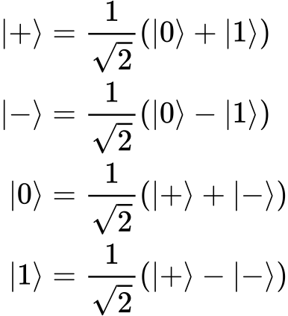


More on Measurement
Actually what we are doing is to use two orthogonal basis: If we encode in one and measure in the other, there is a 50% chance of make a mistake

Slide 43


Alice
Bob
1
Alice chooses one of the four possible photons
2
The photon is sent
3
Bob measures in a basis
Sent bit
1
Sent photon
Basis used
Received photon
Received bit
1

Slide 44
Alice
Bob
50%
1
Alice chooses one of the four possible photons
2
The photon is sent
3
Bob measures in a basis
Sent bit
1
1
Sent photon
Basis used
Received photon
Received bit
1
0

Slide 45
Alice
Bob
1
Alice chooses one of the four possible photons
2
The photon is sent
3
Bob measures in a basis
Sent bit
1
1
0
Sent photon
Basis used
Received photon
Received bit
1
0
0

Slide 46
Alice
Bob
50%
1
Alice chooses one of the four possible photons
2
The photon is sent
3
Bob measures in a basis
Sent bit
1
1
0
0
Sent photon
Basis used
Received photon
Received bit
1
0
0
0

Slide 47
Alice
Bob
1
Bob tells Bob which basis he used
Sent bit
1
1
0
0
Sent photon
Basis used
Received photon
Received bit
1
0
0
0

Slide 48

Alice
Bob
1
Bob tells Bob which basis he used
2
Alice checks which ones coindice
Sent bit
1
1
0
0
Sent photon
Basis used
Received photon
Received bit
1
0
0
0

Slide 49
Alice
Bob
1
Bob tells Bob which basis he used
2
Alice checks which ones coindice
3
Both discard the ‘bad’ photons
Sent bit
1
1
0
0
Sent photon
Basis used
Received photon
Received bit
1
0
0
0

Slide 50
Alice
Bob
1
Bob tells Bob which basis he used
2
Alice checks which ones coindice
3
Both discard the ‘bad’ photons
Sent bit
1
1
0
0
Alice’s key: 10
Sent photon
=
Basis used
Bob’s key: 10
Symmetric key
Received photon
Received bit
1
0
0
0

Slide 51
Alice
Bob
If there are ‘good’ photons with different polarization: there is an Eve!
1
Bob tells Bob which basis he used
2
Alice checks which ones coindice
3
Both discard the ‘bad’ photons
Sent bit
1
1
0
0
Alice’s key: 10
Sent photon
=
Basis used
Bob’s key: 10
Symmetric key
Received photon
Received bit
1
0
0
0

Slide 52
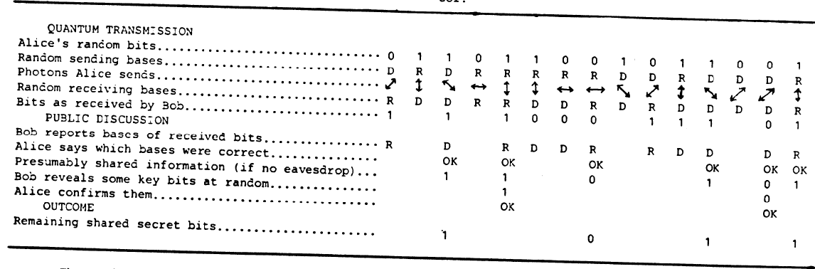
QKD: BB84
Bennet, Brassard. „Quantum Cryptography: Public Key Distribution and Coin Tossing“
International Conference on Computers, Systems and Signal Processing. Bangalore, 1984

Slide 53
QKD: BB84
ALICE
Emitter

Slide 54
QKD: BB84
BOB
receiver

Slide 55
QKD: BB84
(CLASSICAL)
Error correction

Slide 56
QKD: The classical part
After qubit detection at Bob, what we have is a raw key that needs to be processed to obtain the final secret key :
  Sifting
  Error correction
  Privacy amplification
  Authentication
In the theoretical world, it is enough with sifting and error estimation (we dont need to correct erros since one single error is related with the existence of Eve).
However, in the real world, errors come from Eve AND the environment… so we have to perform additional postprocessing.

Slide 57
QKD: The classical part
Raw key extraction and sifting: Using the public channel the emitter publishes the basis in which the qubits were prepared. The receiver acknowledges those in which the measurement was done in the same basis.
  Raw key will differ between emitter and receiver, since there will be errors introduced by the spy (and by noise)
  To start the error correction an error estimate is obtained.
  Raw key is also cleaned from artifacts (e.g. double detections…)
  Note the use of the public channel (also in the following steps): any revealed information has to be removed from the final key and the communications must be authentic.

Slide 58
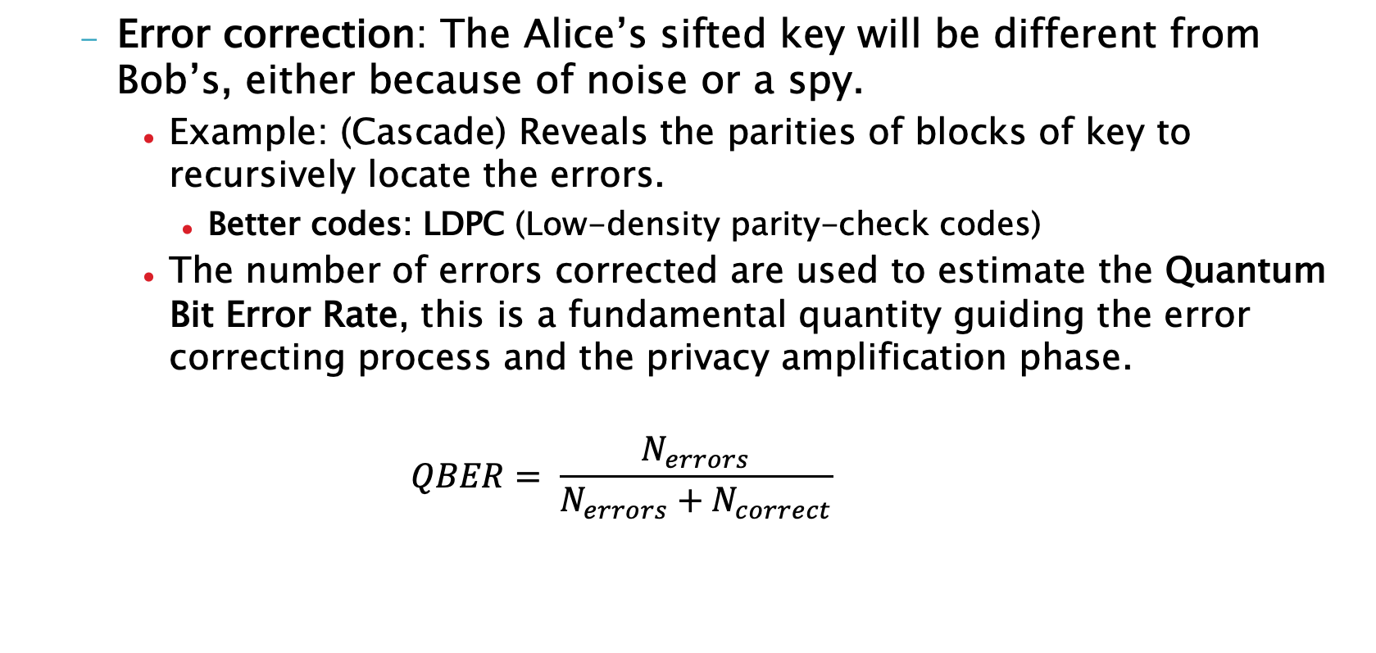
QKD: The classical part
  Error correction: The Alice’s sifted key will be different from Bob’s, either because of noise or a spy.
    Example: (Cascade) Reveals the parities of blocks of key to recursively locate the errors.
      Better codes: LDPC (Low-density parity-check codes)
    The number of errors corrected are used to estimate the Quantum Bit Error Rate, this is a fundamental quantity guiding the error correcting process and the privacy amplification phase.
    $$QBER= \frac{N_{errors}}{N_{errors}+N_{correct}}$$

Slide 59
  Note: The QBER also gives the limits when a secret key can be extracted or not.
Typical parameters:
  A very good QBER ~ 1%, with a 3-4% relatively high key rates are possible. Beyond 6-7% the secret key rate is drastically reduced, even although the theoretical limit is 11%
    This limit depends on protocol and assumptions on the spy (e.g. 15% if incoherent attacks)
    A special case is the one for continuous variables, which works with extremely high error rates. Error correction is very demanding in this case.

Slide 60
Privacy amplification
The error corrected key can still have information known to the spy. Privacy amplification tries to eliminate this mixing bits that are known to the spy (Eve) with others that are unknown. Examples:
  If a spy knows the value of bit 15 but not the 16, then the spy knows nothing about the value of XOR(15,16)
  If the spy knows the values of bits 15 and 16 with a 60% of probability , he will known XOR(15,16) with a probability 0.6² + 0.4² = 0.52, which is less than the original.
In practice this can be done using hash functions on blocks of the corrected key, which efficiently mix all the bits.
Privacy amplification is possible if the mutual information between Alice and Bob is larger than the mutual information between Alice and the spy or Bob and the spy:
S(A,B||E) >= max{I(A,B)-I(A,E), I(A,B)-I(B,E)}

Slide 61
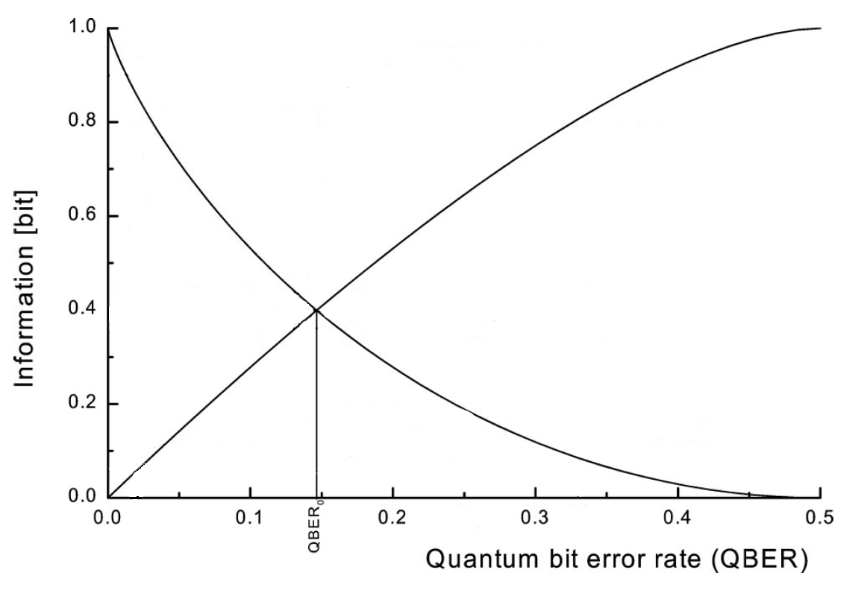
Typical information curves.
Incoherent eavesdropping strategy, BB84
Eve’s information
secret key
Bob’s information
11%, coherent eavesdropping limit

Slide 62
Quantum
Information
Communication
Cryptography
in practice

Slide 63
Quantum Cryptography
Ingredients
Quantum channel.
Single Quantum detectors.
Single Quantum Emitters (incl. entangled pairs)
Quantum State preparation and analysis.

Slide 64
Quantum communications and networks, why is it difficult?
Ingredients:
A qubit emitter (think photons): Alice.
  Can prepare qubits in different states and basis.
A qubit receiver: Bob
  Can measure qubits in different basis
A quantum channel (able to transport the qubits from Alice to Bob)
A classical channel (public but authentic)
… and the spy (Eve)
Single Quantum

Slide 65
Quantum communications and networks, why is it difficult?
The Quantum channel
Extremely weak signals:
  A single pulse in classical communications ~ 10⁸ photons
  Quantum comunications: 1 photon
Comm. laser
Single photon
(not to scale)
Δλ = 0.2~0.8 nm (DWDM)
Δλ = 3~20 nm (CWDM)

Slide 66
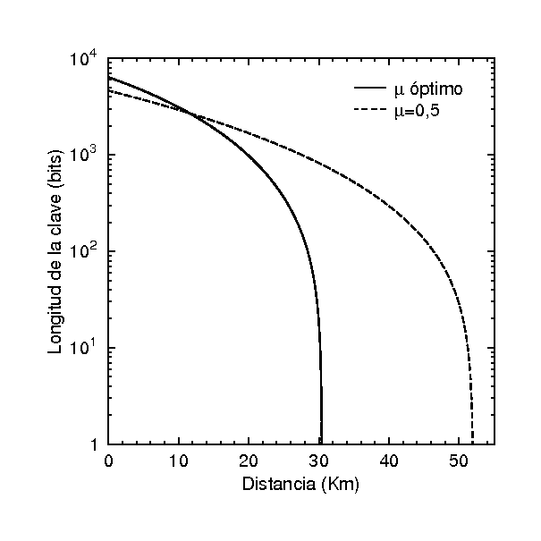
Quantum communications and networks, why is it difficult?
The Quantum channel
0 km | 10⁹ photons/sec.
15 km | 5 10⁸
150 km | 10⁶
300 km | 1000
600 km | 1 p per 20 min.
900 km | 1 p per 36 years
Signals are always absorbed.
  Except in perfect vacuum.
    Exponential decay
  Free space: aperture
Quantum systems interact with the environment
  Decoherence: Loss of information
Quantum cryptography directly sending Quantum systems is fundamentally limited in reach
Losses in fibre 0.2 dB/km

Slide 67
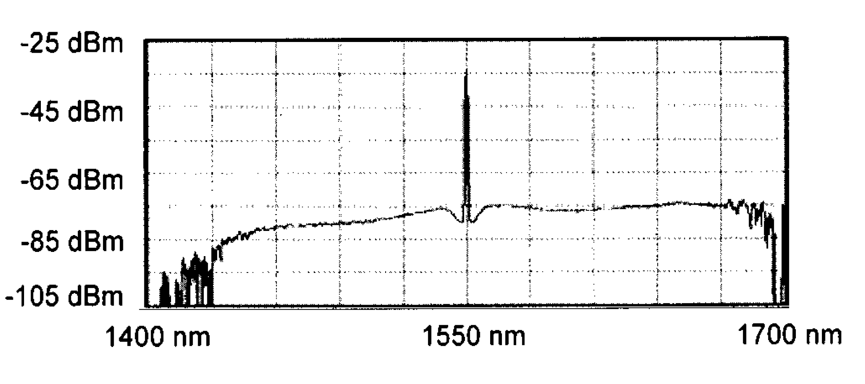
Quantum communications and networks, why is it difficult?
The Quantum channel
Optical infrastructure is expensive: What about sharing?
  Crosstalk is very difficult to avoid when your signal is a single quantum!
  Current trends in classical communications (physical layer): put as many channels as posible in a single fibre.
    DWDM 25GHz channel spacing: 0.2 nm
Noise in the fibre: Raman
150 nm
Raman backscattering of a signal at 1549 nm [ DOI: 10.1063/1.1842862]
Single
Photon
(approx. scale)

Slide 68
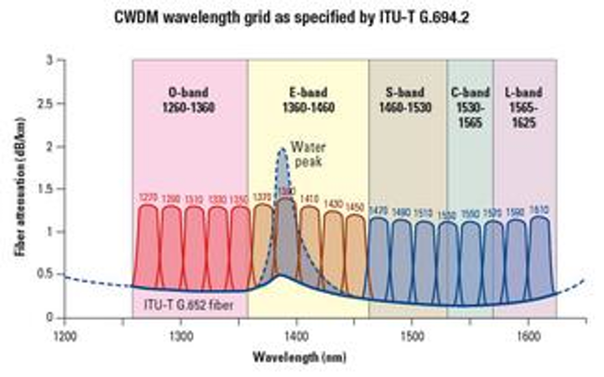
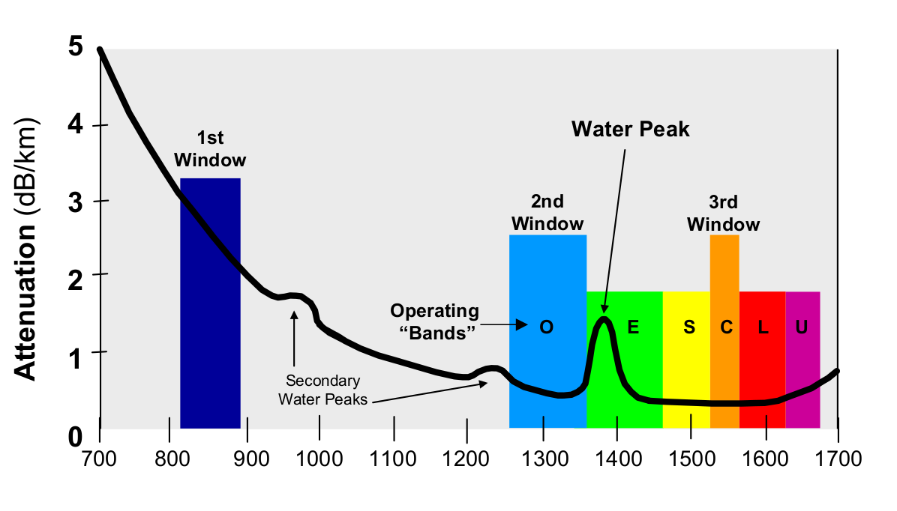
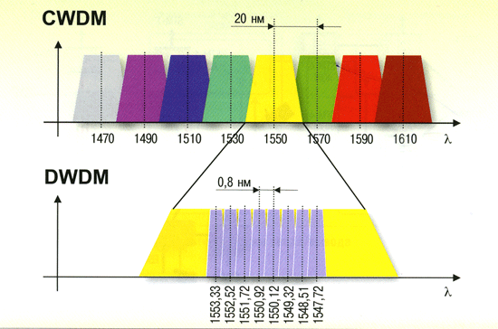
DWDM ~up to 160
Life in the optical fibre
CWDM
18 channels
1270-1610 nm
Sep: 20 nm
.
CWDM
DWDM
1528.77-1536.86 nm
80 channels (50GHz grid. Sep: 0.4 nm)
Lambda (nm)
Notes:
CWDM: ITU-T G.694.2 define 18 longitudes de onda (C1-C18) para el rango de transporte CWDM desde 1270 hasta 1610 nm con espaciados de 20 nm
DWDM: ITU G.694.1 es desde 1528.77nm hasta 1563.86nm que reside principalmente dentro de la banda C. DWDM se puede tener un espaciado de longitud de
onda de 100GHz (0.8nm) para 40 canales, o un espaciado de 50GHz (0.4nm) para 80 canales

Slide 69
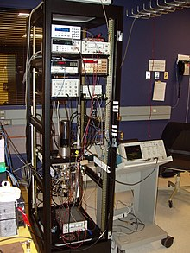
Quantum communications and networks, why is it difficult?
Detectors
Single photons are difficult to detect efficiently (improving!!)
  Superconducting detectors.
    Low dark count, high speed but bulky & low temperature (few K).
  Solid state: not so efficient, afterpulses, still bulky and moderate low T (70-200 K) for better performance.
  Homodyne: convenient, compact and telco-friendly. CV only.
Single photons are difficult to produce.
  Only one at a time and on demand!
  Typical: use attenuated laser sources.
Source: Wikipedia

Slide 70
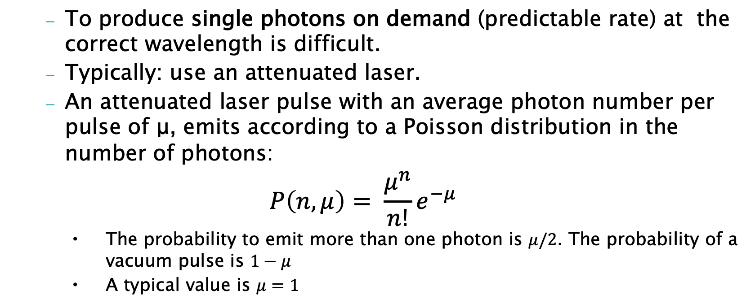
Single photon sources.
  To produce single photons on demand (predictable rate) at the correct wavelength is difficult.
  Typically: use an attenuated laser.
  An attenuated laser pulse with an average photon number per pulse of μ, emits according to a Poisson distribution in the number of photons:
$$P\left(n,μ\right)= \frac{μ^{n}}{n!}e^{−μ}$$
      The probability to emit more than one photon is $μ/2$. The probability of a vacuum pulse is $1−μ$
      A typical value is $μ=1$

Slide 71
QKD Devices
~20 cm
QKD first implementation, 1989. A BB84 protocol essentially as previously explained
(“Deaf proof” version, polarization coding)

Slide 72
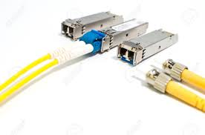
A complete departure on the design of QKD devices: Continuous Variables
Building robust QKD systems is complex and require bulky Single Photon Detectors for which a large market does not exist, hence expensive. Moreover, the technology is notoriously “telco unfriendly” from an integration (e.g. Sharing the physical infrastructure) point of view.
    Do we have some sort of catch-22 problem?
Expensive
Niche market
Typical QKD system
~150K€
“cottage industry”?
Difficult to integrate
SFP module
Finger sized
Mass market
Plug and play
50€
?

Slide 73
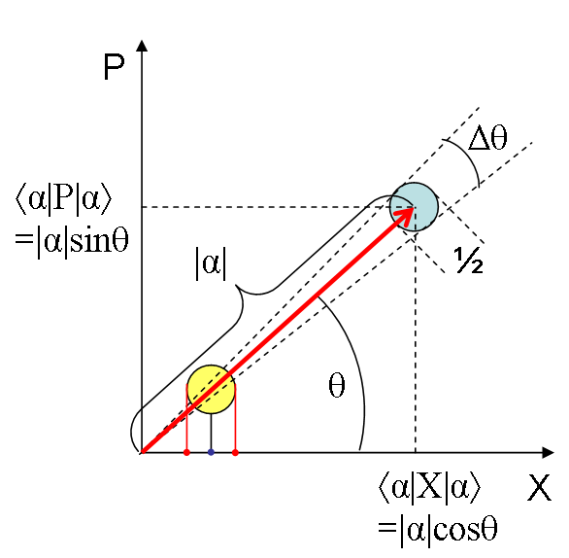
Quantum Cryptography with Continuous Variables.
X_{θ} = X cos(θ) + P sen(θ)
Coherent states.
The quadratures of the electric field of an electromagnetic wave are also subject to the Heisenberg uncertainty principle.
  E.g. the amplitude quadrature (strength of the electric field at phase=0) and the phase quadrature (strength of the electric field at phase=90) are analogous to the position X and momentum P.
    ΔX ΔP >= ½
    The quadratures are Continuous Variables
J_S_Lundeen
In coherent states the uncertainty
in X and P are equal (non-squeezed states)

Slide 74
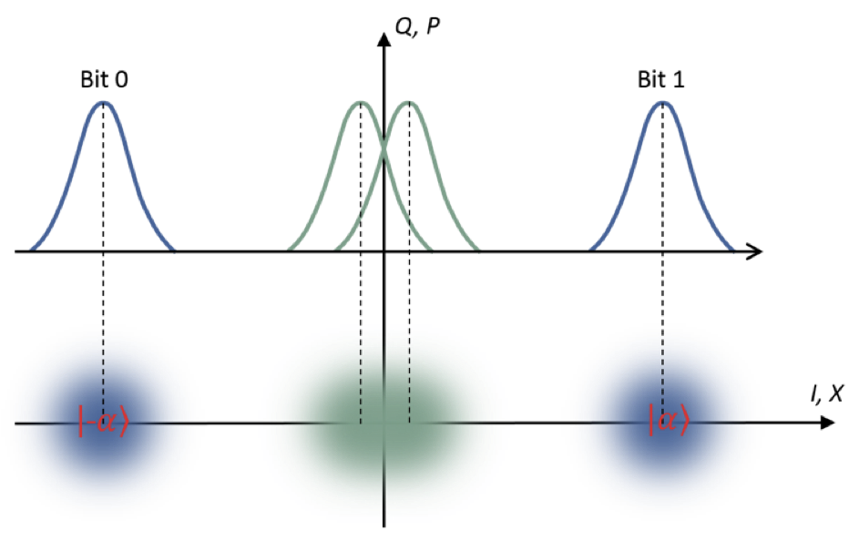
Quantum Cryptography with Continuous Variables.
In classical communications amplitudes are maximized and there is no overlap. In quantum communications, the amplitudes are reduced and the overlap of the uncertainty region allows to do QKD (non-ortogonal bases)

Slide 75
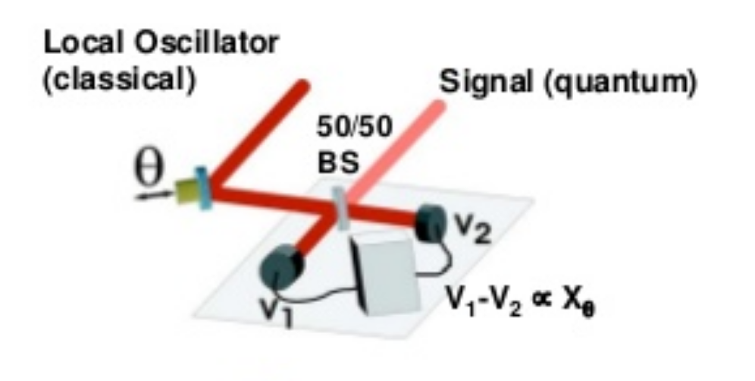
Homodyne detection
Homodyne detection measures:
X_{θ} = X cos(θ) + P sen(θ)
Homodyne detection is very sensitive to the variations of a modulated signal (in phase or frecuency)
from an oscillating one comparing with it (the local oscillator, that would be identical to the original if
it was not carrying any information)

Slide 76
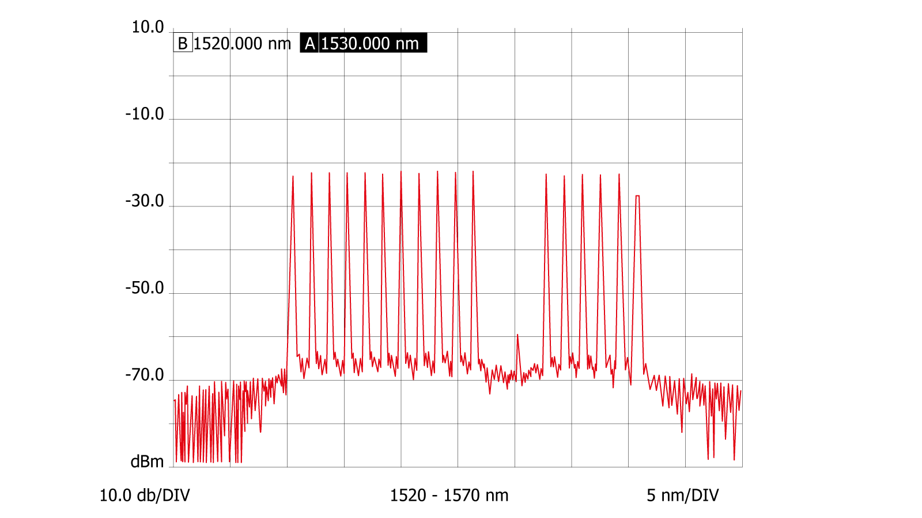
CV QKD: What are the advantages?.
Homodyne/heterodyne detection.
  Forget about bulky/expensive/cold single photon detectors.
  Piggybacking on standard telco technology.
    Better industrialization possibilities
    Better miniaturization possibilities
    Cheaper/better potential to take over the market
  Homodyne/heterodyne detection works as a noise filter
    Better co-propagation with classical signals.
  Can balance how much “detection” you put in optical analog and how much in digital signal processing.

Slide 77
CV-QKD
Not all is perfect:
Lower key rate than DV-QKD
  Can be higher at low distance/losses
Tolerate less losses
  Less reach/tolerant to bad chanels
Computationally heavy postprocessing

Slide 78
Quantum Computing
vs
Conventional Crypto

Slide 79
Quantum Computing and Quantum Crypto: Do we have a problem?
Quantum computers break, in polynomial time, the most used algorithms for public key cryptography and key distribution.
  RSA
  Elliptic curve cryptography
  Diffie-Hellman
    This is key-agreement that relies either in RSA or ECC
But, you know, building a quantum computer will take forever…
  Or, at least, so many years that you do not need to worry…
  Lazy CISO thinking: “I will retire before these guys arrive…”

Slide 80
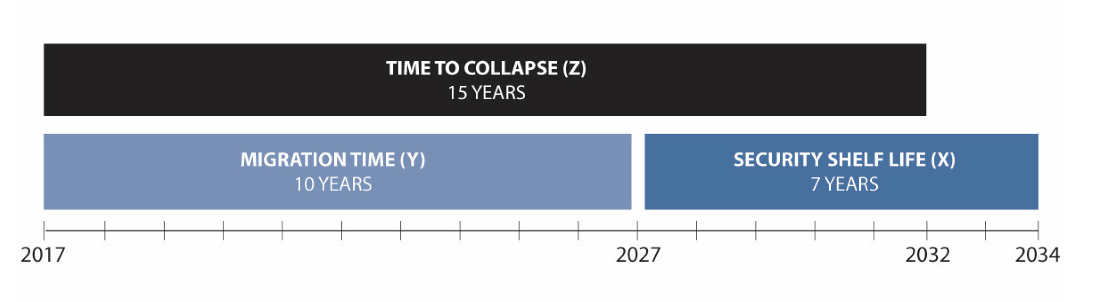
Quantum Computing and Quantum Crypto: Do we have a problem?
Quantum
Computer
From : Quantum Computing: Progress & Prospects 2018. A Consensus Report. National Academy of
Sciences, Engineering and Medicine (adapted from M. Mosca, 2015)
Notes:
Shelf life: the period of time during which a material may be stored and remain suitable for use

Slide 81
… write your own answer:
Z: Time to a quantum computer: ?
Y: Time to fully change the security infrastructure: Estimate (NIST) 20yrs.
X: Shelf life: 1-50 yrs. (what is your application?)
If X+Y > Z… you have problems.
Notes:
Shelf life: the period of time during which a material may be stored and remain suitable for use

Slide 82
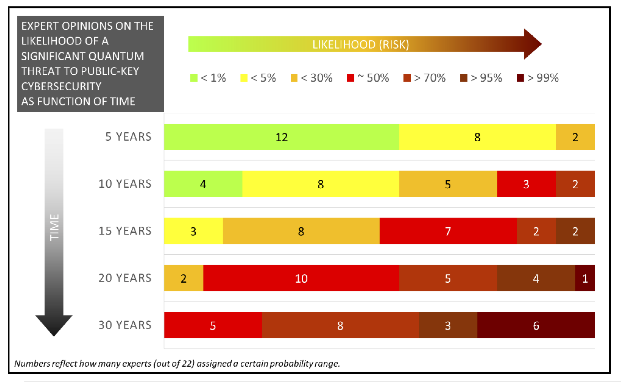
50% of quantum computing experts think than in 15 years public key crypto as we know it will be broken.
Solution as an experts opinion poll.
(Global Risk Institute, 2019)
Question: Indicate how likely
you estimate that a quantum
computer, able to factorize
a 2048-bit number in less
than 24 hours, will be built
within the next 5 years,
10 years, 15 years, 20 years,
and 30 years,
https://globalriskinstitute.org/download/quantum-threat-timeline-full-report-2/

Slide 83
Conventional Crypto
This is a large field, Cryptography can be defined as the science of making the cost of discovery of hidden information greater than the value of the information itself^{(*)}. It provides many tools to cover the typical cryptographic tasks like integrity, confidentiality or non-repudiation…
Since Shor’s algorithm breaks the most used public-key schemes and QKD provides symmetric key schemes, we concentrate on these.
(*) Taken from “Digital Identity” by Phillip J. Windley

Slide 84
Conventional Crypto
Public key schemes (asymmetric)
  Two keys, one for cipher and other to decipher.
  A procedure using one key (public) can cipher (decipher) providing (ideally) no information about the other key (private) that allows to do the inverse operation.
    If the ciphering procedure (C) and deciphering one (D) are inverse for every message M: D(C(M)=M the procedure can be used to transmit secret messages.
    Typically C is made public while D is private.
      If Alice wants to send a secret message to Bob, the she takes Bob’s public key C_{B} and sends C_{B}(M) to Bob. Bob is the only one who can decipher it using his private key D_{B}(C_{B}(M))=M

Slide 85
Conventional Crypto
If also C(D(M) ) = M the system can be used to digitally sign (requires a Certification authority that guarantees who is the real owner of the public key)
  If Bob wants to send a signed message M to Alice:
    Bob calculates a signature S for M using his private key S=D_{Bob}(M) (usually a hash of M is used instead of M)
    Cipher the message with Alice’s public key C_{Alice} (S) and sends it to Alice.
    Alice decipher the signature with her private key as D_{alice}(C_{alice}(S)) =S and the message with Bob’s public key C_{bob}(S)=M and keeps S and M
    Since S and M are linked through Bob’s private key S=D_{Bob}(M) only known to Bob, Alice can prove that Bob was the real sender. The message is thus authenticated (note that the procedure also guarantees integrity).

Slide 86
Conventional Crypto
RSA, ECC (Elliptic Curve Crypto) are examples of public key crypto. These schemes can be used to agree on a symmetric key (this is the Diffie-Hellman key exchange)
E.g. RSA cipher/decipher a message M as:
C = M^{c} mod n
M = C^{d} mod n
Where n is a large integer obtained multiplying two primes p and q. c and d are obtained from products of p and q, so that knowing one does not reveal the other. The pair (c,n) is made public, allowing the ciphering, the pair (d,n) is kept private.

Slide 87
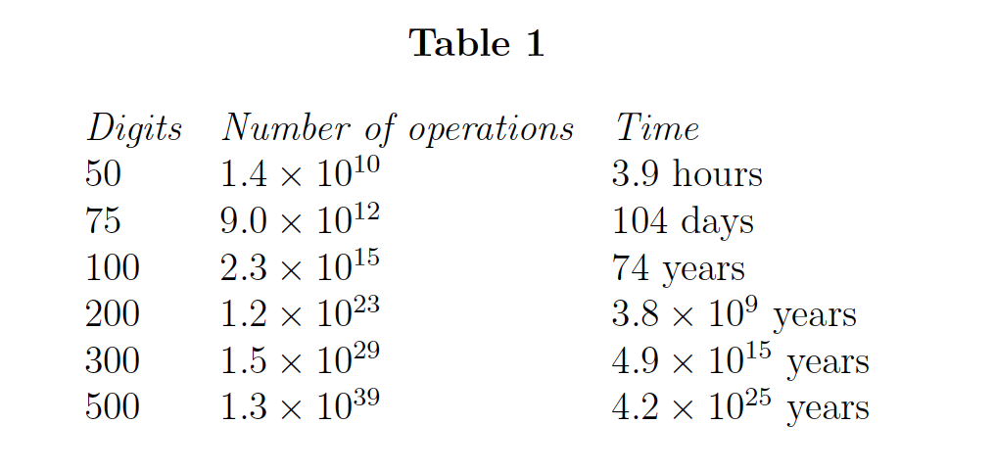
Conventional Crypto
The strength of the method lays in the computational assumption of the difficulty of the factoring problem.
To give an idea of the numbers involved:
  According to the original (1977) paper by Rivest, Shamir y Adleman:
Decimal digits
RSA 129

Slide 88
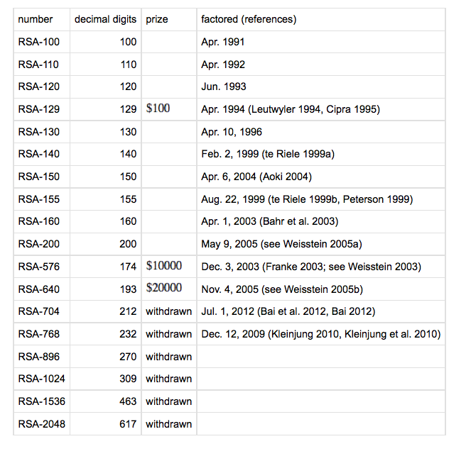
„The magic words are
squeamish ossifrage“
13-August-93 till
2-Abril-94, management included 1600 CPUs
(mostly i386).
Quadratic Sieve. 512
bits (~154 d) within reach. RSA 129 This is the famous Martin Gardner’s bet in Scientific American
Factoring today:
What is considered safe have been changing over the years from 512 to 2048…
Check NIST 800-131A “Transitioning the use of cryptographic algorithms and key lengths (2019)
5 months, 80 Opteron CPU
at 2.2GHz. Number Field
Sieve. RSA 640
http://mathworld.wolfram.com/RSANumber.html

Slide 89
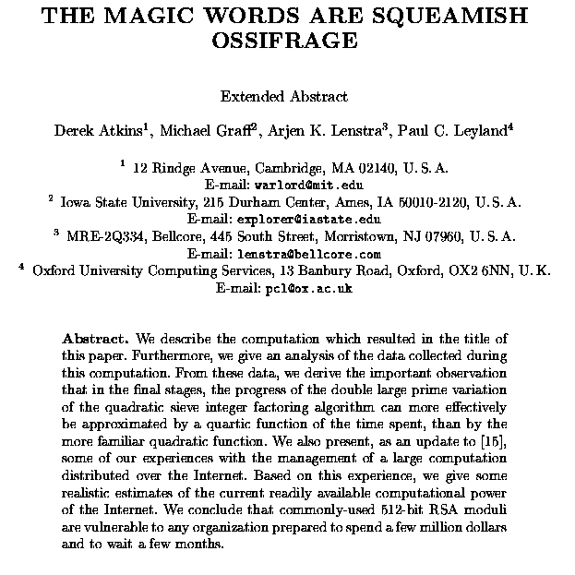
Breaking the RSA
(1994-95)

Slide 90
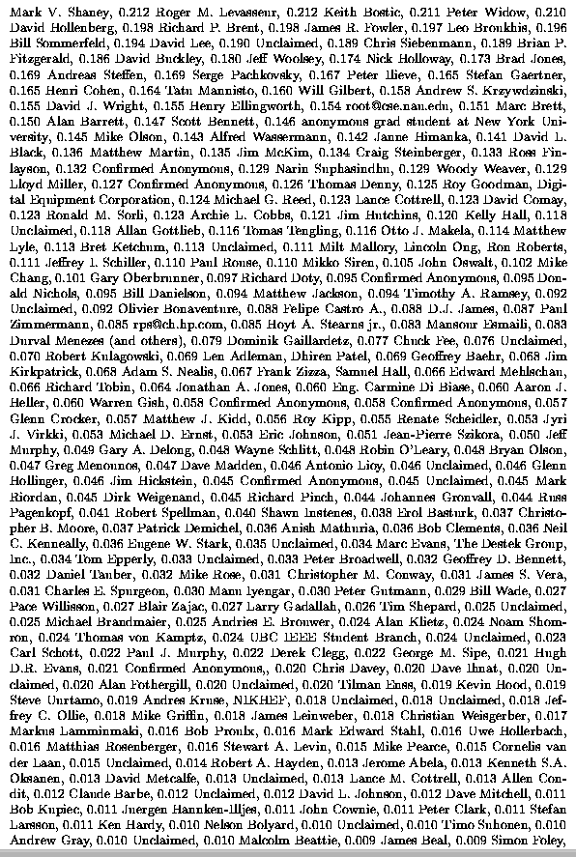
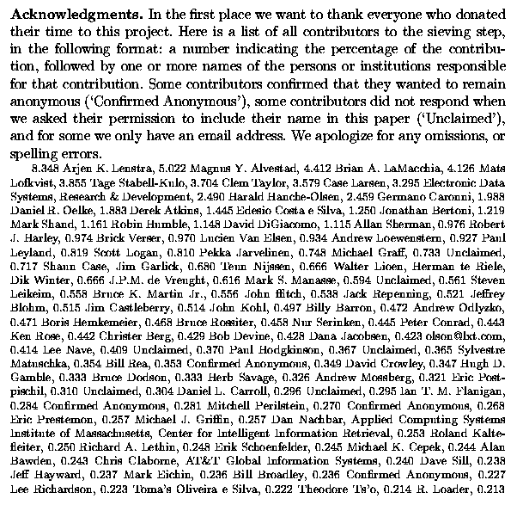
Breaking the RSA
9 months, 600 people 1600 computers
managed with an early internet,
including magnetic tapes sent over mail

Slide 91
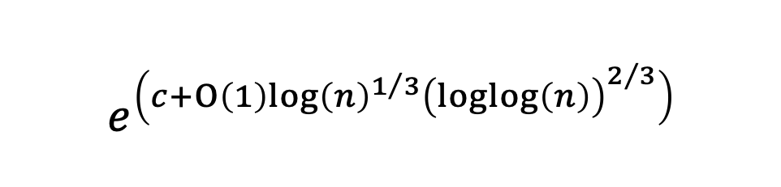
Conventional crypto.
To attack the RSA everything has been tried:
    From a mathematical point of view, fatoring continues being a hard problem, at least chosing p and q wisely. The fastest known algorithm (number field sieve) runs superpolinomially on the number n of key bits:
    All kind of “dirty” war:
      Implementation details (web servers using SSL)
      Analyzing the power consumption of the computer doing the processing, stimates on the length of p and q can be obtained (differential power analysis
      Peeking to the RSA process from another one …
      These are analogous to the “side channels” in QKD implemenations.
$$e^{\left(c+Ο\left(1\right)log{\left(n\right)}^{1/3}{\left(loglog\left(n\right)\right)}^{2/3}\right)}$$

Slide 92
Private key systems (symmetric)
    Encryption and decryption keys are the same.
    They are considered quantum safe (just brute force attack with Grover’s algorithm. Sqrt(N) gain)
    Cyphers work by “adding entropy” to the message such that a point in messages space is assigned to a point in a much larger cypher space through the key. The assignment is isotrophous such that “nearby” keys produce points in cypher space that are not correlated by any “proximity” definition.
    Examples: One Time Pad, DES, Triple DES, AES.
    One Time Pad is ITS (absolutely secure) if used properly. E.g. never reuse key.
      ITS: Information Theoretical Security. No matter the computational power of the attacker, the algorithm is safe. Its security is not related to any computational hardness assumption.

Slide 93
A note about PostQuantum Crypto (PQC)
    Currently “Shor’s resistant” algorithms.
      Note that it is not yet fully clear what is the power of Quantum Computing.
    They are offered as direct replacements of the current Public Key Crypto schemes.
    Computational security
    There are several families of algorithms: lattices, hash functions, multivariate, code based…
      There is no clear winner in terms of performance (time in encrypt/decrypt, size of the key, size of the encrypted text… signatures –also size/time-)
    Examples: NTRU, Newhope, LWE (Learning With Errors), McEliece, MDPC cyclic Mceliece…
    There is currently a NIST call to find the algorithm/set of algorithms that will be recommended as a replacements of RSA or ECC.
Notes:
MDPC : Moderate Density Parity Check code

Slide 94
Quantum
Networks

Slide 95
Quantum communications and networks, why is it difficult?
Limited reach, point to point.
extremely weak signals.
Comm. laser
Limited reach/losses
(~30 dB, 150 km)
(recent experiments with ~60 dB, but in the end losses will dominate)
Single photon
(not to scale)
Δλ = 0.2~0.8 nm (DWDM)
Δλ = 3~20 nm (CWDM)
Noise in the fibre: Raman
Difficult to detect.
Absorpions
Masked by the noise
150 nm
Single
Photon
(approx. scale)
Raman backscattering of a signal at 1549 nm [ DOI: 10.1063/1.1842862]

Slide 96
Quantum communications and networks, why is it difficult?
Limited reach, point to point.
extremely weak signals.
Comm. laser
Limited reach/losses
(~30 dB, 150 km)
(recent experiments with ~60 dB, but in the end losses will dominate)
Single photon
(not to scale)
Trusted nodes are
required
(security issues)
Δλ = 0.2~0.8 nm (DWDM)
Δλ = 3~20 nm (CWDM)
Noise in the fibre: Raman
Difficult to detect.
Absorpions
Masked by the noise
150 nm
Single
Photon
(approx. scale)
Raman backscattering of a signal at 1549 nm [ DOI: 10.1063/1.1842862]

Slide 97
Quantum communications and networks, why is it difficult?
Limited reach, point to point.
extremely weak signals.
Comm. laser
Limited reach/losses
(~30 dB, 150 km)
(recent experiments with ~60 dB, but in the end losses will dominate)
Single photon
(not to scale)
Low tolerance to noise
Δλ = 0.2~0.8 nm (DWDM)
Δλ = 3~20 nm (CWDM)
Noise in the fibre: Raman
Difficult to detect.
Absorptions
Masked by the noise
150 nm
Single
Photon
(approx. scale)
Raman backscattering of a signal at 1549 nm [ DOI: 10.1063/1.1842862]

Slide 98
Quantum communications and networks, why is it difficult?
Limited reach, point to point.
extremely weak signals.
Comm. laser
Limited reach/losses
(~30 dB, 150 km)
(recent experiments with ~60 dB, but in the end losses will dominate)
Single photon
(not to scale)
Low tolerance to noise
Quantum/
classical co-propagation
Issues
(not sharing the infrastructure
–> Expensive!! )
Δλ = 0.2~0.8 nm (DWDM)
Δλ = 3~20 nm (CWDM)
Noise in the fibre: Raman
Difficult to detect.
Absorptions
Masked by the noise
150 nm
Single
Photon
(approx. scale)
Raman backscattering of a signal at 1549 nm [ DOI: 10.1063/1.1842862]

Slide 99
Quantum communications and networks, why is it difficult?
Limited reach, point to point.
extremely weak signals.
Comm. laser
Limited reach/losses
(~30 dB, 150 km)
(recent experiments with ~60 dB, but in the end losses will dominate)
Single photon
(not to scale)
Low tolerance to noise
Alien technology (HW &SW)
Δλ = 0.2~0.8 nm (DWDM)
Δλ = 3~20 nm (CWDM)
Noise in the fibre: Raman
Difficult to detect.
Absorpions
Masked by the noise
150 nm
Single
Photon
(approx. scale)
Raman backscattering of a signal at 1549 nm [ DOI: 10.1063/1.1842862]

Slide 100
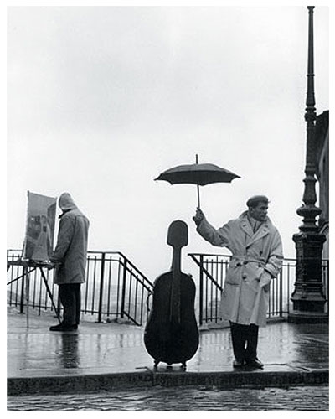
Quantum communications and networks, why is it difficult?
Limited reach, point to point.
extremely weak signals.
Does not play well with (classical) networks.
Comm. laser
It is a delicate
technology.
Single photon
(not to scale)
Δλ = 0.2~0.8 nm (DWDM)
Δλ = 3~20 nm (CWDM)
Noise in the fibre: Raman
150 nm
Ad-hoc network: Large Up-front costs
Limited range: Security model requires trusted nodes
Single
Photon
(approx. scale)
R. Doisneau
Raman backscattering of a signal at 1549 nm [ DOI: 10.1063/1.1842862]

Slide 101
What to do? Solutions
The traditional view of QKD networks
Non-Integrative view: Extreme “ad hoc” A network just for quantum.
Fully integrated quantum/classical network: The SDN paradigm.
Notes:
Aquí se trata de justificar el interés de los proveedores de servicio por QKD, y mencionar lo que ya se hizo en el SEGUR@ hace cinco o seis años. La intro de cualquiera de los papers (la del Comms Magazine, por ejemplo) viene muy bien para esto

Slide 102
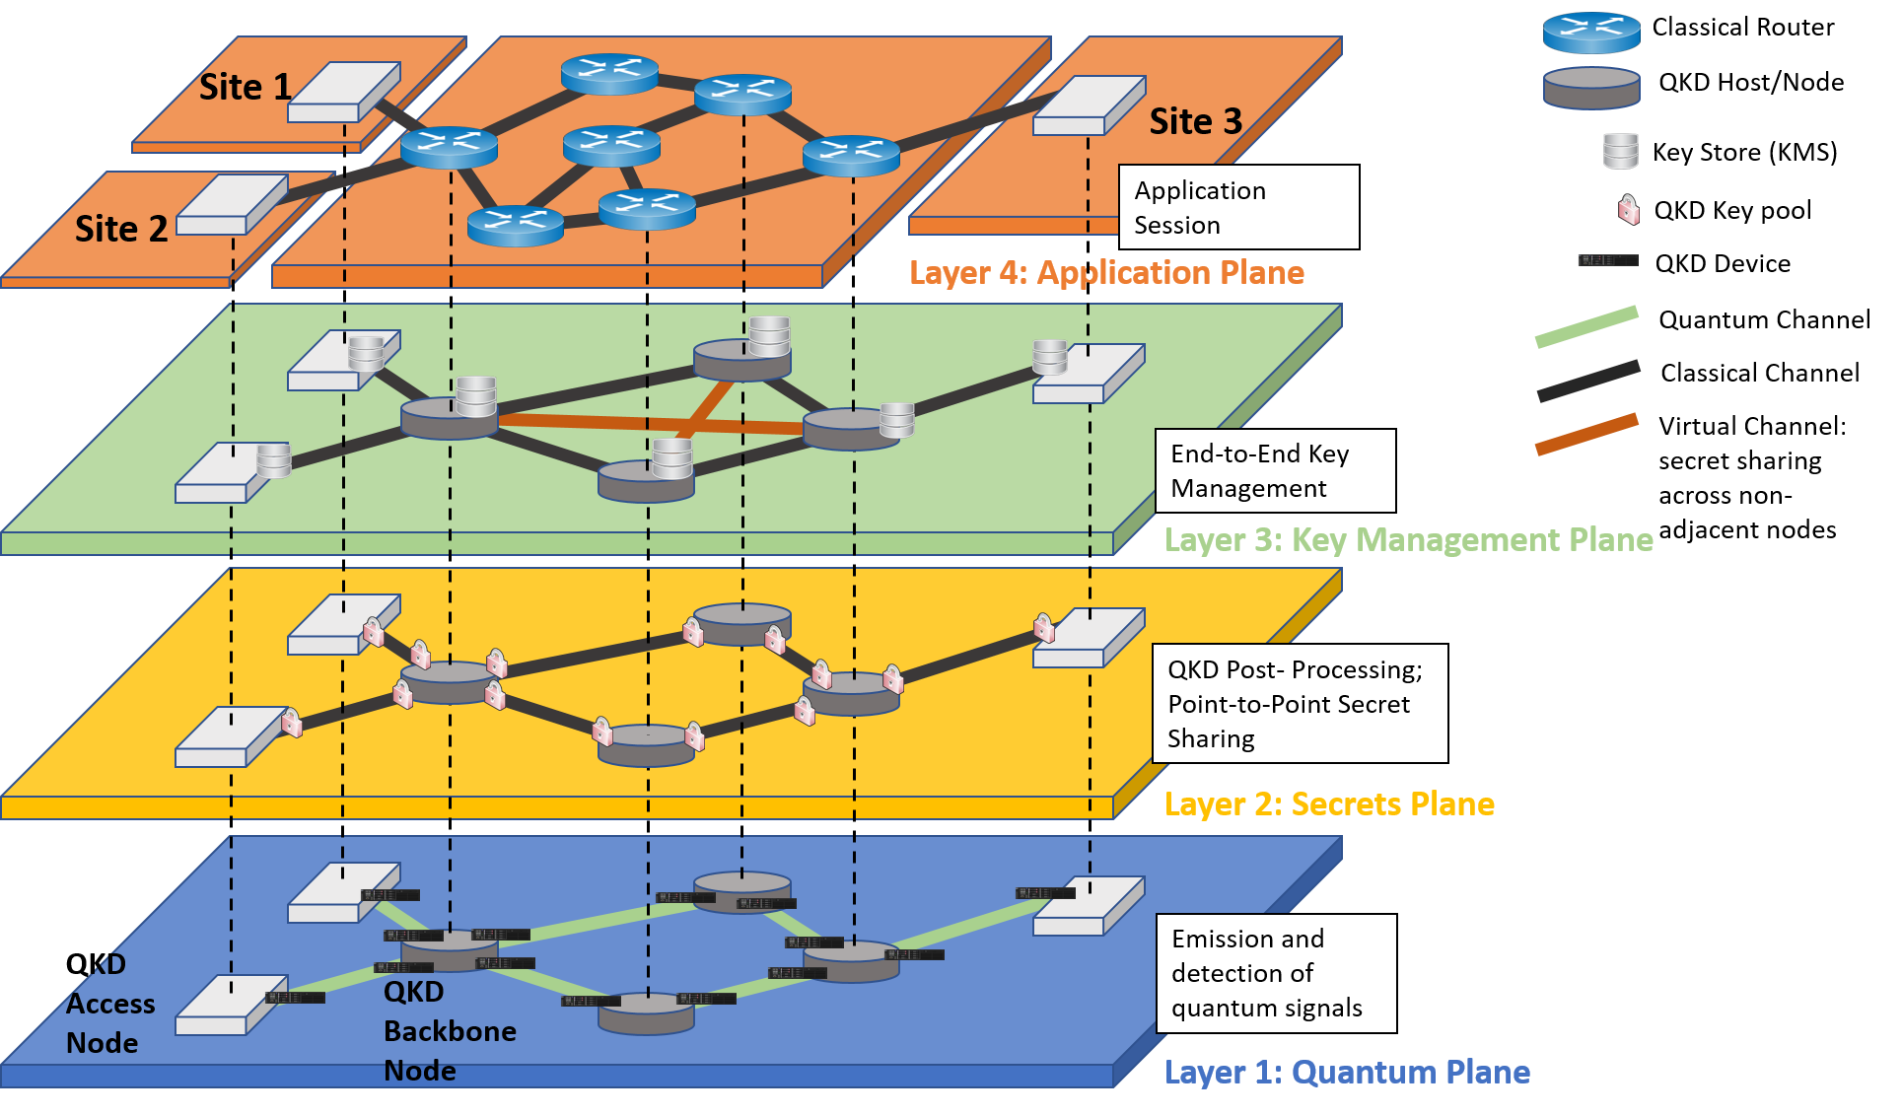
The traditional view of QKD networks
Layer Role:
”Services” feed on the keys from the
“Key storages” that are filled using the
”QKD connections” where the quantum links are.
Source: Oliver Maurhardt SECOQC - Austrian Institute of Technology (2008)

Slide 103
This is an “ad hoc” parallel network for QKD.
Dedicated dark fiber or fine-tuned connections.
It is not integrated with existing telco networks.
The bad:
Difficult to deploy and non-incremental.
  Static
Very high up-front costs…
  … which means that either there is a preexisting large market or it cannot create it.
The good:
High performance for QKD

Slide 104
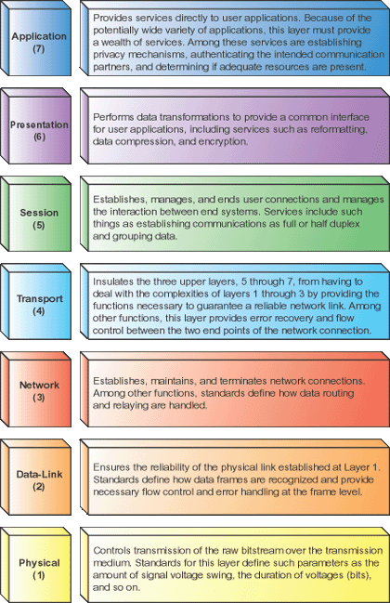
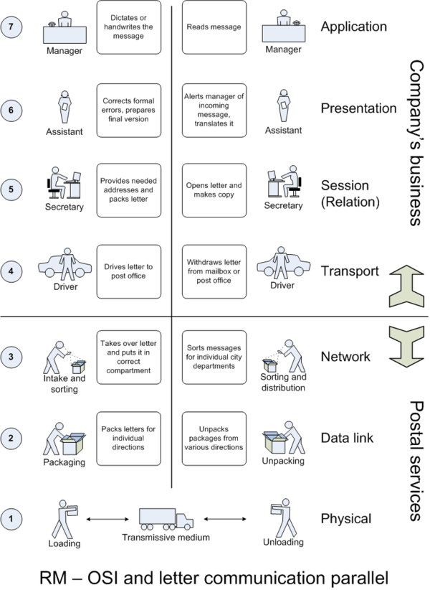
Detour: Layered networks: The OSI Model

Slide 105
Layered networks: The OSI Model
HTTP, TELNET, SSH...
ASCII, MPEG...
TCP, UDP...
Ipsec (IKE)...
Ethernet, WiFi, PPP...
RS-232, 100BASE-TX, USB, 802.11g...

Slide 106
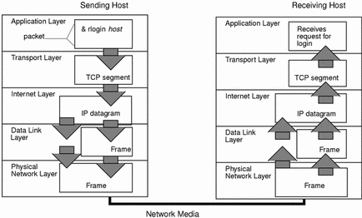
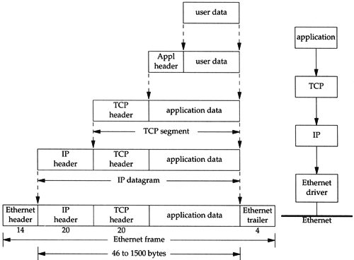


Layered networks
This “matryoshka-like” behavior
“packing-unpacking” does
not exist in a QKD network.
Also: underlying idea of “packets”

Slide 107
ETSI: Current status: Nodes, Components
Security
perimeter
Full QKD Node
with a Classical and Quantum part
It needs to have a control module
  Centralised or distributed. Could be more than one.
It needs to have a Key Manager
  Centralised or distributed. Only one per node: just one entry point for the APPlications.
Interfaces appear naturally between well defined components (with clear functionality)
Intra-node (local) and Inter-node ifcs.
Possible standardization points.
APPs
QKD Node
C.
Part
Key Management
QKD Agent
QKD Key Manager Peer
Q.
Part
“QKD
Host”
Quantum optical processing
Key Reconciliation
Privacy Amplification
Forwarding Module
QKD Key Manager Peer
Quantum optical processing
Key Reconciliation
Privacy Amplification
QKD Key Manager Peer
Quantum optical processing
Key Reconciliation
Privacy Amplification

Slide 108






Quantum Networks in Madrid
2009
UPM &
2014
Full metro network: CWDM core + GPON access
Madrid SDN QKD Network
(actual layout)
2018

Slide 109
Madrid SDN Quantum Network (2018)
Madrid SDN QKD Network
(actual layout)
2018
First Quantum SDN Network in the world (2018)
Installed in production facilities.
“The Engineering of a SDN Quantum Key Distribution Network” IEEE Comms. Mag. July 2019, Special number “The Future of Internet” doi: 10.1109/MCOM.2019.1800763 ; http://arxiv.org/abs/1907.00174

Slide 110



How to Solve the Integration problem: Software Defined Networking
Programmability is
Key: A SDN controller can manage the
Network.
SDN
Network equipment as
Black boxes
Open interfaces (OpenFlow) for instructing the boxes what to do
FEATURE
FEATURE
SDN decouples
the data plane
trom the control
plane
OPERATING SYSTEM
FEATURE
FEATURE
SPECIALIZED PACKET FORWARDING HARDWARE
FEATURE
FEATURE
SDN
OPERATING SYSTEM
OPERATING SYSTEM
SPECIALIZED PACKET FORWARDING HARDWARE
FEATURE
FEATURE
SPECIALIZED PACKET FORWARDING HARDWARE
OPERATING SYSTEM
SPECIALIZED PACKET FORWARDING HARDWARE
Boxes with autonomous
behaviour
Decisions are taken out of the box
SDN can adapt,
allowing for
a fast innovation
Cycle.
SDN
FEATURE
FEATURE
OPERATING SYSTEM
FEATURE
FEATURE
SPECIALIZED PACKET FORWARDING HARDWARE
FEATURE
FEATURE
OPERATING SYSTEM
OPERATING SYSTEM
SPECIALIZED PACKET FORWARDING HARDWARE
FEATURE
FEATURE
SPECIALIZED PACKET FORWARDING HARDWARE
OPERATING SYSTEM
Simpler OSS to manage the SDN controller
SPECIALIZED PACKET FORWARDING HARDWARE
Adapting OSS to manage black boxes
Telefónica I+D
Notes:
El paradigma de SDN permite pasar de un modelo de caja negra en el que el comportamiento de los equipos está definido por el suministrador a un modelo en el que hay interfaces abiertas y desde el que puedo controlar desde fuera el comportamiento de los equipos. Esta capacidad me permite:
Centralizar el control de la red si así lo requiero en ciertos segmentos de la misma. En los protocolos distribuídos llegar a la situación deseada de la red, como una propiedad emergente frente a un cambio exógeno es más complicado que con un mecanismo de control centralizado. Eso es lo que se consigue con SDN. En sistemas autónomos es mejor un sistema distribuido, pero en nuestro entorno de red hay ciertos ámbitos, cuando requiero un control férreo, donde es preciso aplicar SDN.
Abstraer una visión de la red como un todo (segmentos de la red).
Simplificar los sistemas. En un modelo de cajas negras los vendors tienen sus propios sistemas de control. En un entorno multisuminsitrador ello hace que necesite un sistema paraguas que controle al resto. Con un enfoque SDN que tenga en OpenFlow un controlador estándar se quitaría un nivel de complejidad y sólo se requirían sistemas entre varios vendors.
NFV: me da movilidad y reutilización
SDN: me da control
SDN+NFV= moldeabilidad
SDN, from a technical point of view:
Fully decouple data and control planes
Simple packet processing elements (switches)
Software-based controlling components (controllers)
Network functions are split between per-packet rules on the switch and high-level decisions at the controller
Open interface between control and data plane
OpenFlow

Slide 111
Why SDN for QKD?
NOT VERY
“QUANTUM
FRIENDLY”
Ad hoc modifications required
(Difficult acces to the market)
“QUANTUM
FRIENDLY”
Potentially “zero touch” integration.
(Enabling access to the market)
SDN
Network equipment as
Black boxes
Open interfaces (OpenFlow) for instructing the boxes what to do
SDN
FEATURE
FEATURE
Programmability is
Key: A SDN controller
can manage the
Network.
OPERATING SYSTEM
FEATURE
FEATURE
SPECIALIZED PACKET FORWARDING HARDWARE
FEATURE
FEATURE
SDN
OPERATING SYSTEM
OPERATING SYSTEM
SPECIALIZED PACKET FORWARDING HARDWARE
FEATURE
FEATURE
SPECIALIZED PACKET FORWARDING HARDWARE
OPERATING SYSTEM
SPECIALIZED PACKET FORWARDING HARDWARE
Boxes with autonomous
behaviour
Decisions are taken out of the box
SDN can adapt,
allowing for
a fas innovation
Cycle.
SDN
FEATURE
FEATURE
OPERATING SYSTEM
FEATURE
FEATURE
SPECIALIZED PACKET FORWARDING HARDWARE
FEATURE
FEATURE
OPERATING SYSTEM
OPERATING SYSTEM
SPECIALIZED PACKET FORWARDING HARDWARE
FEATURE
FEATURE
SPECIALIZED PACKET FORWARDING HARDWARE
OPERATING SYSTEM
Simpler OSS to manage the SDN controller
SPECIALIZED PACKET FORWARDING HARDWARE
Adapting OSS to manage black boxes
Telefónica I+D
Notes:
El paradigma de SDN permite pasar de un modelo de caja negra en el que el comportamiento de los equipos está definido por el suministrador a un modelo en el que hay interfaces abiertas y desde el que puedo controlar desde fuera el comportamiento de los equipos. Esta capacidad me permite:
Centralizar el control de la red si así lo requiero en ciertos segmentos de la misma. En los protocolos distribuídos llegar a la situación deseada de la red, como una propiedad emergente frente a un cambio exógeno es más complicado que con un mecanismo de control centralizado. Eso es lo que se consigue con SDN. En sistemas autónomos es mejor un sistema distribuido, pero en nuestro entorno de red hay ciertos ámbitos, cuando requiero un control férreo, donde es preciso aplicar SDN.
Abstraer una visión de la red como un todo (segmentos de la red).
Simplificar los sistemas. En un modelo de cajas negras los vendors tienen sus propios sistemas de control. En un entorno multisuminsitrador ello hace que necesite un sistema paraguas que controle al resto. Con un enfoque SDN que tenga en OpenFlow un controlador estándar se quitaría un nivel de complejidad y sólo se requirían sistemas entre varios vendors.
NFV: me da movilidad y reutilización
SDN: me da control
SDN+NFV= moldeabilidad
SDN, from a technical point of view:
Fully decouple data and control planes
Simple packet processing elements (switches)
Software-based controlling components (controllers)
Network functions are split between per-packet rules on the switch and high-level decisions at the controller
Open interface between control and data plane
OpenFlow

Slide 112
… but there is more.
SDN is an enabler of QKD in telecommunications networks.
SDN is a consumer of QKD:
  As a critical infrastructure that “owns” the physical means to do QKD.
    New security challenges in network “softwarization”
  Its structure of “secured connected locations”, with typical distances within the QKD range, matches the security model of “connected trusted nodes” in current QKD. Trusted nodes are already there (PoPs)
SDN QKD

Slide 113
… but there is more.
SDN is an enabler of QKD in telecommunications networks.
SDN is a consumer of QKD:
  As a critical infrastructure that “owns” the physical means to do QKD.
    New security challenges in network “softwarization”
  Its structure of “secured connected locations”, with typical distances within the QKD range, matches the security model of “connected trusted nodes” in current QKD. Trusted nodes are already there (PoPs)
SDN is both, an enabler of QKD in communications networks
and, at the same time, a very good use case for QKD.
SDN QKD

Slide 114
… but there is more.
SDN is an enabler of QKD in telecommunications networks.
SDN is a consumer of QKD:
  As a critical infrastructure that “owns” the physical means to do QKD.
  Its structure of “secured connected locations”, with typical distances within the QKD range, matches the security model of “connected trusted nodes” in current QKD.
In our case, the first user is the telco.
(and you can think later about other users)
SDN is both, an enabler of QKD in communications networks
and, at the same time, a very good use case for QKD.
SDN QKD

Slide 115


arXiv:2311.12791v2

Slide 116



R&S L2 encryptor
OBJECTIVE:
OADM+programm.
Switch (add/drop
Quantum Channels)
2 HWDU
CV QKD +
2 servers
From CiViQ
SDN server
ADVA OTN +
Link encryptor
Quiron
Quijote
a “central” Node
Quijote
Quevedo
Quintin
2 idQ DV QKD (C and O-band,
1550 nm + 1310nm)
OpenQKD systems
2 Quantum & service channels DV and CV from/to previous/next node. Compatibility in C & O bands in same fiber.
Classical communications in bidi fiber, cyphered L1, L2 & L3 traffic.
116

Slide 117
How to adapt QKD to the SDN?
The structure of an SDN network.
The network connects Points of Presence (PoPs), where the servers and telco equipment is installed, that are assumed secure.
Distance limitations are less significant.
  Average distance between PoPs in Germany or Spain < 60 Km
A centralized (SDN) controller knows the structure of the network and capabilities of the devices, managing the requirements to stablish quantum channels and optimize the whole quantum/classical network.
SDN-Aware devices export capabilities (can be programmed) so that the controller can manage them, whether they are quantum or not.
SDN
Controller/
NFV
Mano
QKD
Notes:
Requirements, lack of standarization, etc.

Slide 118
Key structure: SD-QKD-Node Abstraction
SDN
Controller
App Layer
ISG-QKD 004 “Application
Interface”
SDN Controller
ISG-QKD 015 “Quantum Key Distribution Control
Interface for Software Defined Networks”
OpenFlow
NETCONF
SD-QKD
Node
APPS
QKD Iface
…
…
SDN Agent
ETSI: Industry Specification
Group on QKD.
QKD Iface
QKD Iface
Key stats
Key requirements
Quantum
Channels
Configuration
Information
Keys
LKMS
NW people is familiar with this
way of doing things.
Key
extraction
QKD System
Quantum
Channels

Slide 119
Global view of the SDQKD Network
SDN Controller
Key points
Dynamical connections
Integrated in a classical network
Part of a security ecosystem
The SDN controller manages the
Requirements of the quantum and
Classical devices to optimize the network.
APPS
SDN-QKD
Node
SDN Agent
SDN-QKD
Node
SDN-QKD
Node
SDN-QKD
Node
Keys
Configuration
Information
LKMS
SDN-QKD
Node
QKD System
SDN-QKD
Node
SDN-QKD
Node
SDN-QKD
Node

Slide 120

SDN Controller
SDN Controller
SDN Controller:
To control simultaneously the quantum and
classical resources in the network.
Path computation to calculate optical paths for
a quantum channel
Topology application
Quantum part designed as a plug-in of existing,
commercial grade, controllers (e.g. OpenDaylight)
  Easier acceptance by telcos.
NETCONF
SDN Agent
APPS
LKMS
QKD
Quantum
Channels

Slide 121
SDN Agent
SDN Controller
SDN Agent:
Manages the Interactions in the node with the set of QKD devices installed.
  Based on:
    QuAI (Quantum Abstraction Interface) minimal set of comms with the QKD system for easy integration.
    QuAM (Quantum Abstraction Module) Translates SDN Control commands into commands that the QKD device can understand via QuAI.
    Uses ETSI (European Telecommunications Standards Institute ) ISG 015 “SDN Control interface” in the northbound interface.
ETSI ISG-QKD 015
NETCONF
SDN Agent
APPS
LKMS
QuAI
QKD
Quantum
Channels

Slide 122
LKMS
SDN Controller
LKMS:
Local Key Mangement System:
  Manages the keys extracted from the QKD device and handles it to the Application
  Keeps statistics and requests services to the SDN Agent (QoS)
  Simple version
  Uses ETSI ISG 004 “Application Interface”
NETCONF
SDN Agent
APPS
LKMS
QKD
Quantum
Channels
ETSI ISG-QKD 004
Noteworthy:
All components shown are large enough to be manufactured separately: Disaggregation.
Entry point for new manufacturers
Using trusted technologies in Telco environments.

Slide 123
Thanks!...
Curiosities? Questions? Comments?
Laura Ortiz
laura.ortiz@upm.es
Javier Faba
javier.faba@upm.es

Slide 124

Time for Questions? (and coffee)

