Slide 1
6G Networks and the Role of AI: AI-Related Threats, AI-Driven Attacks and AI-based Attack Detection
1st Summer School on Security and Privacy, UCM
Maria Christopoulou
Research Associate, CORE Research Group, NCSR "Demokritos"

Slide 2
Overview of the Session
6G Networks Overview
AI-related Threats in 6G
Automated vulnerability exploitation
Intrusion Detection Systems
Future Trends in AI-based Security

Slide 3
Brief Overview of 5G/6G

Slide 4
Timeline
1980s
1G
Analog Communications
1990s
2G
2000s
3G
3GPP Rel. 1999
2010s
4G
3GPP Rel. 8
2020s
5G
3GPP Rel. 15
2030s
6G
3GPP Rel. 21+
Notes:
Release 19 (2024)
Release 20 5G Advanced (2025)
Release 21 1st set of 6G tech. Specs (TBD)

Slide 5
The Ecosystem
Organization | Role
ITU (International Telecommunications Union) | UN Agency for Information & Communication Technologies Responsible for global radio spectrum allocation, satellite orbits, standards and recommendations for seamless connectivity
3GPP (3rd Generation Partnership Programme) | Develops technical specifications, not standards. The specifications are transposed into standards by the 7 regional Standardization Bodies (Organizational Partners of the 3GPP): ETSI (Europe), ARIB (Japan), CCSA (China), ATTIS (USA), TSDSI (India), TTA (Korea), TTC (Japan)
Market Representation Partners | 5G-AA NGMN GSMA And many others
https://www.3gpp.org/about-us/partners
https://www.itu.int/en/about/Pages/default.aspx

Slide 6
6G Networks Overview

Slide 7
6G Usage Scenarios
Scenario
Immersive Communication | Immersive XR Telepresence Holographic Communications
Hyper Reliable and low-Latency Communication | Industrial automation Emergency services Telemedicine
Massive Communication | Smart Cities/Transport/Health
Ubiquitous Connectivity | Rural and remote areas
Artificial Intelligence and Communication | Distributed computing and AI applications Automated driving Medical Assistance Digital Twins
Integrated Sensing and Communication | Sensing for navigation Activity Detection Environmental monitoring
Recommendation ITU-R M.2160-0 (11/2023), Framework and overall objectives of the future development of IMT for 2030 and beyond

Slide 8
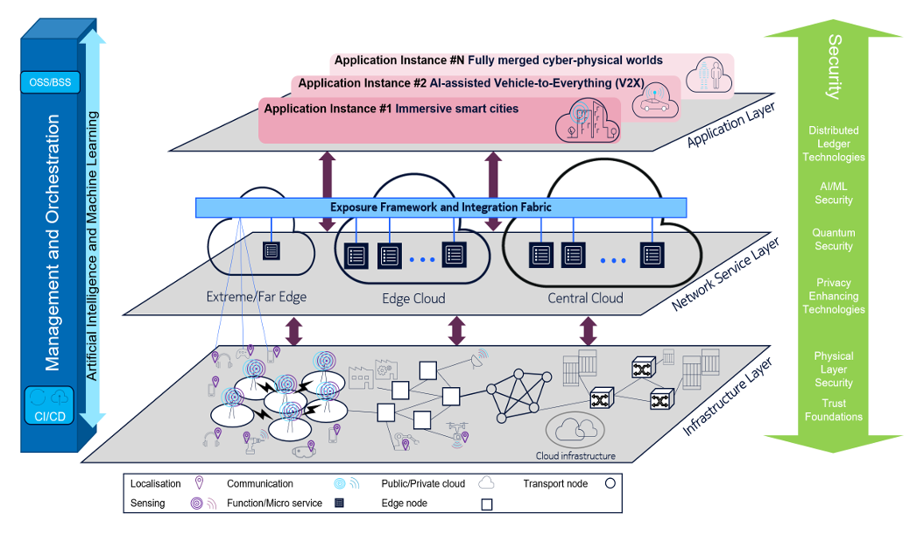
6G E2E Architecture
HEXA-X Project, Deliverable D1.3 Targets and requirements for 6G – initial E2E architecture, 2022

Slide 9
Role of AI in 6G Networks
AI-native architecture
Embedded AI in every network layer
AI-native air interface
AI for advanced use cases (e.g., holographic communications)

Slide 10
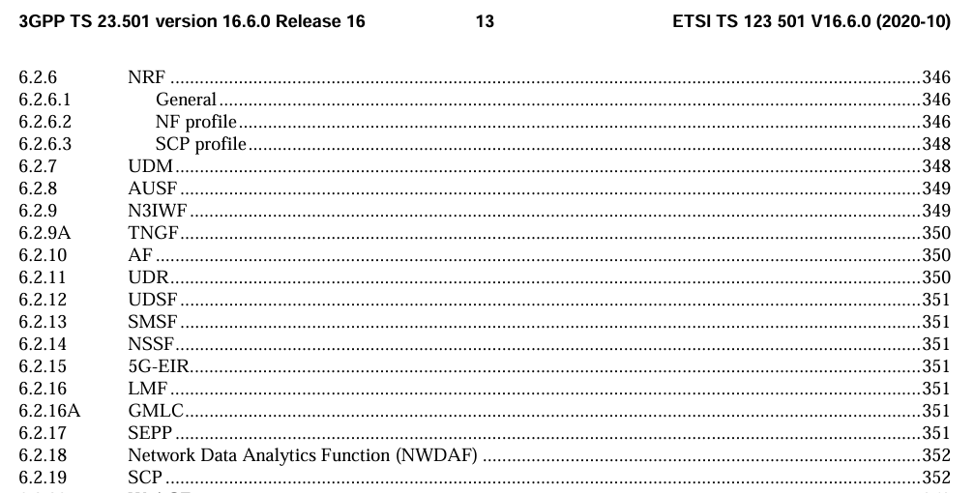
AI is already provisioned in 5G
The Network Data Analytics Function (NWDAF) was introduced in 3GPP Release 16 (July 2020)
Document | Description
3GPP TS 23.288 | Describes the architecture and functionality of the NWAF within the 5G System
3GPP TS 23.501 | Describes the system architecture for the 5G System (5GS)

Slide 11
But AI in 5G presents limitations
The NWDAF was specifically designed for data acquisition and analytic information provisioning.
Supports data collection from other Network Functions and OAM.
Does not consider data from other business domains
Data privacy not considered
6G is foreseen to be “AI-native”.

Slide 12
AI/ML Brief Overview

Slide 13
Learning Systems
Learning System
Supervised Learning | Uses labeled data for training Regression/Classification Linear regression, SVM, Neural Networks
Unsupervised Learning | Uses unlabeled data for discovering patterns Density modelling, dimensionality reduction, anomaly detection K-means, PCA, Autoencoders
Reinforcement Learning | Learns by interacting with the environment Q-learning, DQN
Semi-supervised Learning | Combines a small amount of labeled data with a large amount of unlabeled data Semi-supervised SVM, Graph-based methods

Slide 14
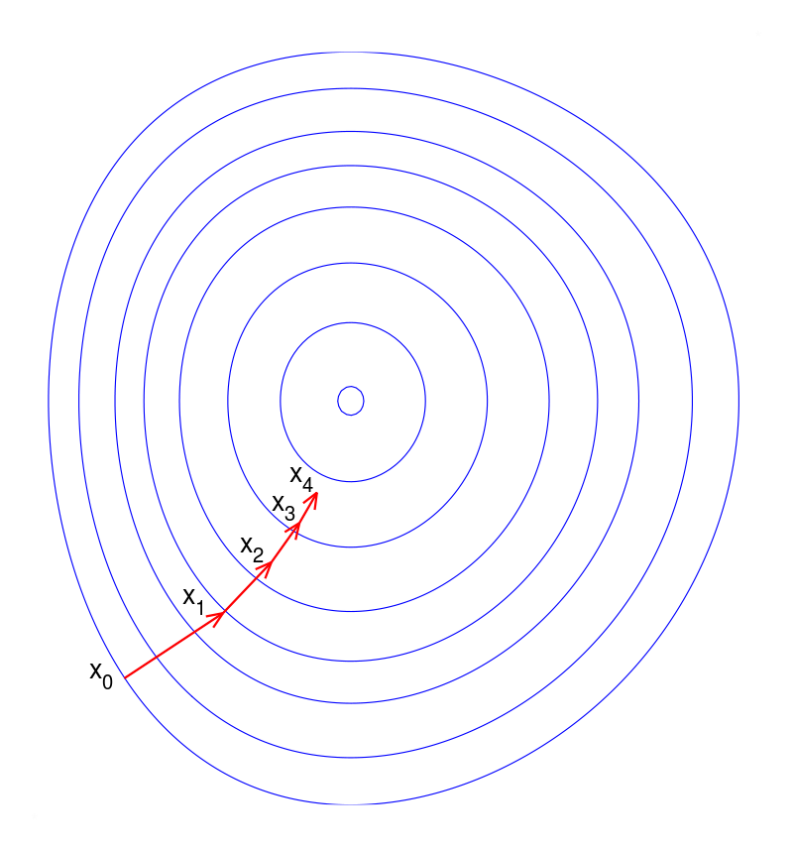
Model Training
Given a dataset $D=(x_{i},y_{i})$, find the parameters $θ$ of the function $f(x;θ)$ that minimize the difference between the predicted output $\hat{y}$ = f(x;θ) and the actual output $y$.
If $f$ is a neural network, then $θ$ includes the weights and biases.
We define a loss function $L(θ)$for measuring the prediction error (e.g., mean squared error for regression, cross-entropy loss for classification)
Using Gradient Descent, we adjust $θ$ to minimize the loss function $L(θ)$, through the update rule:
$θ=θ−η∙∇_{θ}L(θ),$where $η$ is the learning rate, and $∇_{θ}L(θ)$is the gradient of the loss function with respect to $θ$.
After training is complete, we evaluate the model on a separate validation set to examine how it performs on unseen data.
Image Source: Olegalexandrov at English Wikipedia, Public domain, via Wikimedia Commons, https://commons.wikimedia.org/wiki/File:Gradient_descent.png

Slide 15
Training on the MNIST Dataset
We will use the MNIST dataset throughout the session.
It is composed of 70000, 28x28 pictures of handwritten digits 0-9.
We train a simple neural network and validate it on a separate test set.
We will use the trained model to test adversarial attacks against it.
Image By Suvanjanprasai - Own work, CC BY-SA 4.0, https://commons.wikimedia.org/w/index.php?curid=132282871

Slide 16
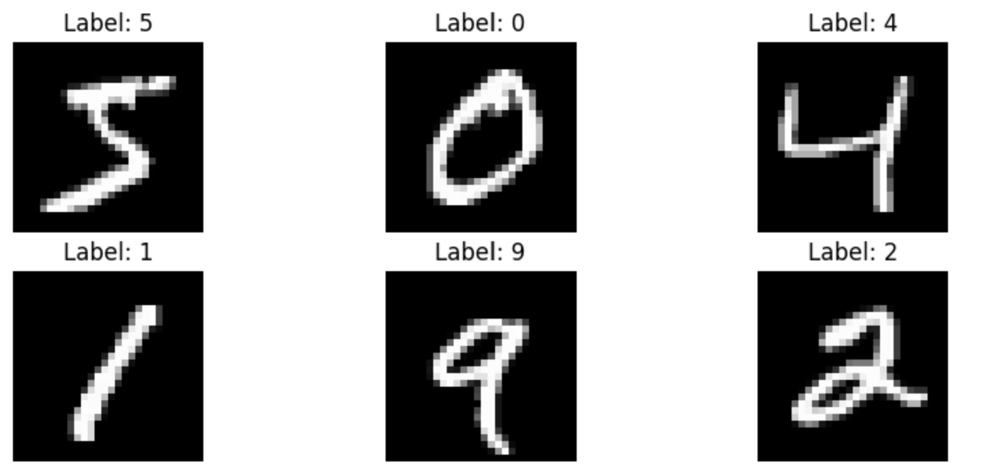
Training & Testing of NN in the MNIST dataset
We train a NN with 1 hidden layer (128 neurons)
5 epochs for training
Loss function: Categorical cross-entropy (classification problem)
Accuracy on clean test data: 97.41%
In the next part, we will perform an attack against the NN model and inspect how its accuracy is affected.
Source Image of NN: By Glosser.ca - Own work, Derivative of File:Artificial neural network.svg, CC BY-SA 3.0, https://commons.wikimedia.org/w/index.php?curid=24913461

Slide 17
Adversarial Attacks on AI systems

Slide 18
Adversarial Attacks
Definitions and mechanisms
Hands-on Examples
Defense mechanisms
Use cases & Consequences for 6G networks

Slide 19
Adversarial Attacks
Attack | Description | Used during
Evasion Attacks | The attacker modifies input data at inference time to cause the model to misclassify. | Inference
Exploratory (Inference) Attacks | The attacker extracts information about the model without altering it. | Inference
Transferability Attacks | Use adversarial examples generated for one model to attack another model. | Inference
Poisoning Attacks | The attacker injects malicious data during the training phase to corrupt the model. | Training
Backdoor Attacks (subset of poisoning attacks) | Embed triggers in the training data to produce specific incorrect outputs when the triggers are activated. | Training

Slide 20
The Adversary’s Goal is
Targeted Misclassification
Classify an input as a specific incorrect class
An attacker may want to a security system to classify a malicious file as benign
Untargeted Misclassification
Cause any incorrect classification
Model degradation
Frequent misclassifications degrade the performance and reliability of the model
Ensure the model’s output is incorrect
To cause a machine learning model to make incorrect predictions or classifications by altering the input data at inference time.

Slide 21
Techniques for performing Evasion Attacks
Technique | Description
Fast Gradient Sign Method (FGSM) | Generates adversarial examples by adding a perturbation in the direction of the gradient of the loss.
Basic Iterative Method (BIM) | Iterative version of FGSM that applies perturbations multiple times for stronger adversarial examples.
Projected Gradient descent (PGD) | Extends BIM by projecting adversarial examples back onto the ε-ball around the original input.
Carlini & Wagner (C&W) attack | Uses optimization to find minimal perturbations that cause misclassification, formulated as an optimization problem.
Jacobian-based Saliency Map Attack (JSMA) | Uses the Jacobian of the model’s output to identify and modify the most important features for misclassification.
And more…

Slide 22
Fast Gradient Sign Method
Compute the Gradient
$∇_{x}L(θ, x, y)$
$∇_{x}$, the gradient w.r.t. to x
$L\left(θ, x, y\right),$ loss function
$θ$, model parameters
$x$, input data
$y$, true label
Gradient:
A vector that shows the direction and rate of the fastest increase of a function.
It shows how much the model’s prediction will change w.r.t. a small change in the input.
Adversarial Example:
An input to the ML model that has been intentionally modified to cause the model to make a mistake.
1
Generate the perturbation
$δ=ε∙sign(∇_{x}L(θ, x, y))$
δ, perturbation added
ε, constant controlling the perturbation size
Sign, the sign function
2
Create the adversarial example
$x^{′}=x+δ$
$x’$, the adversarial example
$x$, the original input
3

Slide 23
Image from: Goodfellow, I. J., Shlens, J., & Szegedy, C. (2014). Explaining and harnessing adversarial examples. arXiv preprint arXiv:1412.6572.

Slide 24
Case Study: FGSM in MNIST
Apply the FGSM to a model trained with the MNIST Dataset
Train a Neural Network to classify the numbers shown in the images
The NN predicts the correct image with an accuracy of
Create Adversarial Image using FGSM
Compute the Gradient: Calculate the gradient of the loss with respect to the input image. This tells us how to change the image to make the model's prediction worse.
Create perturbation: Add a small amount of this gradient (scaled by epsilon) to the original image. This small change is used to fool the model.
Generate the Adversarial Image
Feed the Adversarial Image into the NN and see if it misclassifies the image.
https://nbviewer.org/github/Trusted-AI/adversarial-robustness-toolbox/blob/main/notebooks/adversarial_training_mnist.ipynb
https://pytorch.org/tutorials/beginner/fgsm_tutorial.html#fast-gradient-sign-attack

Slide 25
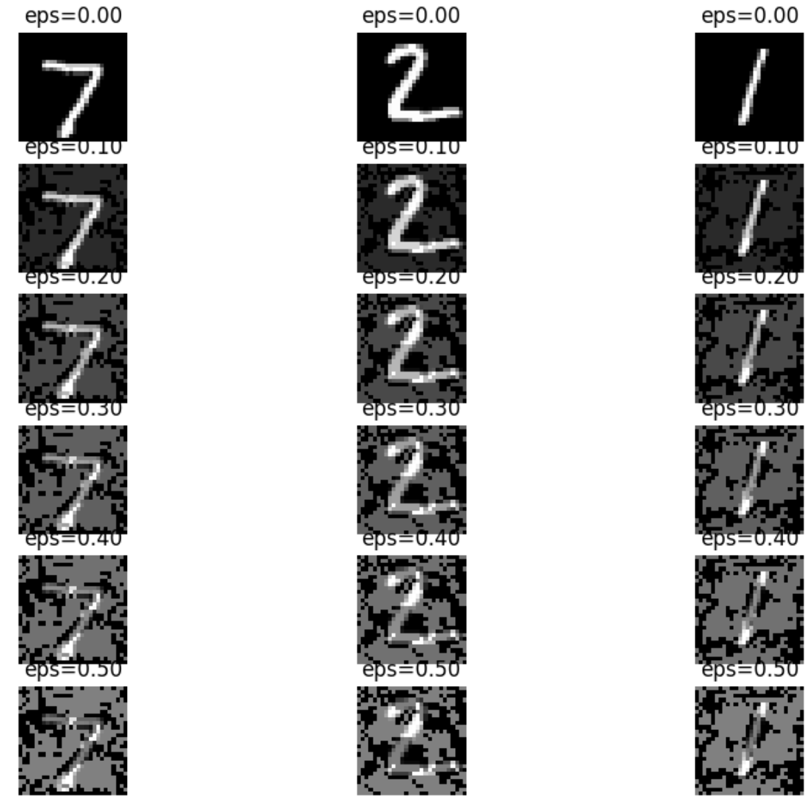
Increasing epsilon distorts further the image
The distortion can be conceived by humans.
There is a trade off between how large epsilon should be and the impact it may have on the AI model.

Slide 26
The model misclassifies adversarial images

Slide 27
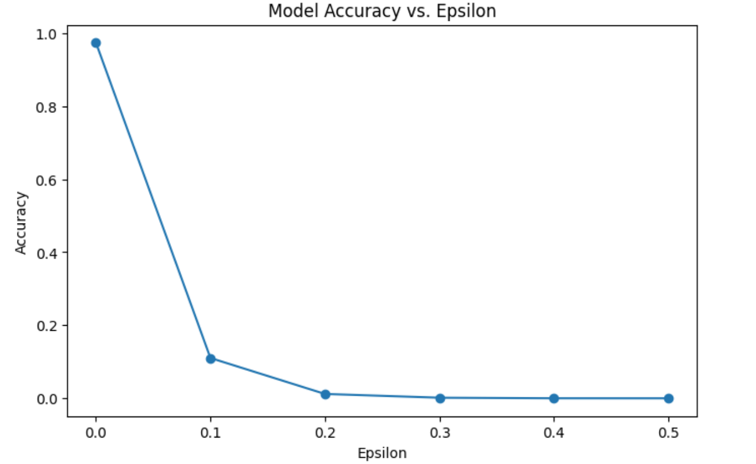
Accuracy vs Epsilon

Slide 28
Case Study: FGSM in MNIST Dataset
The model misclassifies the input image "7" as "3". The attack is successful.

Slide 29
ε=0.3

Slide 30
Defense Mechanisms against Evasion Attacks
Adversarial training
Defensive distillation
Gradient Masking

Slide 31
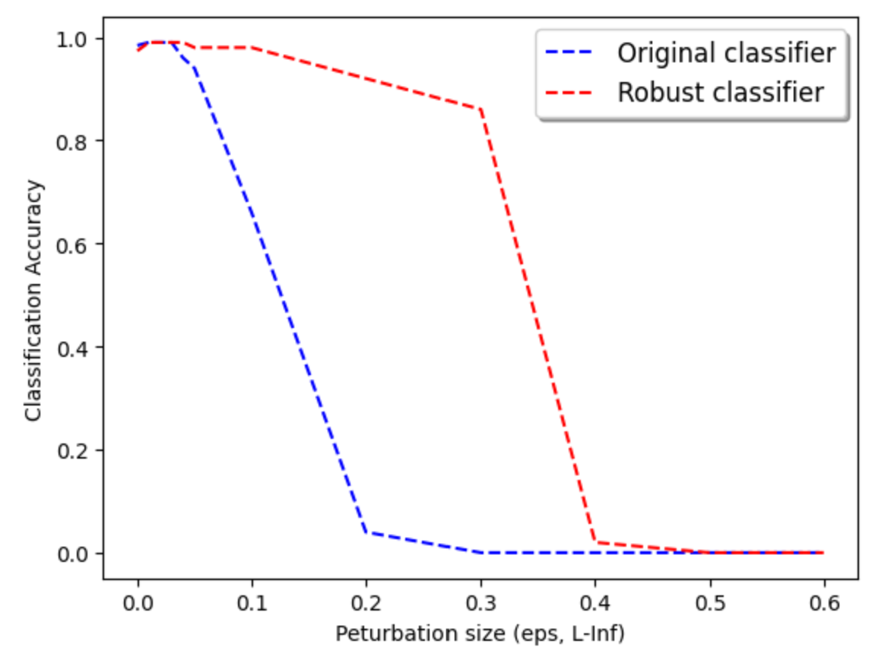
Adversarial Training
Adversarial Training aims to make the model more robust by incorporating adversarial examples into the training process.
Expose the model to the kinds of perturbations it might encounter in real-world attacks, so it learns to recognize and correctly classify inputs that have perturbations.
You are expecting to see the following behavior:
Image from: https://nbviewer.org/github/Trusted-AI/adversarial-robustness-toolbox/blob/main/notebooks/adversarial_training_mnist.ipynb

Slide 32
Exploratory Attacks
Exploratory Attack | Description | Methods | Defense Mechanism
Model extraction | Replicate a target model by querying it and observing the outputs | Querying repeatedly the model, training a new model on the queries and outputs | Limiting number of queries
Membership Inference | Determine if a particular data point was part of the model’s training set | Querying the model with data points and analyzing confidence scores | Differential Privacy, limiting model confidence outputs
Model inversion | Reconstruct input data or extract sensitive information about the training data | Analyzing output distributions to infer inputs | Differential Privacy, restricting access to model outputs
Sethi, T. S., & Kantardzic, M. (2017). Data Driven Exploratory Attacks on Black Box Classifiers in Adversarial Domains. arXiv preprint arXiv:1703.07909.

Slide 33
Transferability Attacks
Use adversarial examples crafted on one model to fool another
Transferability Attack
Gradient-based methods (FGSM, BIM) | Use gradient-based techniques on the source model to create adversarial examples. | Cause the target model to misclassify inputs. | Adversarial training
Optimization methods (C&W) | Use optimization techniques to craft robust adversarial examples that transfer well. | Generate adversarial examples that transfer across models. | Adversarial training
Ensemble methods | Combine adversarial examples from multiple source models | Creating adversarial examples using multiple source models | Ensemble defenses, adversarial training
Papernot, N., McDaniel, P., & Goodfellow, I. (2016). Transferability in machine learning: from phenomena to black-box attacks using adversarial samples. arXiv preprint arXiv:1605.07277.

Slide 34
Data Poisoning Attacks
The attacker inserts malicious samples into the training dataset.
Data poisoning attack | Description | Defense Mechanism
Backdoor/Trojan Attack | Inserts a “Backdoor” to training data (“trigger”) to produce specific incorrect outputs when the triggers are activated. | Data sanitization, anomaly detection
Offline data poisoning | Modifying, deleting or inserting training examples | Anomaly detection, statistical testing
Black-box poisoning | Introducing poisoned data without knowledge of the model’s parameters. | Data sanitization, ensemble methods

Slide 35
Backdoor Attacks / Trojan Attacks
The attacker has access to the training dataset.
Inserts a “Backdoor” to training data (“trigger”) to produce specific incorrect outputs when the triggers are activated.
The “trigger” can be a small pattern, such as a specific pixel arrangement to a subset of the training data, and labels these images as a specific class.
The model is trained on the combined dataset of clean and poisoned images.
During inference, any image that contains the trigger pattern is misclassified according to the designated label, regardless of its input.
Defense mechanism:
Anomaly detection methods to identify and remove poisoned samples containing backdoor triggers
Data inspection, Model auditing
Dynamic Backdoor Attacks Against Machine Learning Models

Slide 36
Image from: Salem, A., Wen, R., Backes, M., Ma, S., & Zhang, Y. (2022, June). Dynamic backdoor attacks against machine learning models. In 2022 IEEE 7th European Symposium on Security and Privacy (EuroS&P) (pp. 703-718).

Slide 37
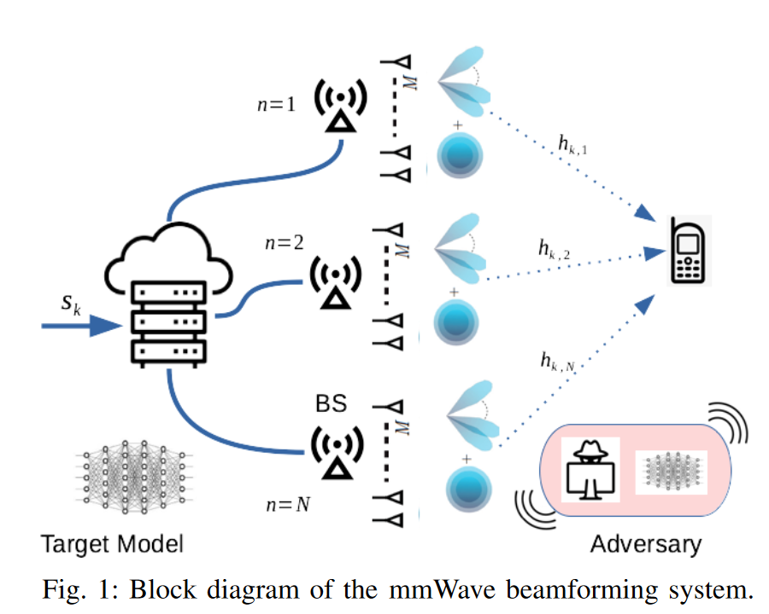
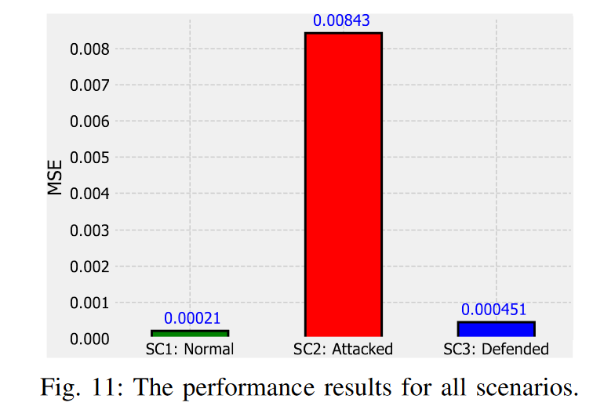
Adversarial Example on Beam Prediction
Catak et al. showcased FGSM & adversarial training in a mmWave environment
Deep Learning for predicting RF beamforming vectors – used for beam prediction & management in mmWave
The authors use FGSM for attacking the DL model
Adversarial training is used to defend the model
The results show increased MSE for the undefended system under FGSM attack
Comparable achievable rate for system with adversarial training compared to the baseline (no attack-no defense)
Images from : Catak, E., Catak, F. O., & Moldsvor, A. (2021). Adversarial Machine Learning Security Problems for 6G: mmWave Beam Prediction Use-Case. arXiv preprint arXiv:2103.07268.

Slide 38
Summary
Different assumptions for each attack type
Integrating/Using AI/ML into wireless communications tasks opens a new attack surface for cellular networks
Different defense mechanisms should be provisioned across the ML pipeline
The field is rich of adversarial techniques – Begin from the foundations

Slide 39
AI-driven attacks

Slide 40
AI-Driven Attacks
Phishing
Social engineering
Vulnerability exploitation

Slide 41
Penetration Testing is
Reconnaissance
Gather information about the target system
Scanning & Enumeration
Identify open ports, services, potential entry points
a simulated cyber attack against a computer system, network, or web application to identify security vulnerabilities that an attacker could exploit.
Exploitation
Exploit identified vulnerabilities
Post-Exploitation
Maintain access, privilege escalation

Slide 42
Reinforcement Learning for Pen Testing
How AI can identify and exploit vulnerabilities
Examples of automated attacks

Slide 43
Reinforcement Learning Concepts
Term | Description
Agent | The RL agent interacts with the environment
Environment | Everything the agent interacts with and learns about.
Actions | The set of all possible moves or decisions the agent can make.
Policy | A strategy or mapping from states to actions.
State | A representation of the current situation of the environment.
Reward | Feedback to the agent: positive if the agent made the correct decision, negative if the agent made a mistake.

Slide 44
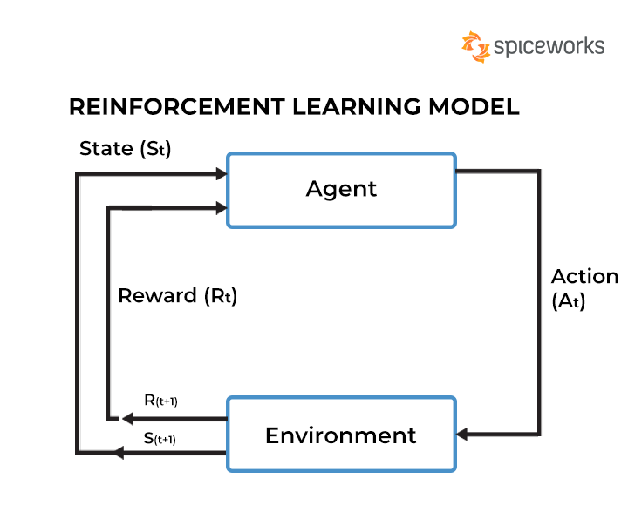
Image Source: https://www.spiceworks.com/tech/artificial-intelligence/articles/what-is-reinforcement-learning/

Slide 45
Case Study: Automated Penetration Testing Frameworks
Proposed by Jonathon Swartz^{1,2}: Automate pentesting to reduce manual effort and specialized expertise
Model-free RL: No environment model, the agent learns an optimal policy for selecting actions through interactions with the environment
How to model attacks against a system: Markov Decision Process (MDP)
MDP is defined through:
State Space, S {all the possible configurations of the target machines}
Action Space, A {all the possible exploits or scans}
Transition function, T {controls the result of the actions}
Reward Function, R {based on action cost and value gained when compromising a system}
1) Jonathon Schwartz, Autonomous Penetration Testing using Reinforcement Learning, BSc Thesis, University of Queensland, 2018, 1905.05965 (arxiv.org)
2) GitHub - Jjschwartz/NetworkAttackSimulator: An environment for testing AI pentesting agents against a simulated network.

Slide 46
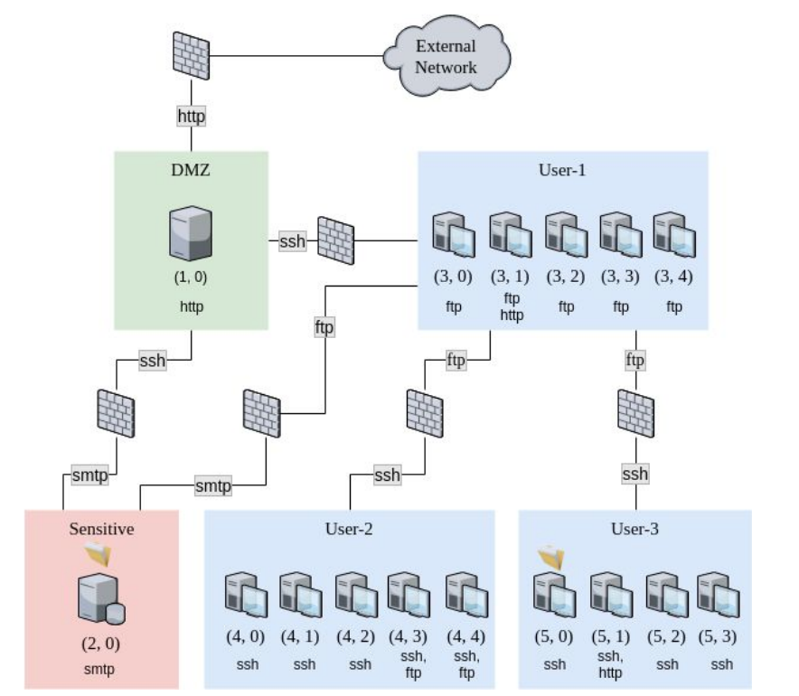
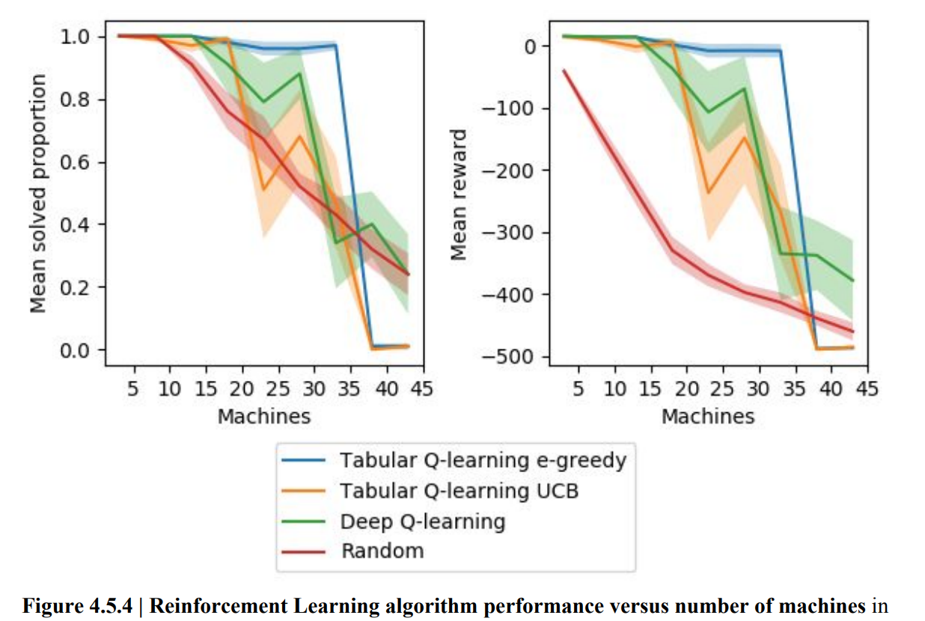
Case Study: Automated Penetration Testing Frameworks
Use Q-learning and DQN
Different scenarios were evaluated
All RL algorithms found an attack policy that led to compromise sensitive machines
But: the performance of the algorithms dropped beyond certain numbers of network size.
This was attributed to the pre-defined training time (2 minutes)
Increasing training time would increase performance:
But how scalable is this in the real-world?
How rapidly to update the system (given new exploits and services) ?
Promising approach with existing limitations
Jonathon Schwartz, Autonomous Penetration Testing using Reinforcement Learning, BSc Thesis, University of Queensland, 2018, 1905.05965 (arxiv.org)
GitHub - Jjschwartz/NetworkAttackSimulator: An environment for testing AI pentesting agents against a simulated network.

Slide 47
AI-based Detection

Slide 48
Concepts
AI-Based Detection: Utilizing machine learning to detect anomalies and threats.
Real-Time Monitoring: Continuous observation of network traffic and behavior.
Anomaly Detection: Identifying patterns that deviate from the norm, indicating potential threats.

Slide 49
Intrusion Detection Systems
Signature-based:
Identify patterns (e.g., malware)
Anomaly detection based
Can use machine learning

Slide 50
Methodologies
Supervised learning:
Labeled dataset with benign and malicious samples
Detect specific attacks like malware and DDoS
Naïve Bayes, Decision Trees, SVM, ANNs (CNN)
Unsupervised learning:
Find patterns representing anomalous behavior
Potentially detect new attacks
K-Means, Autoencoders

Slide 51
Dataset Availability
There are many datasets for intrusion detection
But often they resemble enterprise networks
There are existing works with attacks against 5G networks:
National Centre of Scientific Research "Demokritos", & Space Hellas (Greece). (2024). NCSRD-DS-5GDDoS: 5G Radio and Core metrics containing sporadic DDoS attacks (1.0) [Data set]. Zenodo. https://doi.org/10.5281/zenodo.10671494
Sehan Samarakoon, Yushan Siriwardhana, Pawani Porambage, Madhusanka Liyanage, Sang-Yoon Chang, Jinoh Kim, Jonghyun Kim, Mika Ylianttila, December 2, 2022, "5G-NIDD: A Comprehensive Network Intrusion Detection Dataset Generated over 5G Wireless Network", IEEE Dataport, doi: https://dx.doi.org/10.21227/xtep-hv36.
We can inspect cellular specific features, like signaling information, patterns of users/devices
https://github.com/shramos/Awesome-Cybersecurity-Datasets

Slide 52
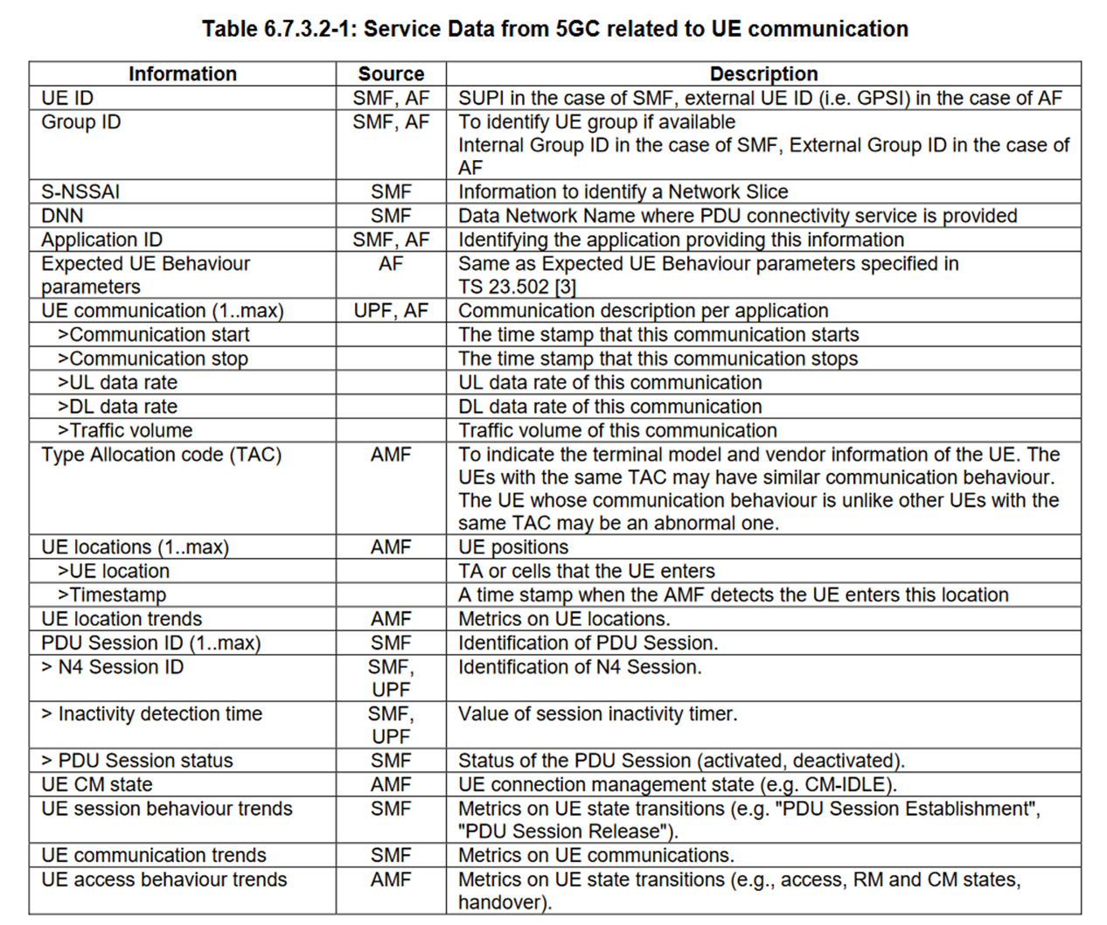
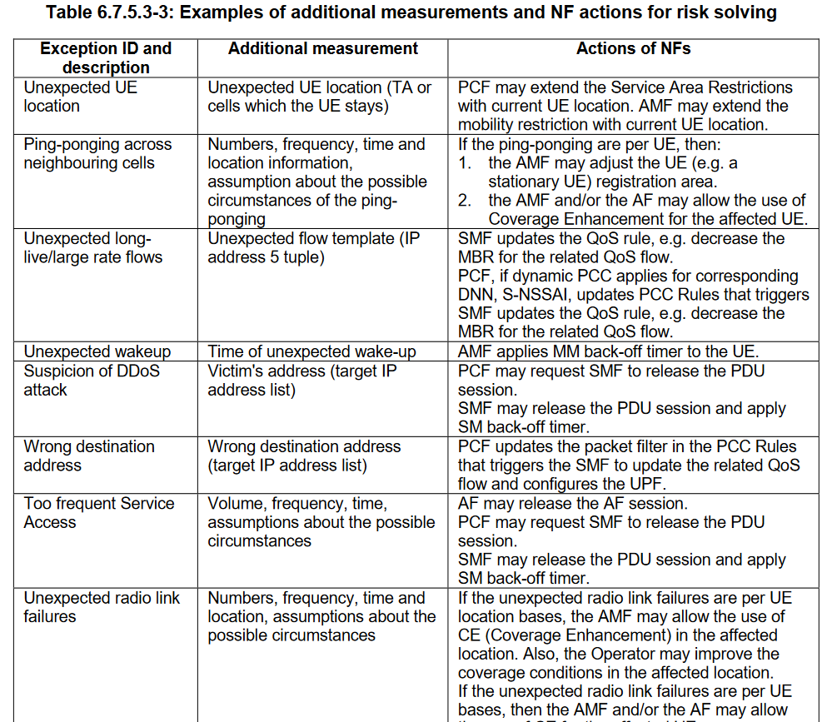
Anomaly Detection in the 3GPP (NWDAF)
3GPP, TS 23.288 V16.4.0, Technical Specification Group Services and System Aspects; Architecture enhancements for 5G System (5GS) to support network data analytics services (Release 16)

Slide 53
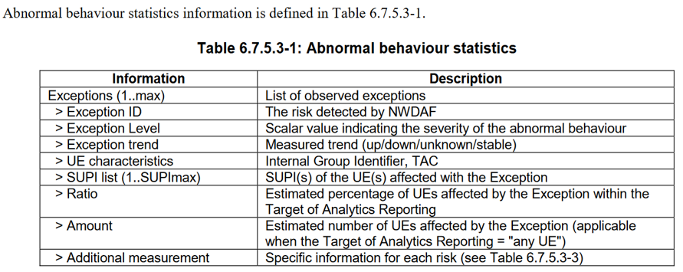
NWDAF Output Analytics for Abnormal UE behavior
3GPP, TS 23.288 V16.4.0, Technical Specification Group Services and System Aspects; Architecture enhancements for 5G System (5GS) to support network data analytics services (Release 16)

Slide 54
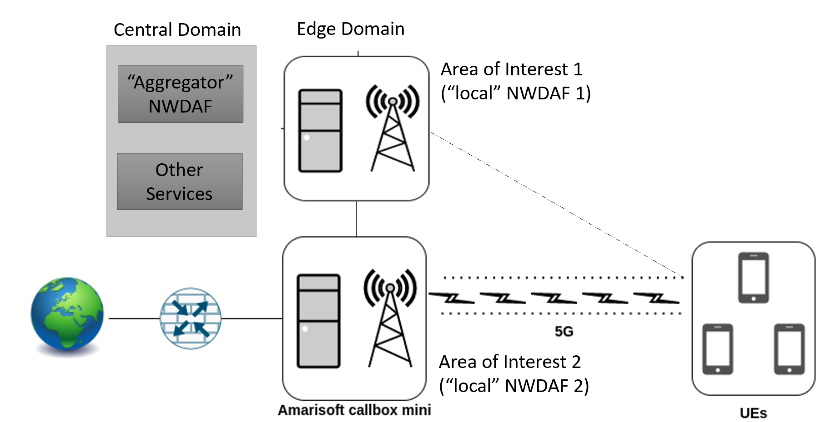
NWDAF Federated Deployment (3GPP Rel. 17)
From 3GPP TR 23.700-91 V17.0.0, Technical Specification Group Services and System Aspects; Study on enablers for network automation for the 5G System (5GS); Phase 2 (Release 17)

Slide 55
Future Trends towards 6G

Slide 56
Future Trends towards 6G
Adaptive defense mechanisms:
Adapt to new threats
Increase resilience
Moving Target Defense paradigm
Transparency and interpretability of AI-based solutions
Adversarial Attacks:
Training with resilience of AI systems in mind
Privacy Enhancing Technologies:
User privacy in 6G (pervasive use cases)
Differential Privacy for protecting data

Slide 57
Q&A Session
Open floor for questions and discussion

Slide 58
Thank you
maria.christopoulou@iit.demokritos.gr
www.linkedin.com/in/mariachristopoulou

