Slide 1
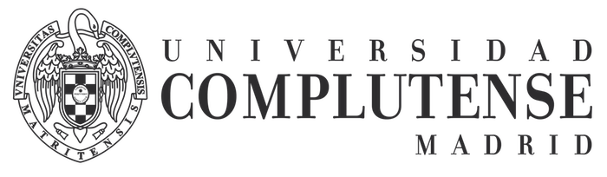
First Summer School on Security and Privacy in 6G Networks
  CLOUD AND DATA CYBERSECURITY ISSUES CONSIDERING 6G
Robson de Oliveira Albuquerque
University of Brasília
Faculty of Computer Science and Engineering, UCM
Madrid (Spain), June 24 - 28, 2024

Slide 2
AGENDA
6G and the CLOUD
CLOUD CYBERSECURITY
CLOUD DATA SECURITY

Slide 3
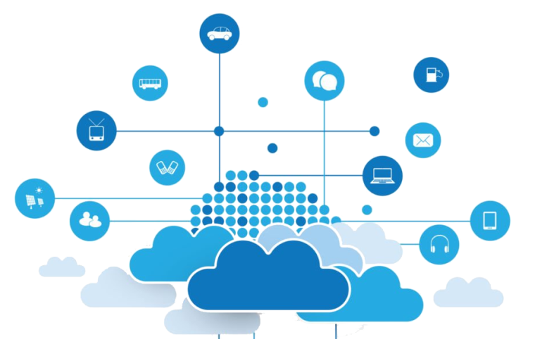
6G and the CLOUD
Not yet defined
Different approaches
Too many issues to address in a single architecture
Expect huge amount of data by the second...
https://www.6g-cloud.eu/

Slide 4
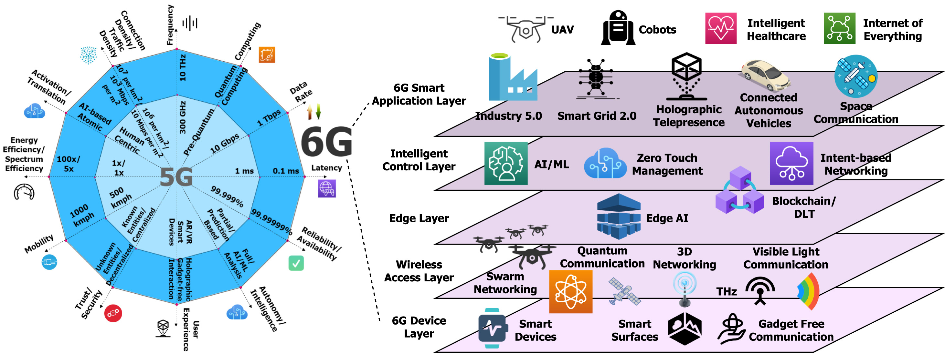
6G and the CLOUD
https://www.sciencedirect.com/science/article/pii/S2405959522001485

Slide 5

6G and the CLOUD
Key concepts and elements:
AI-native and cloud-friendly 6G system architecture
  end-to-end service-oriented 6G network atop multi-stakeholder cloud environment
  last mile into a truly cloud-native experience
https://www.linkedin.com/pulse/navigating-final-frontier-unlocking-strategic-value-last-vempati-43qqc/
https://www.6g-cloud.eu/

Slide 6
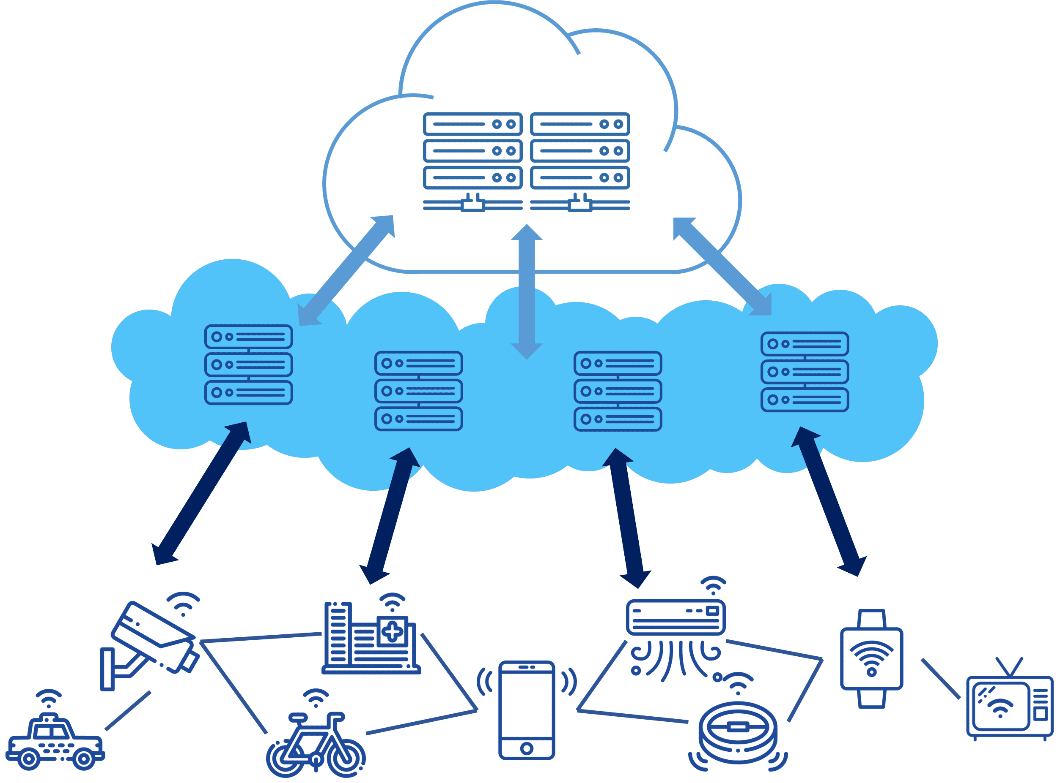
6G and the CLOUD
Key concepts and elements:
Cloud Continuum Framework
  resource management
  exposure with relevant business interfaces
  flexible network composition of RAN-Core-Edge-Extreme-Edge networks
CLOUD
EDGE NODES
EDGE DEVICES
https://www.6g-cloud.eu/
https://devopedia.org/edge-computing

Slide 7

6G and the CLOUD
Key concepts and elements:
  dynamic multi-tenant environment.
    support accounting,
    service level agreements,
    security,
    reliability,
    trust,
    energy efficiency
  Try to offer intelligence to network functions
https://www.6g-cloud.eu/

Slide 8
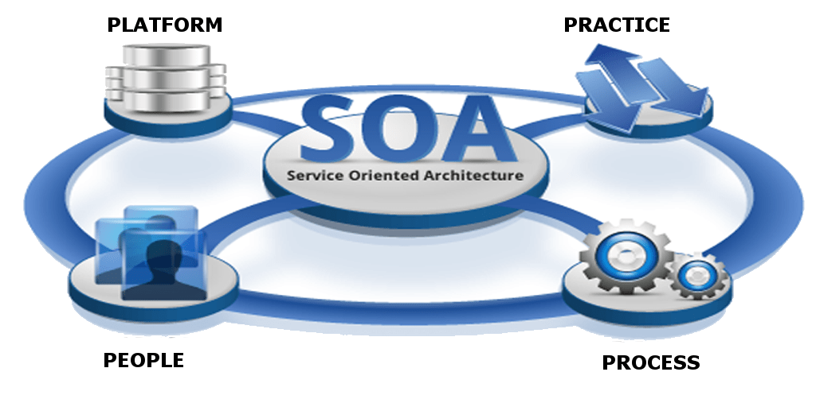
6G and the CLOUD
Key concepts and elements:
service-oriented design
end-to-end 6G service-based considering integrated RAN and core
network-of-networks scenario.
A sort of evolution of...
https://francescolelli.info/service-oriented-enterprise-soe/
https://www.6g-cloud.eu/

Slide 9

6G and the CLOUD
Key concepts and elements:
distributed management and orchestrated framework
  deployment, modification, or termination of networks or applications by AI
https://cyware.com/security-guides/cyber-fusion-and-threat-response/security-orchestration-automation-and-response-soar-in-cyber-fusion-7403
https://www.6g-cloud.eu/

Slide 10
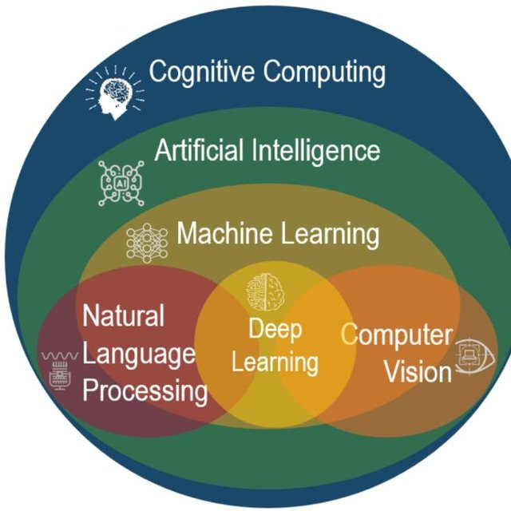
6G and the CLOUD
Key concepts and elements:
native and network digital twin-enabled AI/ML
overarching cognitive plane
  data collection interfaces and functions,
  AI/ML model management,
  model training
  model distribution
http://jb7.sanyan.fr/a.aspx?cid=141&cname=cognitive+learning+ai
https://www.6g-cloud.eu/

Slide 11
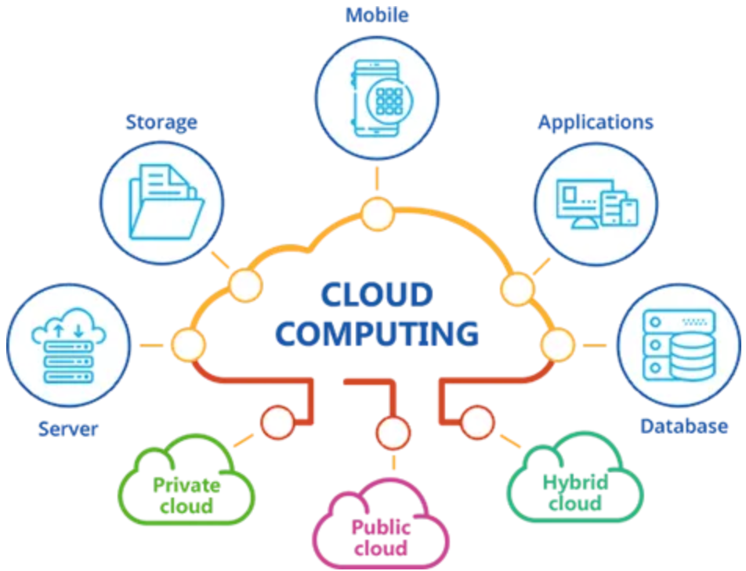
6G and the CLOUD
Key concepts and
elements:
open programable control framework
  network functions
  provision network and cloud resources,
  offer interfaces and control mechanisms
  integrate with third-party control apps.
https://medium.com/@zkaya245/introduction-for-cloud-%EF%B8%8F-1-638e5f050fe
https://www.6g-cloud.eu/

Slide 12
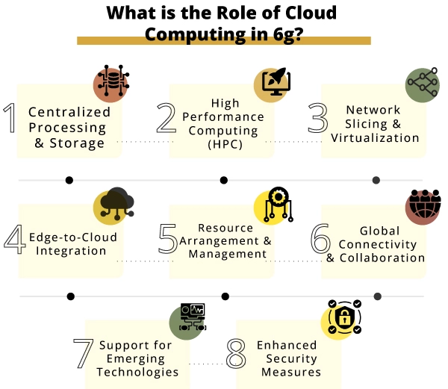
6G and the CLOUD
https://www.conurets.com/how-cloud-and-edge-computing-shape-6g-technology/

Slide 13
AGENDA
6G and the CLOUD
CLOUD CYBERSECURITY
CLOUD DATA SECURITY

Slide 14

CLOUD ARCHITECTURE
Main Technologies for Cloud
Virtualization:
Virtualized computer
Old computers
Application
Application
Operating
System
Operating
System
Hypervisor
Hardware
Hardware

Slide 15
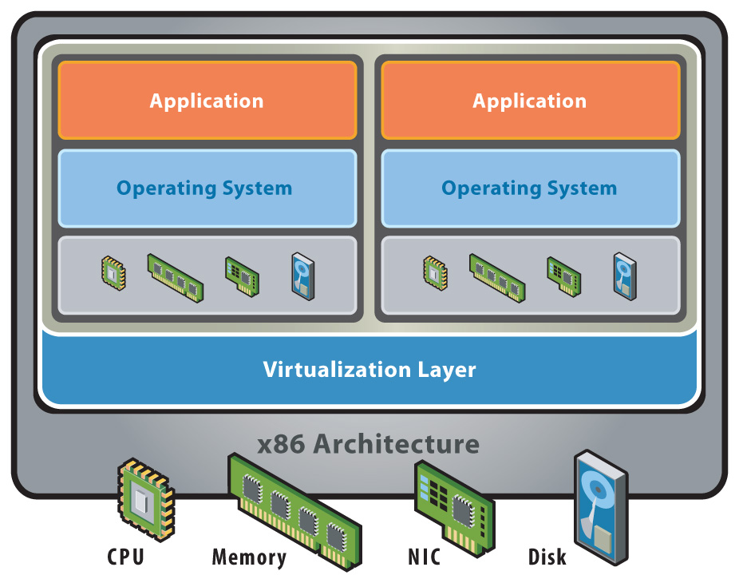
CLOUD ARCHITECTURE
Main Technologies for Cloud
Virtualization:

Slide 16
CLOUD ARCHITECTURE
Main Technologies for Cloud
Virtualization:
Application
Application
Move…
Application
Application
Application
Application
Operating
System
Operating
System
Operating
System
Operating
System
Operating
System
Operating
System
Hypervisor
Hardware
Hardware

Slide 17
CLOUD ARCHITECTURE
Main Technologies for Cloud
Anatomy:
Applications
Services
Platform
Services
Infrastructure
Services

Slide 18
CLOUD ARCHITECTURE
Main Technologies for Cloud
CLIENTS
SERVICES
APPLICATIONS
PLATFORMS
STORAGE
INFRASTRUCTURE
CLOUD SERVICE
(EG QUEUE)
CLOUD PLATFORM
(EG WEB FRONTEND)
CLOUD INFRASTRUCTURE
(EG BILLING VMs)
CLOUD STORAGE
(eg Databases)
Layers
Architecture

Slide 19
CLOUD ARCHITECTURE
Main Technologies for Cloud
Individuals
Corporations
Non-Commercial
Government
Cloud Middle Ware
Storage
Provisioning
OS
Provisioning
Network
Provisioning
Service(apps)‏
Provisioning
SLA(monitor),
Security, Billing,
Payment
Resources
Services
Storage
Network
OS

Slide 20
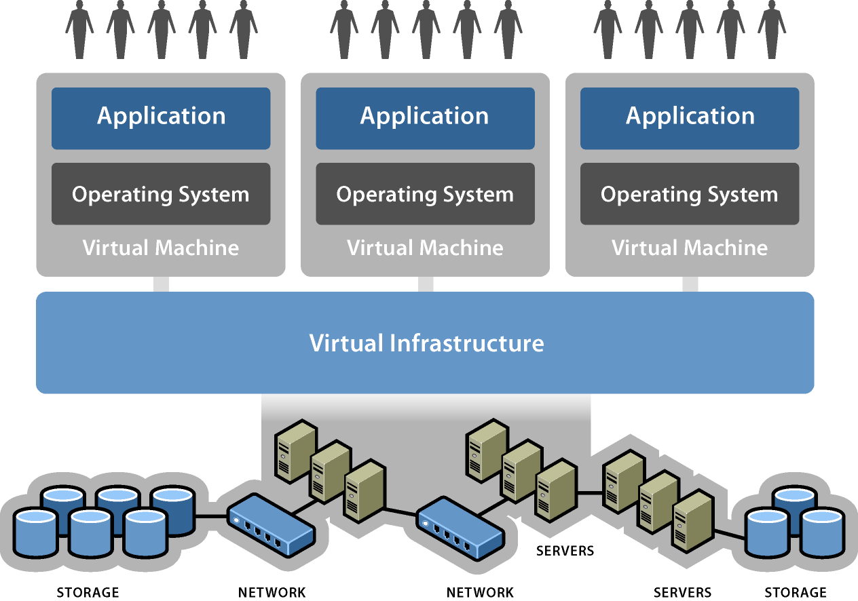
CLOUD ARCHITECTURE
Main
Technologies
for Cloud

Slide 21
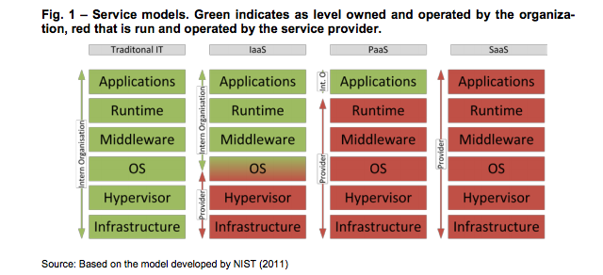
SERVICE MODELS

Slide 22
SERVICE MODELS
IaaS
ARCHITECTURE

Slide 23
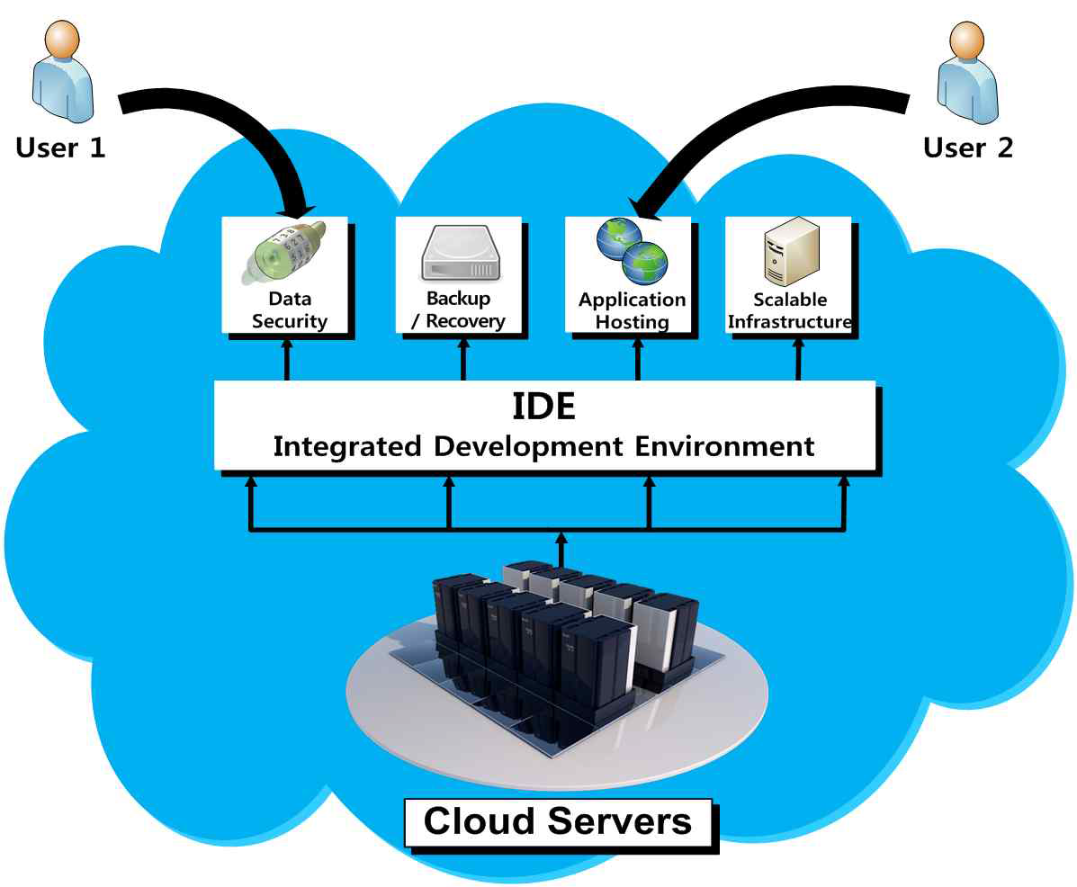
SERVICE MODELS
PaaS
Provides a program
executable platform for
applications,
development tools, etc.;
Provides runtime
environment for apps;

Slide 24
SERVICE MODELS
PaaS
Types
Application Delivery-Only Environment
Stand Alone Development Environment
Add-on Development Facilities
Open Platform as a Service

Slide 25
SERVICE MODELS
Operating System
PaaS
PaaS
Development
Platform
Database
Middleware

Slide 26
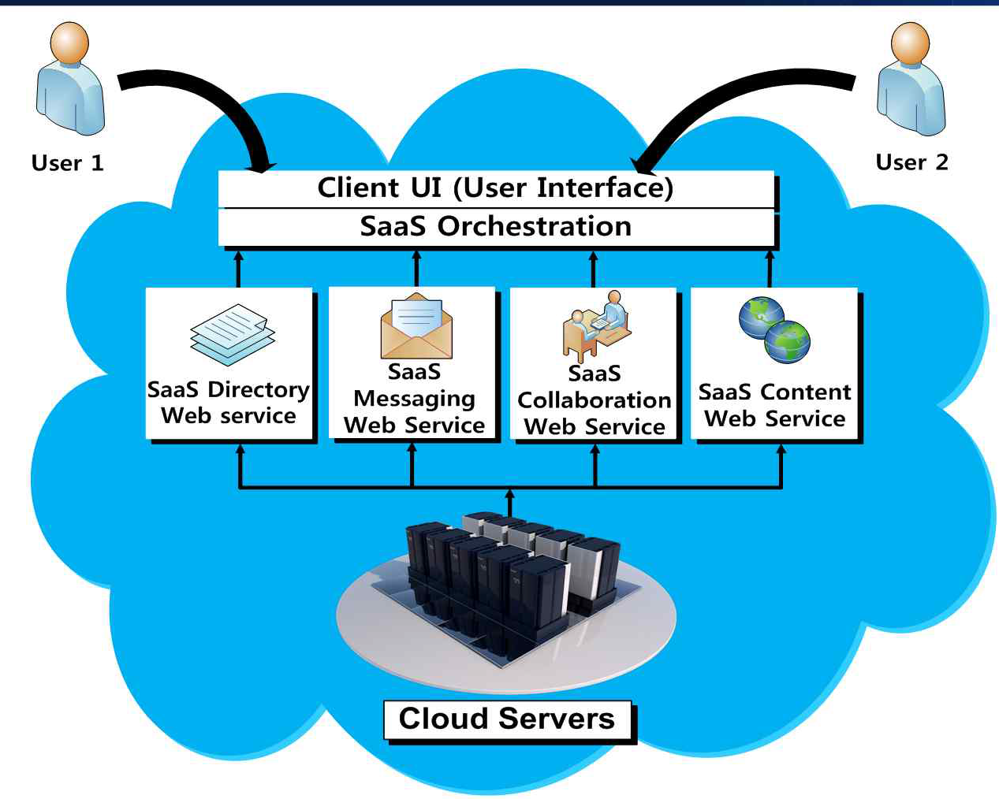
SERVICE MODELS
SaaS

Slide 27
SERVICE MODELS
Service Extensions
XaaS = Anything as a Service
    NaaS ➔ N for Network as a Service
    DaaS ➔ D for Database as a Service
    BaaS ➔ B for Business as a Service

Slide 28
SERVICE MODELS
Service Extensions
XaaS = Anything as a Service
    DRaaS ➔ DR for Disaster Recovery as a Service;
    CaaS ➔ C for Communications as a Service
DaaS ➔D for Desktop as a service
PCaaS ➔ PC for Personal Computer as a service

Slide 29
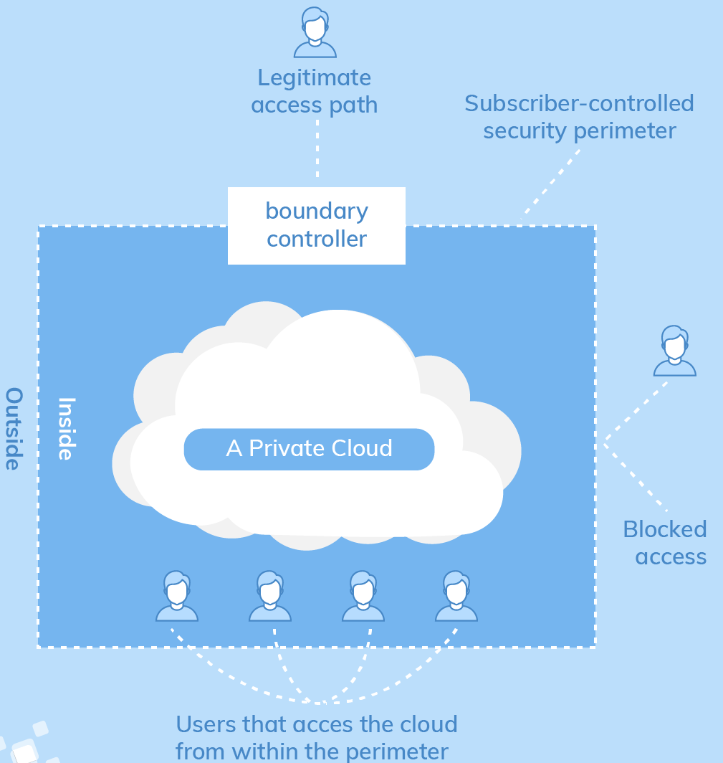
CLOUD TYPES
Private Cloud

Slide 30
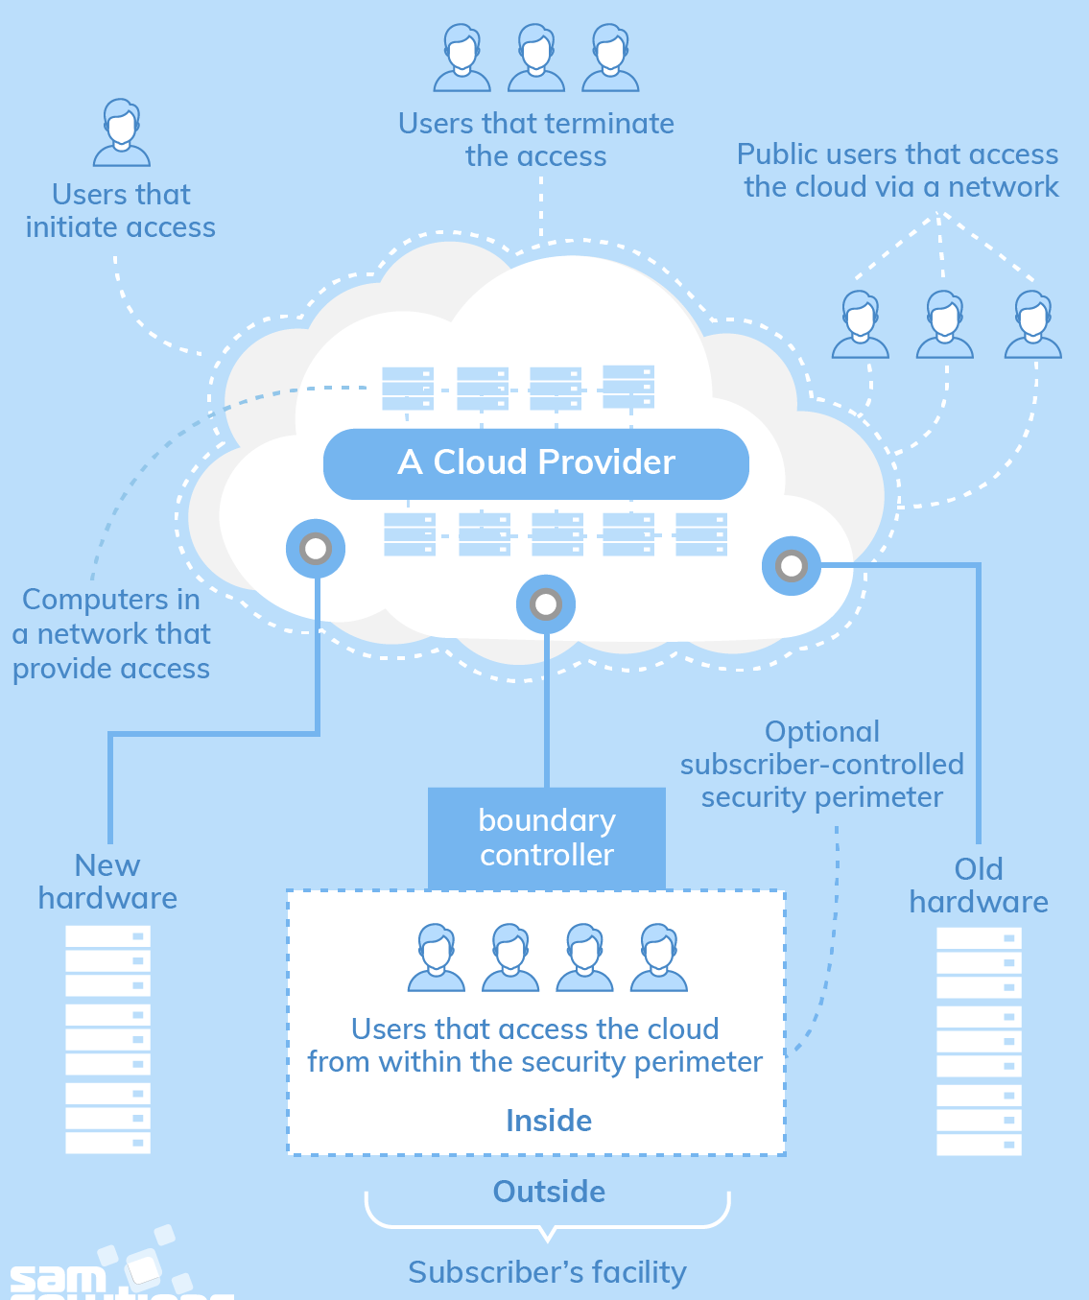
CLOUD TYPES
Public Cloud

Slide 31
CLOUD TYPES
Public Cloud
      Question:
      Due to its public nature, do you think a public cloud is said to be less secure?

Slide 32
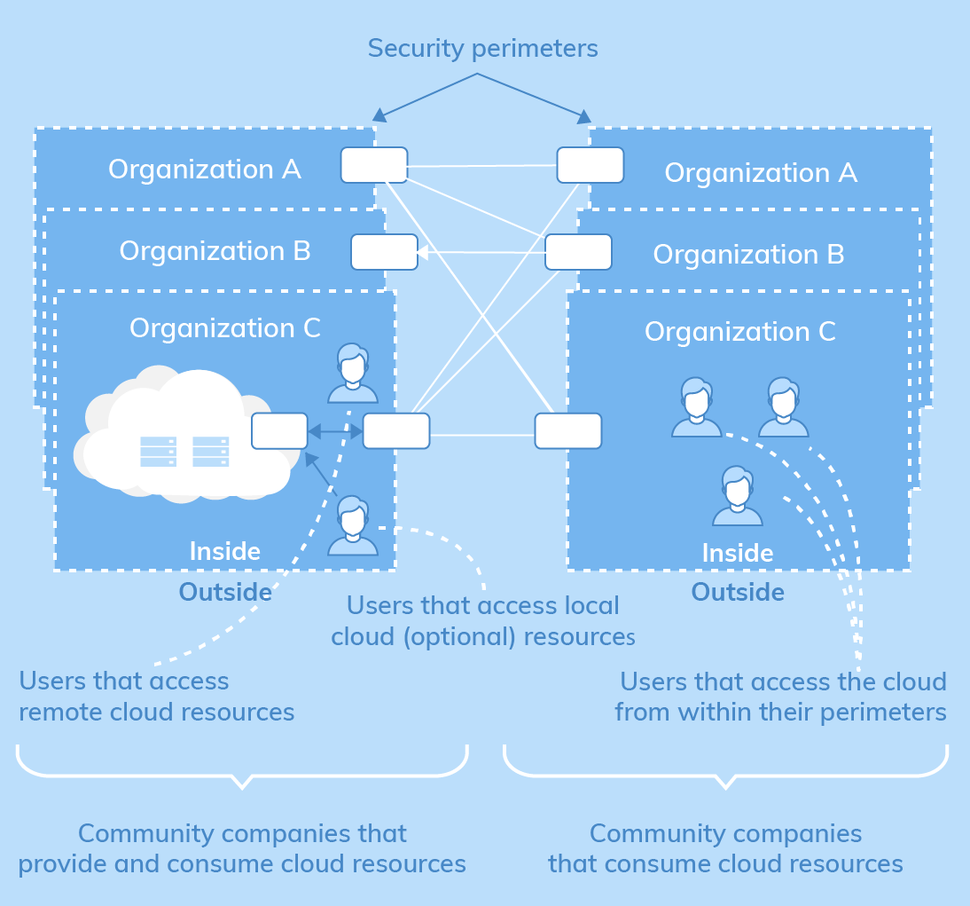
CLOUD TYPES
Community
Cloud

Slide 33
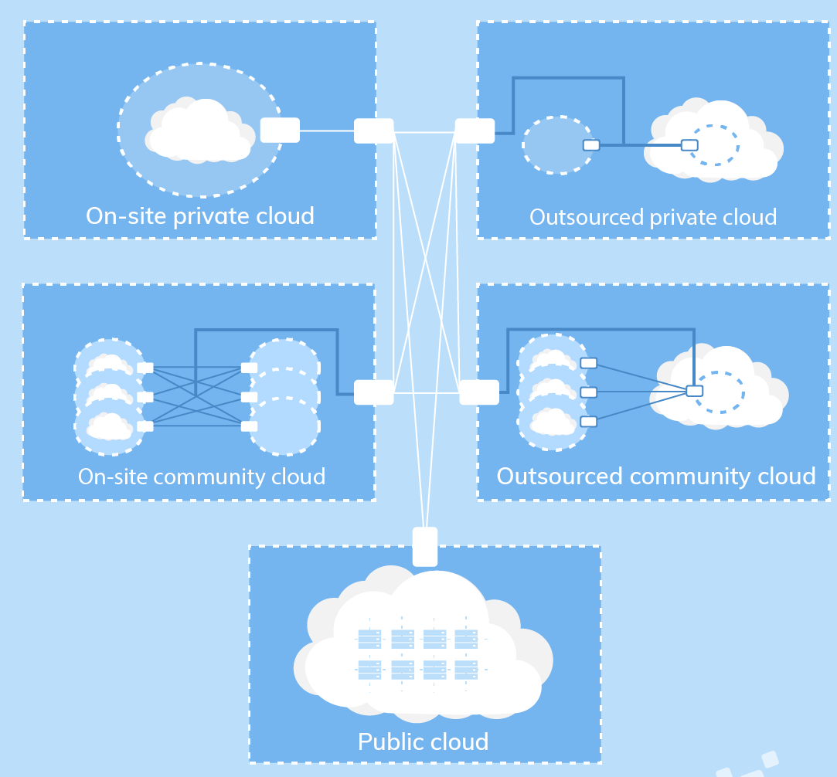
CLOUD TYPES
Hibrid Cloud

Slide 34
CLOUD TYPES
Resume

Slide 35
Context of Problems x Security
Basically Cloud rely on:
    Connectivity;
    network access;
    data distribution;
Security issues are raised:
    The anything conected concept

Slide 36
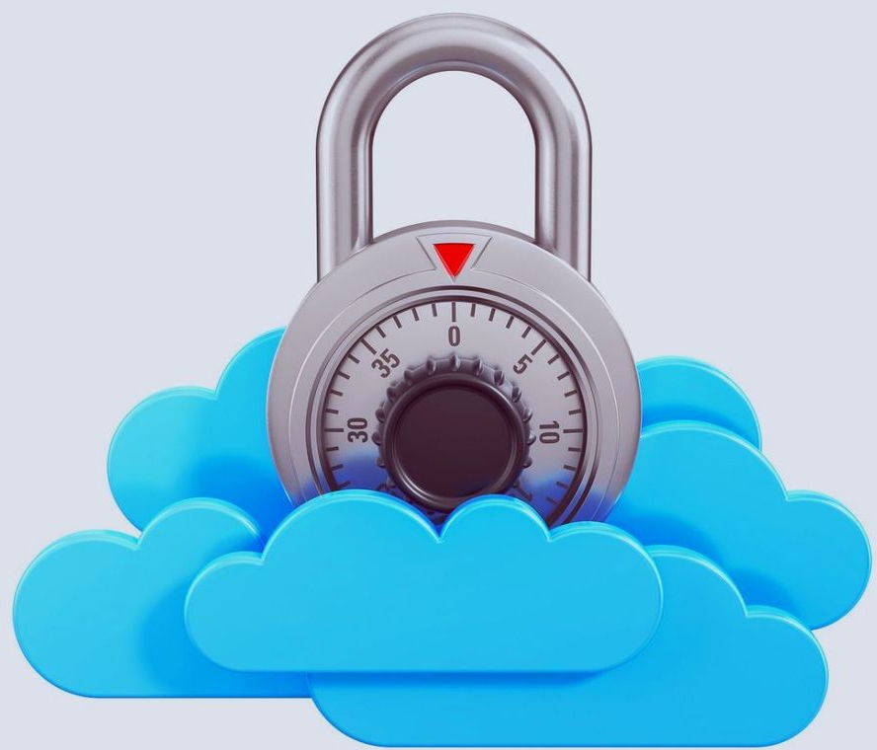
Context of Problems x Security
Adoption of cloud computing:
    Solutions coping with cloud security threats need to be addressed;
    Lacking trust between service providers and cloud users;
    Lack of privacy protection;
    Security assurance;
    Copyright protection;

Slide 37
Context of Problems x Security
Cloud poses:
    new security threats;
    more difficulty to contain than the traditional client and server approach;
Cloud demands protection of:
    servers from malicious software attacks (worms, viruses, and malwares);
    hypervisors or VM monitors from software based attacks and vulnerabilities;

Slide 38
Context of Problems x Security
Cloud demands protection of:
    VMs and monitors from service disruption and denial of service attacks;
    data and information from theft, corruption and natural disasters;
Cloud should provide:
    authenticated and authorized access to critical data and services;

Slide 39
Context of Problems x Security
Security Challenges in Virtual Machines:
  network attacks include buffer overflows, DoS, DDoS, spyware, malwares, rootkits, Trojans, worms, etc.;
Newer attacks may be resulted from:
    hypervisor malware;
    guest hopping;
    guest hijacking;
    VMRootKits;
    man-in-the-middle attack for VM migrations;

Slide 40
Context of Problems x Security
Security of all cloud providers varies widely;
Integrating and aligning security programs across a cloud provider and an enterprise is a challenge;
Communication gaps:
    inability to share security event information seamlessly between the two parties.

Slide 41
Context of Problems x Security
Considering security in general:
    3 major security goals:
      Confidentiality;
      Integrity;
      Availability;
    They should be applied to:
      IaaS, PaaS, SaaS;
  Each model brings different security requirements and responsibilities;

Slide 42
Context of Problems x Security
Considering security in general:
    Other security goals:
      Privacy;
      Authenticity;
      Access Control;
      Continous monitoring;
      Authentication and Authorization;
      Etc;

Slide 43
Context of Problems x Security
Security in Cloud is a Big Problem:
How to apply all security requirements to cloud service models?
    Highlight security requirements for cloud-based systems;
    Consider high-level security goals and the services models;
    Consider the deployment models;
    Define of the specific security requirements for a given cloud based solution.

Slide 44
Context of Problems x Security
Security in Cloud is a Big Problem:
How to apply all security requirements to cloud service models?
    Monitor, monitor and monitor;
    Adjust, adjust and adjust;
    Security is never monolitic;

Slide 45
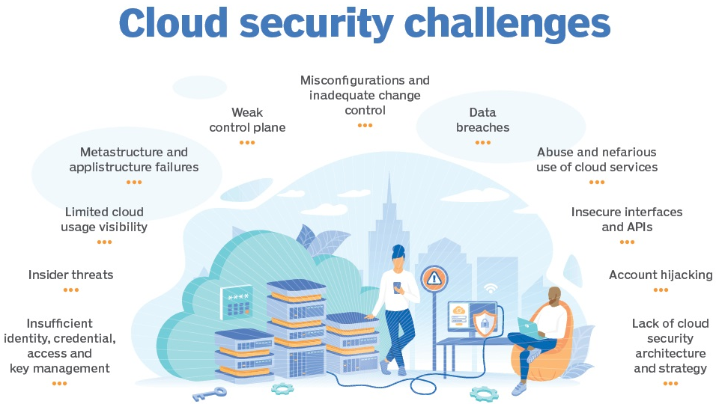
Top Cloud Security Threats
https://forum.huawei.com/enterprise/en/relationship-between-ai-and-privacy/thread/667267821207437313-667213860102352896

Slide 46
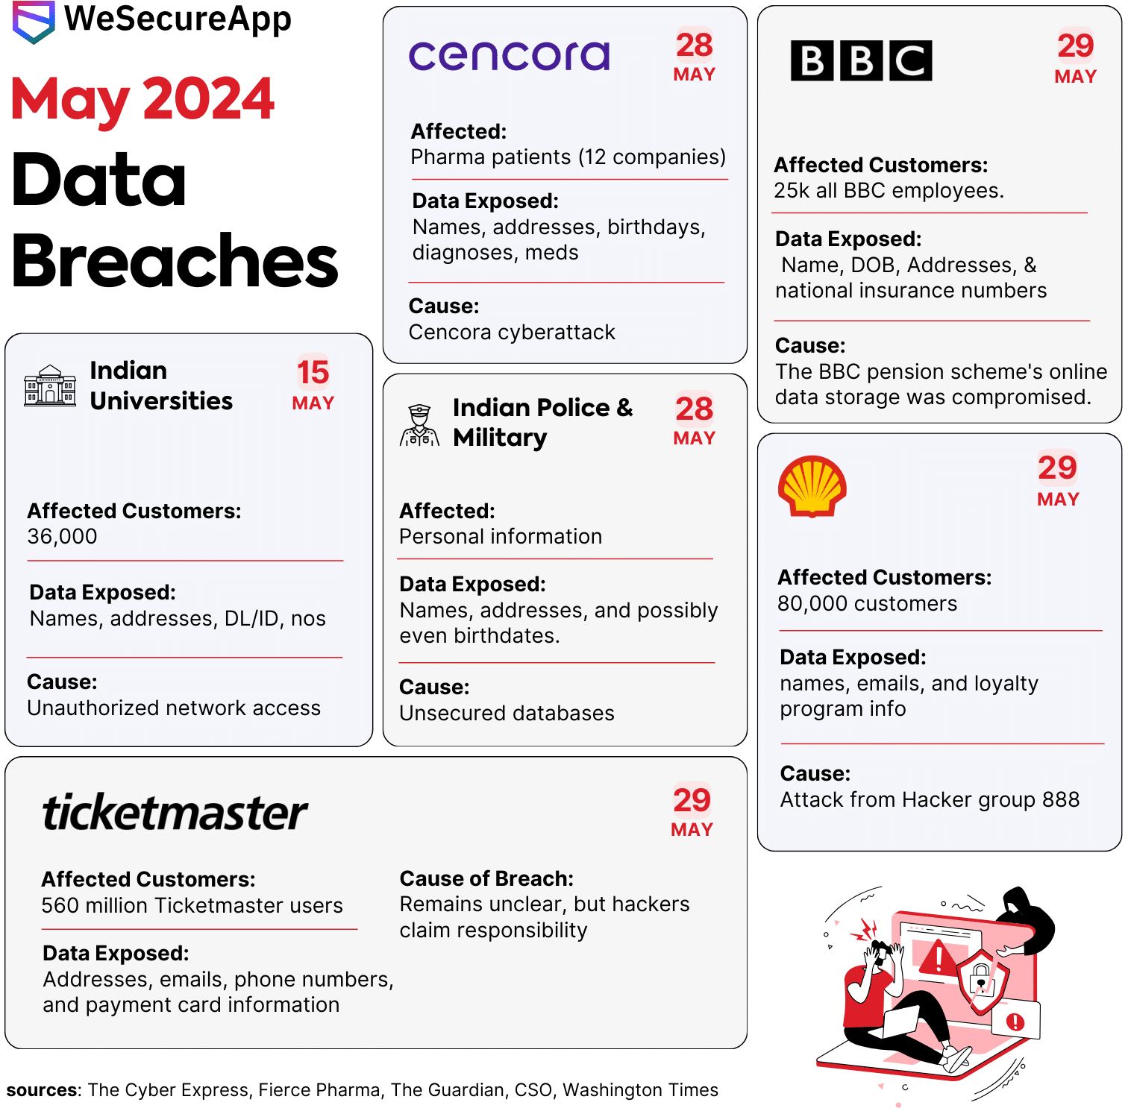
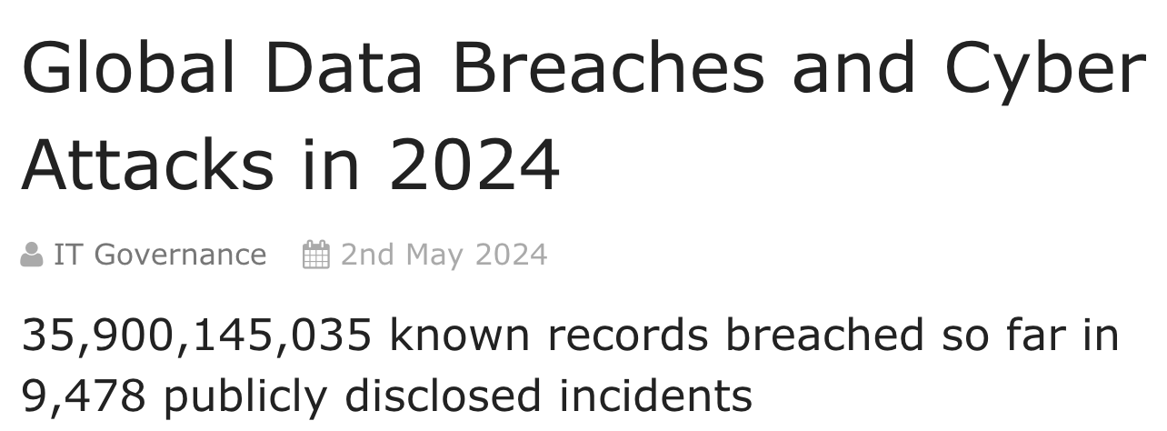
Top Cloud Security Threats
Data Breaches
https://www.itgovernance.co.uk/blog/global-data-breaches-and-cyber-attacks-in-2024
https://wesecureapp.com/blog/data-breaches-in-may-2024-infographic/

Slide 47
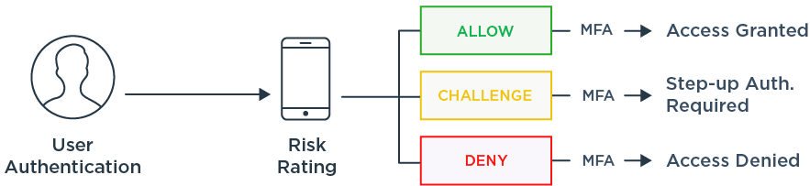
Top Cloud Security Threats
Insufficient Identity, Credential and
Access Management
https://www.pingidentity.com/en/resources/blog/post/everything-you-need-to-know-about-cloud-iam.html

Slide 48
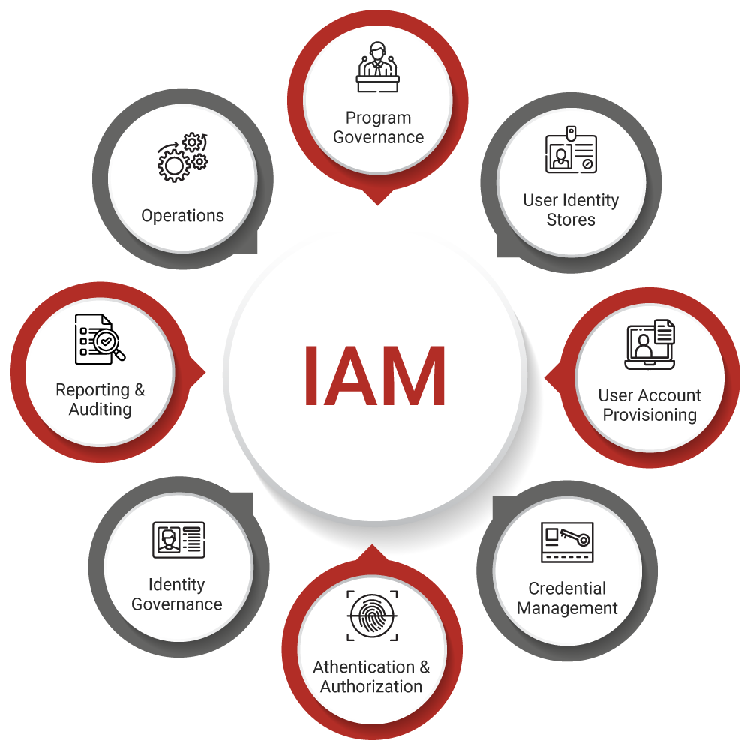
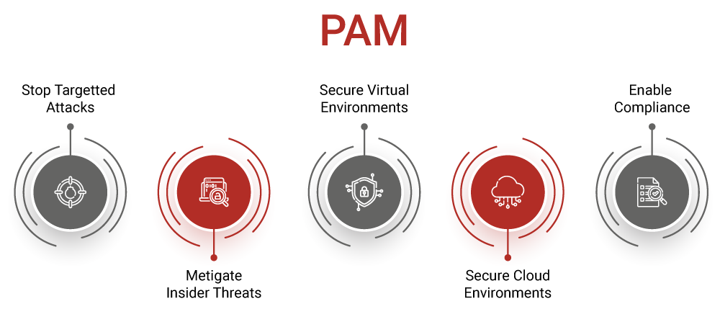
Top Cloud Security Threats
Insufficient Identity, Credential and
Access Management
Privileged Access Management
https://www.securew2.com/blog/iam-vs-pam

Slide 49
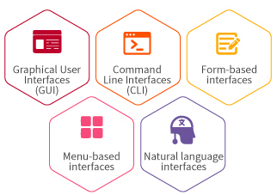
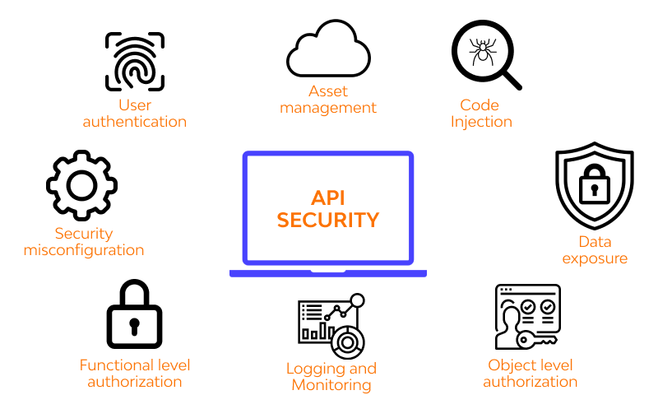
Top Cloud Security Threats
Insecure Interfaces and APIs

Slide 50
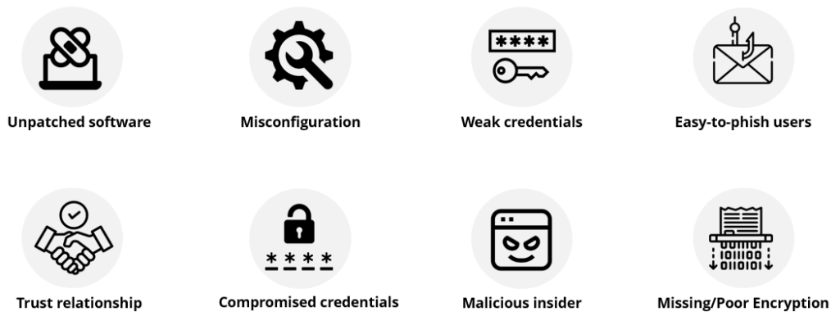
Top Cloud Security Threats
System Vulnerabilities
https://www.balbix.com/insights/what-is-a-vulnerability/

Slide 51

Top Cloud Security Threats
Account Hijacking

Slide 52

Top Cloud Security Threats
Malicious Insiders
https://cyberhoot.com/cybrary/malicious-insider-incident/

Slide 53
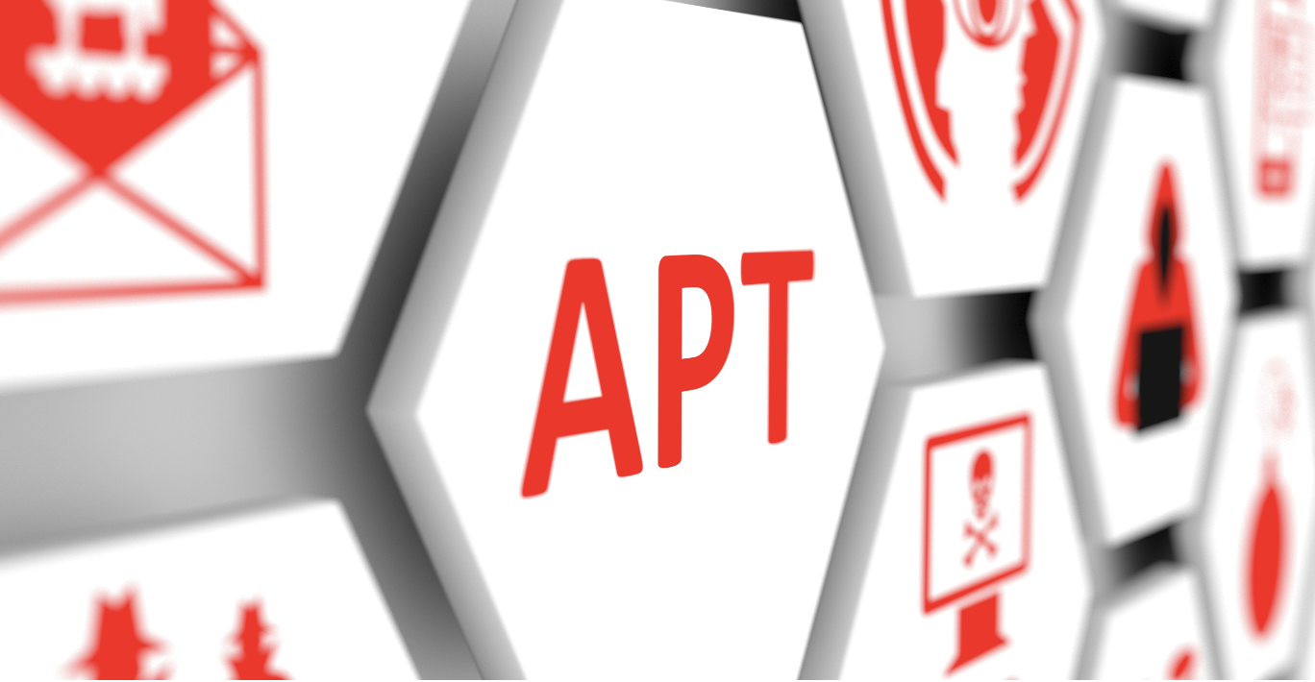
Top Cloud Security Threats
Advanced Persistent Threats
https://www.netsecurity.com/what-is-an-advanced-persistent-threat-apt/

Slide 54
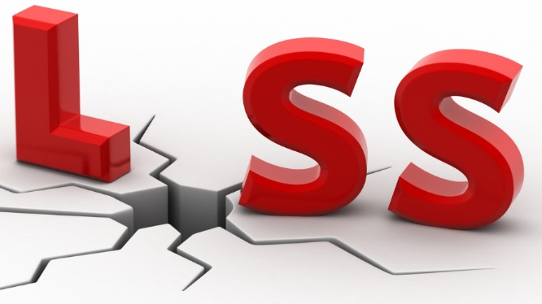
Top Cloud Security Threats
Data Loss

Slide 55
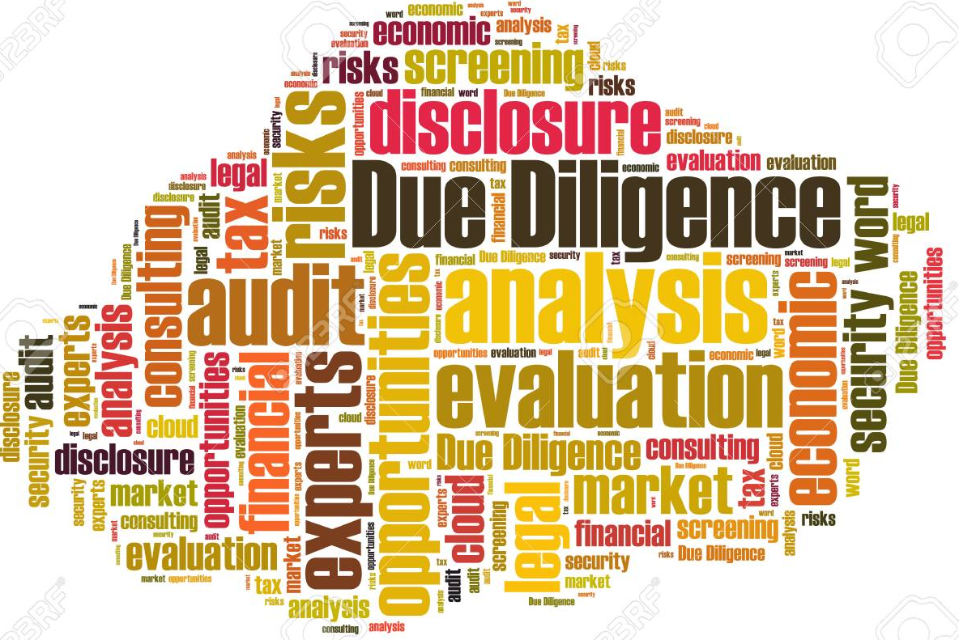
Top Cloud Security Threats
Insufficient Due Diligence
https://www.123rf.com/photo_38205813_due-diligence-word-cloud.html

Slide 56
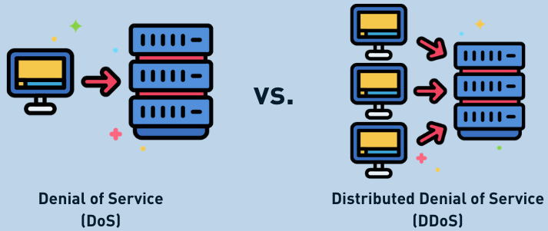
Top Cloud Security Threats
Denial of Service
https://x.com/InnotecSecurity/status/1359798980939558912

Slide 57
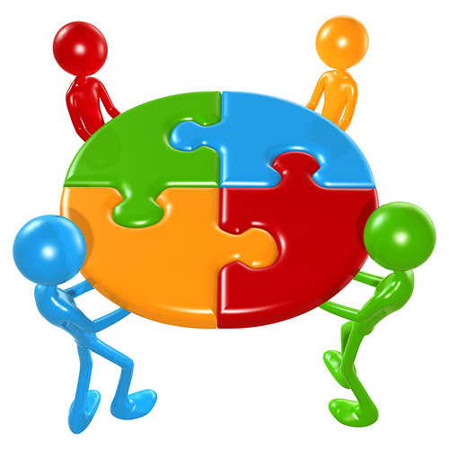

Top Cloud Security Threats
Shared Technology Vulnerabilities
Log4j affected companies…
  Amazon Web Services…
  Broadcom...
  Cisco...
  ConnectWise...
  Fortinet...
  HCL...
  IBM...
  ….

Slide 58
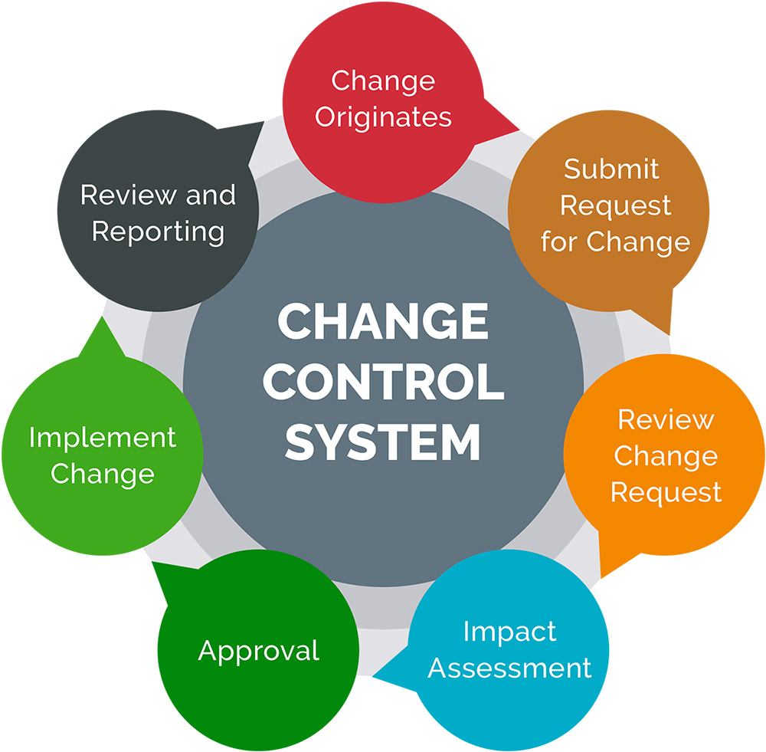
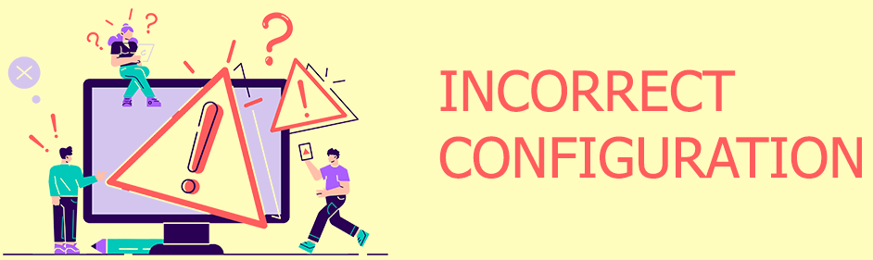
Top Cloud Security Threats
Misconfiguration and Inadequate Change Control

Slide 59
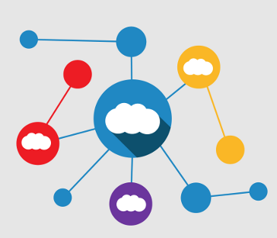
Top Cloud Security Threats
Lack of Cloud Security Architecture and Strategy

Slide 60
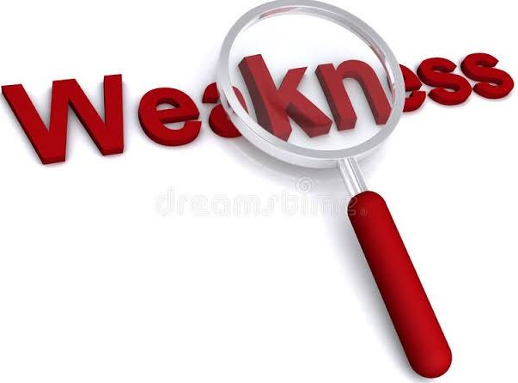
Top Cloud Security Threats
Weak Control Plane

Slide 61
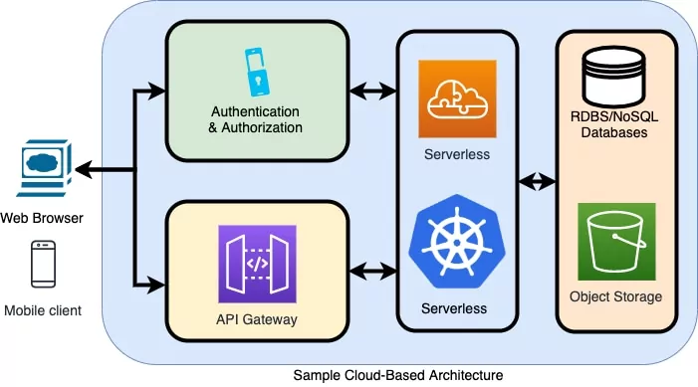
Top Cloud Security Threats
Metastructure and Applistructure Failures

Slide 62
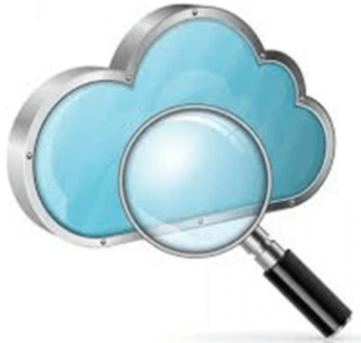

Top Cloud Security Threats
Limited Cloud Usage Visibility
x

Slide 63
AGENDA
6G and the CLOUD
CLOUD CYBERSECURITY
CLOUD DATA SECURITY

Slide 64
Concepts and fundamentals
Basically data must be secured from threats.
Fundamentally data (bits and bytes) has 3 states:
    In use;
    Storaged;
    In transit;
Data has to be processed to be availible to users;

Slide 65
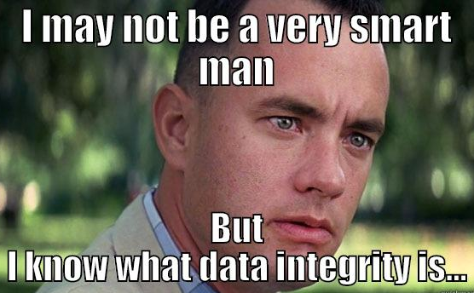
Concepts and fundamentals
    Security services:
    Authentication;
    Authorization;
    Access control;
    Data integrity;
    Confidentiality of data;
    Audit / logging;
    Attack mitigation;

Slide 66
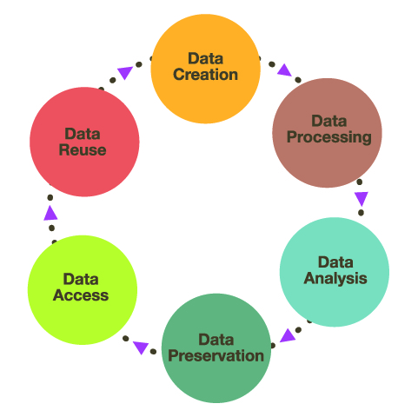
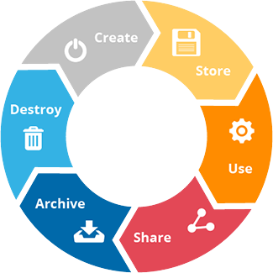
Life Cycle of Data in Cloud
    Data cycle in general:

Slide 67
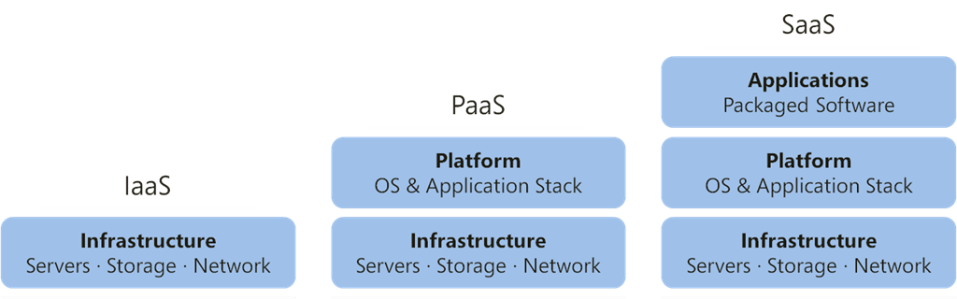
Life Cycle of Data in Cloud
    Data cycle in general:
Apply data management and security controls
PUBLIC
PRIVATE
HYBRID
COMMUNITY

Slide 68
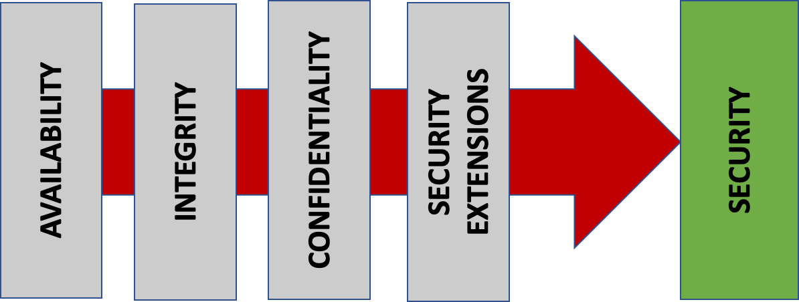
Data Protection Techniques
    Objectives:
      Guarantee confidentiality;
      Assure integrity;
      Provide avaiability;

Slide 69
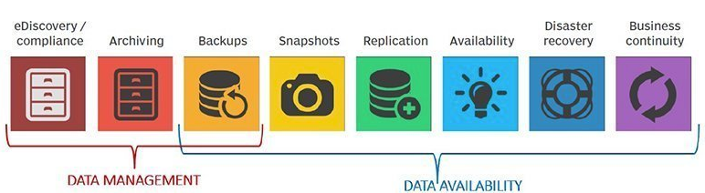
Data Protection Techniques
High level view:

Slide 70
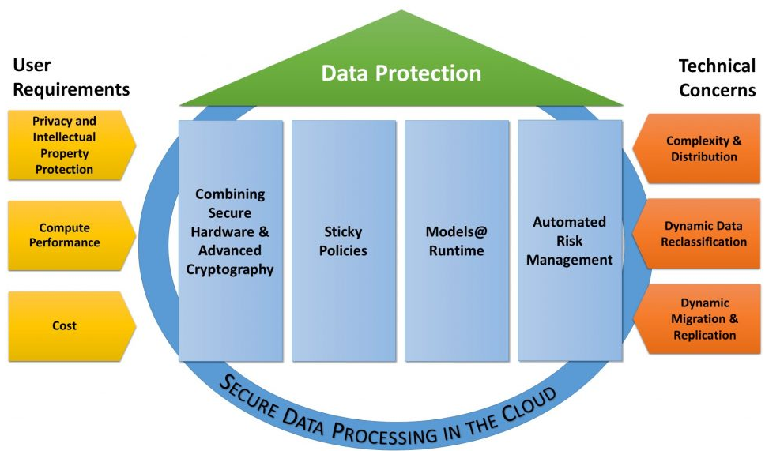
Data Protection Techniques
High level view:

Slide 71
Data Protection Techniques
Considering data states:
DATA AT REST PROTECTION
DATA IN USE PROTECTION
DATA IN TRANSIT PROTECTION
DATA LEAVING THE SECURITY PERIMETER PROTECTION

Slide 72
Data Protection Techniques
Considering data states:
Includes many different policies:
    Backup (test it for recovery);
    Encryption;
    Access control;
    Authentication and authorization;
    Replication;
    Deduplication (erase duplicated data);
    Business continuity;
    Disaster recovery;

Slide 73
Data Protection Techniques
Considering data states:
Define security controls:
    Network perimeters;
    Systems and application monitoring;
    Incident response;
    Vulnerabilities management;
    Security tests;
    Physical access;
    Threat intelligence;
    Share security information;

Slide 74
Data Protection Techniques
Considering data states:
Define security controls:
    Vendors validation;
    Supply chain validation and controls;
    Implement error detection procedures;
    Train users;

Slide 75
Data Privacy
Deals with:
    relationship that exists between the collection and dissemination of data;
    personal identification information or other confidential information that is collected, stored, used and eventually destroyed or deleted, either digitally or otherwise;
    An inadequate or nonexistent control of its disclosure is usually the main cause of privacy problems.

Slide 76
Data Privacy
Problems to protect (sources):
    Health records.
    Investigations and criminal justice procedures.
    Institutions and financial transactions.
    Biological traits, such as genetic material.
    Residence and geographical records.
    Services based on location and geolocation.
    Web browsing behavior or user preferences using persistent cookies.
    Academic research.

Slide 77
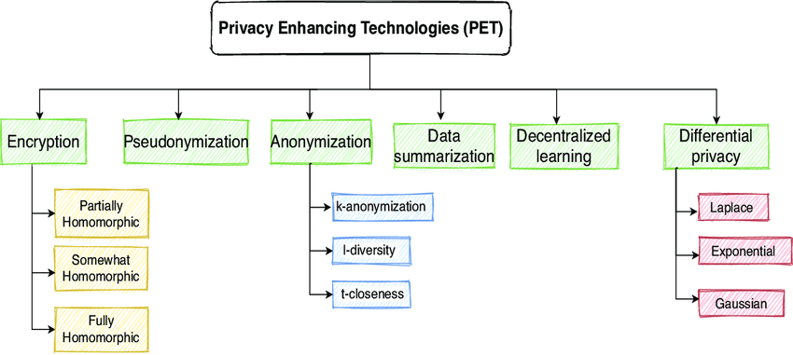

Data Privacy
DOI: 10.1109/ACCESS.2021.3064896

Slide 78
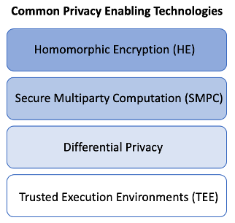
Data Privacy
ALSO THERE IS SEARCHABLE ENCRIPTION
The TEE typically consists of a hardware isolation mechanism plus a secure operating system running on top of that isolation mechanism

Slide 79
Data Privacy
Big challenge in Cloud:
To use data while protecting an individual's privacy preferences and their personally identifiable information.

Slide 80
Data Integrity
Data is expected to be:
  Attributable:
    Data should clearly demonstrate who observed and recorded it, when it was observed and recorded, and who it is about.
  Legible:
    Data should be easy to understand, recorded permanently and original entries should be preserved.

Slide 81
Data Integrity
Data is expected to be:
  Contemporaneous:
    Data should be recorded as it was observed, and at the time it was executed.
  Original:
    Source data should be accessible and preserved in its original form.
Accurate:
    Data should be free from errors, and conform with the protocol.

Slide 82
Data Integrity
Refers to:
Any unintended changes to data as the result of a storage, retrieval or processing operation, including malicious intent, unexpected hardware failure, and human error, is
failure of data integrity -> undermine information assurance;

Slide 83
Data Integrity
Roughly divided into two overlapping categories:
    Physical integrity:
      deals with challenges associated with correctly storing and fetching the data itself.
    Logical integrity:
      concerned with the correctness or rationality of a piece of data, given a particular context

Slide 84
Encryption/Decryption Considerations in Cloud
Basically:
    It provides confidentiality and, depending on the encription model, integrity;
    if data is encrypted before being uploaded to a cloud storage provider and that data is then needed on a mobile or remote device that does not already have the decryption key, the resulting download will be useless, encrypted data;

Slide 85
Encryption/Decryption Considerations in Cloud
Complex problem:
    Key rotation and destruction also becomes more complex:
      manage keys for what can entail millions of files;
      A third-party proxy provider can add a layer of protection by keeping the keys separate from the encrypted data at a cloud provider, but this also adds another layer of complexity -> higher cost

Slide 86
Encryption/Decryption Considerations in Cloud
Complex problem:
    Index encrypted data?
    Find information in encripted data?
    TLS implementation?
        What about legacy systems?
    Trust cloud provider to protect your data or
    protect it yourself?

Slide 87
Encryption/Decryption Considerations in Cloud
Requirements:
  Encrypted for data privacy with approved algorithms and long, random keys;
  Encrypted before it passes from the enterprise to the cloud provider;
  Should remain encrypted in transit, at rest, and in use;
  The cloud provider and its staff should never have access to decryption keys;

Slide 88
Cloud Storage Component Security
The main components are:
    Server-side;
    Client-side;
    Mobile device;
    Channel protection;

Slide 89
Cloud Storage Component Security
Server-side:
  to provide the eficient and reliable data storing;
  data syncing;
  responsible for data in transit protection in the communication with the client;

Slide 90
Cloud Storage Component Security
Server-side:
The main features are:
  Strong encryption method for data at rest (no resource limitation)
  Implementation of all key generation and distribution procedures
  Constant enhanced IT monitoring

Slide 91
Cloud Storage Component Security
Server-side:

Slide 92
Cloud Storage Component Security
Client-side:
    One has to consider IaaS, PaaS, or SaaS;
    responsibility for the protection is not the same for the three models;
    depending on the service model, the cloud provider has more responsibility in relation to the security issue.

Slide 93
Cloud Storage Component Security
Client-side:
    The cloud provider has a given responsibility for IaaS provision;
    is augmented for the PaaS model;
    achieves its highest level in the SaaS model.

Slide 94
Cloud Storage Component Security
Client-side:
    User access data through the network or the internet;
    this concerns the data in transit and data in use;

Slide 95
Cloud Storage Component Security
Mobile device:
mobile device protection:
    can leave the physical limits of the company;
    concerns about data at rest, data in transit, and data in use;
    to take care about the data leaving the security perimeters;

Slide 96
Cloud Storage Component Security
Mobile device:
mobile device protection:
    security mechanisms have to be adapted to their environment and modes of operation;
      Online mode: connected to the cloud;
      Offline mode: not connected to the cloud;

Slide 97
Cloud Storage Component Security
Mobile device:

Slide 98
Cloud Storage Component Security
Channel protection:
  serve for syncing the server and client data;
  Users have limited modification capabilities so the traffic from the server to the client is more intense;
  data transfer channel protection in the distributed environment relies on cryptographic methods;
  channel security depends on the network security:
    VPNs;
    Firewalls;
    Security configurations;

Slide 99
FUTURE REMARKS
Provide cybersecurity in Cloud in the perspective of 6g will be a huge challenge;
if the stack is supposed to change in a lot of different ways to guarantee security, actual technology will be legacy…
many, many, many thoughts there…
a lot of research avenue there…

Slide 100
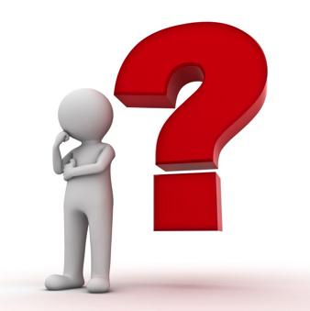
READY FOR…
Q&A

Slide 101
First Summer School on Security and Privacy in 6G Networks
  CLOUD AND DATA CYBERSECURITY ISSUES CONSIDERING 6G
Robson de Oliveira Albuquerque
University of Brasília
Faculty of Computer Science and Engineering, UCM
Madrid (Spain), June 24 - 28, 2024

